Slide 1

Epidemiology
Dewi Depositario-Cabacar, MD
Associate Professor, Neurology and Pediatrics
Children’s National Hospital Center
George Washington University School of Medicine and Health Sciences

Slide 2

DISCLOSURES
Disclosure of Financial Relationships
None
Off-Label Usage
  None
  ** Some of the tables/slides from Dr. Leeman-Markowski, MD previous lecture 2015.

Slide 3

Epidemiology - Outline
Incidence and prevalence
Natural history of epilepsy
- recurrence after a single seizure
- intractability
- remission
- relapse after medication
withdrawal
- mortality (SUDEP)

Slide 4
Statistics
Epilepsy is the 4th most common neurological condition
Approximately 2.2 million people in the US have epilepsy
Epilepsy affects more than 65 million people worldwide (0.5-1%)
These numbers are increasing (better diagnostic tools, aging), but may still be underestimates.
(IOM 2012)

Slide 5
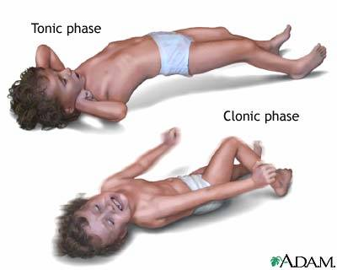
The first seizure
Acute symptomatic – 29-39/100,000 per year
Single unprovoked – 23-61/100,000 per year.
Lifetime risk of developing epilepsy by 80 years old = 1.4 - 3.3%.
Hauser WA. 2008 Epilepsia.

Slide 6

The first seizure
2 year recurrence risk – 25% to 66%
Risk of recurrence: increases
1. neurologic deficit
2. focal seizures +/- Todd palsy
3. abnormal EEG
4. status epilepticus
5. multiple seizures
6. prior acute symptomatic seizures
Shinnar S et al 1990 Pediatrics; Lindsten H et al 2001 Acta Neurol Scand

Slide 7
The first seizure
20 people per 100,000
25,000 – 40,000 children per year in US
(Camfield et al Epilepsia 1996; Hauser et al Epilepsia1993; Jallon et al Epilepsia 1997)
at 2 years, recurrence risk:
idiopathic first seizure: 32%
remote symptomatic: 57%

Slide 8
The first seizure
Prospective , population-based studies (Olafsson et al Neurol 2005; Loiseau P et al Epilepsia 2005)
33 - 42% remote symptomatic
21 – 53% cryptogenic**
14 – 37% idiopathic**
* Commission on Classification and Terminology of the ILAE (Berg 2010)

Slide 9
Does treatment with AED after a first seizure change the long term prognosis for seizure remission?
Class II (RCT, prospective, not placebo-controlled)
N=419, 114 (between 2-16 yold)
1 or 2 year seizure remission
Pts treated after 1st sz 68% , n= 215
Pts treated after 2nd sz 60%, n = 204 risk of recurrence [RR]=1.04, 95% CI=1.3-0.82
Musicco et al. Treatment of first tonic clonic does not improve the prognosis of epilepsy. Neurology 1997;49:991-998.

Slide 10
Prediction of Risk of Seizure Recurrence after a single and early epilepsy: Further results from the MESS Trial
Multicenter trial for Early Epilepsy and Single Seizures (MESS) Trial
n=722
Randomized to immediate and deferred tx
***Same conclusions obtained.
Kim LG et al Lancet Neurol 2006

Slide 11
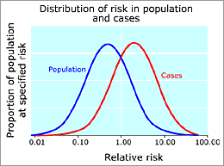
Frequency Measures of Incidence and Prevalence
Incidence – number of new cases occurring in a given time. e.g. no. of cases per 100,000 population/year.
Epilepsy – 50 / 100,000 per year
higher in infants and older person
About 40% develop epilepsy < 16 yold
20% epilepsy > 65 yold
* Higher in low and middle income countries
Hirtz et al 2007 Neurology 68:326-337
*

Slide 12
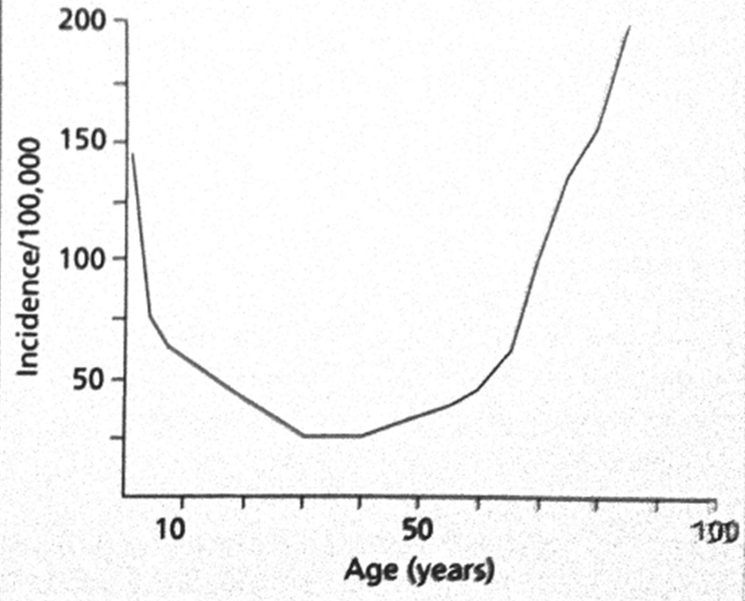
Age-specific incidence rate
Bimodal peaks in age-specific incidence (Forsgren 1996, Granieri 1983, Hauser 1996, Olafsson 2005, Sidenvall 1993)
High in the first year of life
Low throughout adult years
Incidence increases > 55 years
Over time, a trend for a decrease
in childhood epilepsy, but an
increase in older adults with
epilepsy in developed countries.
Age-specific incidence rates based on combined results from studies in the USA, Iceland, and Sweden.

Slide 13
Frequency Measures of Incidence and Prevalence
Prevalence – current number of active cases at a specific moment in time.
- no. of persons with epilepsy /1000 population.
- 4-10 cases /1000 population
* Higher in developing countries

Slide 14
Incidence and Cumulative Incidence of Epilepsy
Age-specific incidence rate, cumulative incidence rate and prevalence rate of epilepsy in Rochester, Minnesota (1983-1974)
150 -
-3.0
Prevalence / cumulative incidence (%)
incidence /100000
100 -
Incidence
-2.0
Cumulative
incidence
50 -
-1.0
Prevalence
25 -
-0.5
0 -
0 10 20 30 40 50 60 70 80
Age (yr)
Hauser et al, 1983

Slide 15
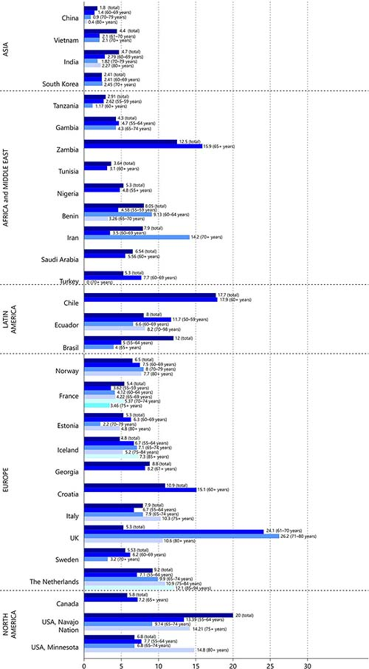
Incidence of Epilepsy
The incidence in
high-income countries ranges from 24 to 71.0 per 100,000
per year.
In low/middle-income countries, the incidence
is higher and can be up to 190 per 100,000
Beghi, E and Giussani, G . Neuroepidemiology 2018;51:216–223

Slide 16
Distribution by Seizure Type and epilepsy syndrome
Absence epilepsy
incidence: 0.7 -8/ 100,000
prevalence: 0.1 to 0.7/ 1000
Juvenile myoclonic epilepsy
incidence: 1 /100,000 persons
prevalence: 0.1 – 0.2 /1000 (Jallon and Latour, 2005)
Infantile spasms:
incidence: 2-4.5/ 100,000 per year (Trevathan 1999)
Lennox Gastaut :
incidence: 1-2 / 100,000
prevalence: 1.3 – 2.6 / 1000
(Cowan, 2002)

Slide 17
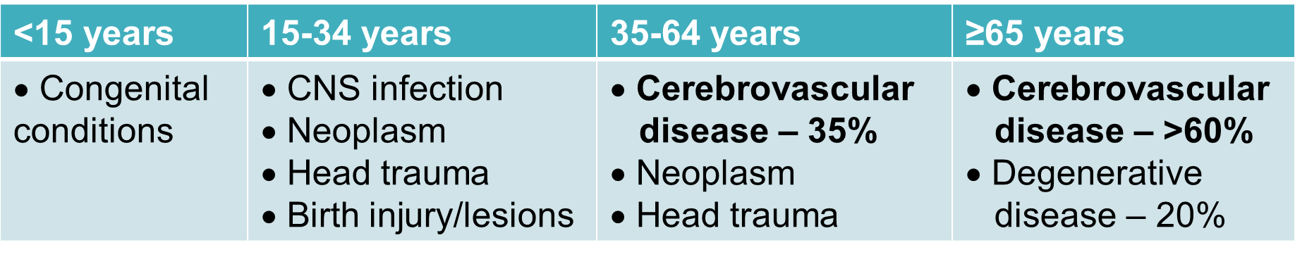
Etiology by age
Hauser 1996

Slide 18
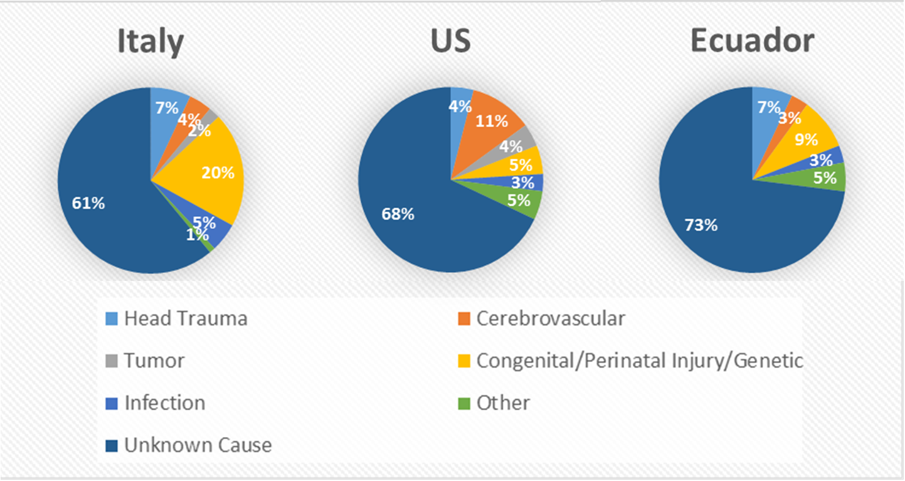
Etiology
Hauser 1975, Placencia 1992, Granieri 1983

Slide 19
Usual age of onset and common etiologies/pathologic substrates often encountered in children with Epilepsy
HIE, CNS infection, focal MCD, tumor, ischemic lesion
Hemispheric or diffuse MCD
Sturge-Weber syndrome
Genetic and metabolic disorders
Rasmussen encephalitis
0 2 4 6 8 10 12 14 16 18 20 age in years
Gupta A, Wylie E. Presurgical assessment of the Epilepsies with Clinical Neurophysiology and Functional Imaging. 2004

Slide 20
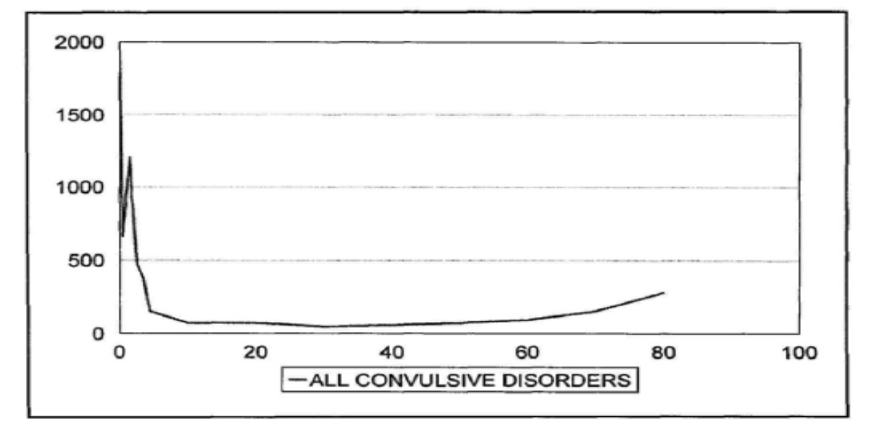


Common seizure type varies by age
Partial-onset
At least 2-fold increase > 24 years
5-fold increase ≥ 75 years
Symptomatic
Generalized-onset
Greatest in first year
Most common ages 0-5 years
Focal/Partial-onset
At least 2-fold increase > 24 years
5-fold increase ≥ 75 years
Symptomatic

Slide 21
Epilepsy risk in special populations
25.8% with mental retardation (MR)
13% with cerebral palsy (CP)
50% with both CP and MR
10% with Alzheimer
22% with stroke
33% with single unprovoked seizure

Slide 22
Definitions
Active epilepsy – 1 seizure has occurred in the preceding period (2-5 years).
Remission - no seizure has occurred in the preceding period (2-5 years).

Slide 23
Remission of Treated Epilepsy
Community-based study Rochester, MN
- 75% had 5 year remission
The National General Practice Study of Epilepsy in United Kingdom (prospective study)
- 60% had 5 year remission (9 years follow up)
**** Nearly 70% expected to enter remission.
Shafer SQ et al Epilepsia 1988; Cockerell OC et al Epilepsia 1997

Slide 24
Remission of Treated Epilepsy
Terminal remission data from selected studies
Reference | Study setting | Special study features | No. of patients | Median follow-up (years) | Years in remission | % in remission at median follow-up
Elwes et a. (32) | Hospital |  | 106 | 5.5 | 2 | 79
Shafer et al. (29) | Community |  | 432 | 17 | 5 | 66
Collaborative Group (33) | Hospital |  | 280 | 4 | 1 | 70
Cockerell et al. (14) | Community | Definite epilepsy | 564 | 7 | 5 | 68
Sillanpaa et al. (34) | Hospital | Children only | 176 | 40 | 1 | 93
Lindsten et al. (35) | Community | ≥1 baseline seizure ≥2 baseline seizures | 107 89 | 9 9 | 5 5 | 64 58
From Kwan P, Sander JW. The natural history of epilepsy: an epidemiological view. J Neurol Neurosurg Psychiatry. 2004; 75: 1376-1381.

Slide 25
Relapse
High risk of relapse:
unrecognized minor seizure
long history of seizure before remission
structural brain lesion
abnormal neurologic signs
Learning disability
past history of relapse
more than one seizure type
MRC Antiepileptic drug withdrawal group. Randomised study of antiepileptic drug withdrawal in patients in remission. Lancet 1991

Slide 26
Intractable Epilepsy
5-10% of epilepsy cases become refractory.
60% with focal seizures.
- etiology
- younger age at onset (<1 year old)
- high initial seizure frequency
- mental retardation

Slide 27
Intractable Epilepsy
Prospective study: 613 children with newly diagnosed epilepsy
10% met criteria for intractable epilepsy
( failure of > 2 seizure meds, >1 seizure /month,
over 18 month period)
Increased risk of developing intractable epilepsy
cryptogenic/symptomatic generalized syndromes
high initial seizure frequency
focal slowing on EEG
Berg, AT et al. Early development of intractable epilepsy in children: a prospective study. Neurology 2001.

Slide 28

63% become seizure-free
More likely if idiopathic and ≤ 20 seizures prior to treatment
AED #1: 47% seizure-free
AED #2: 13% seizure-free
AED #3: 1% seizure-free
3% seizure-free with two AEDs in combination
Reason for failure is important predictor

Slide 29
Mortality
Standardized mortality rate (SMR)
observed no. of deaths in an epilepsy
population to that expected based on the
age and sex – specific mortality in a
population
SMR - 2-3 x higher in patients with epilepsy.
Highest in children and >75 years old.
Increased in remote symptomatic cases
Lhatoo et al Mortality in epilepsy Ann Neurol 2001

Slide 30
Mortality
Major causes:
a. Epilepsy- related deaths
SUDEP, Status epilepticus, accidents and suicide
b. Deaths related to the underlying cause
c. Deaths unrelated to the underlying cause

Slide 31
Causes of Death in Epilepsy
Unrelated deaths
Related to underlying disease
Neoplasms outside the central nervous system
Ischemic heart disease
Pneumonia
Others
Brain tumors
Cerebrovascular disease
Cerebral infection-abscesses and encephalitis
Inherited disorders, e.g., Batten’s disease
Nashef L, Shorvon SD. Mortality in epilepsy. Epilepsia. 1997; 38: 1059-1061.

Slide 32
Causes of Death in Epilepsy
Epilepsy-related deaths
Suicide
Treatment-related deaths
Idiosyncratic drug reactions
Medication adverse effects
Seizure-related deaths
Status epilepticus
Trauma, burns, drowning
Asphyxiation, aspiration
Aspiration pneumonia after a seizure
Sudden unexpected death in epilepsy (SUDEP)
Nashef L, Shorvon SD. Mortality in epilepsy. Epilepsia. 1997; 38: 1059-1061.

Slide 33
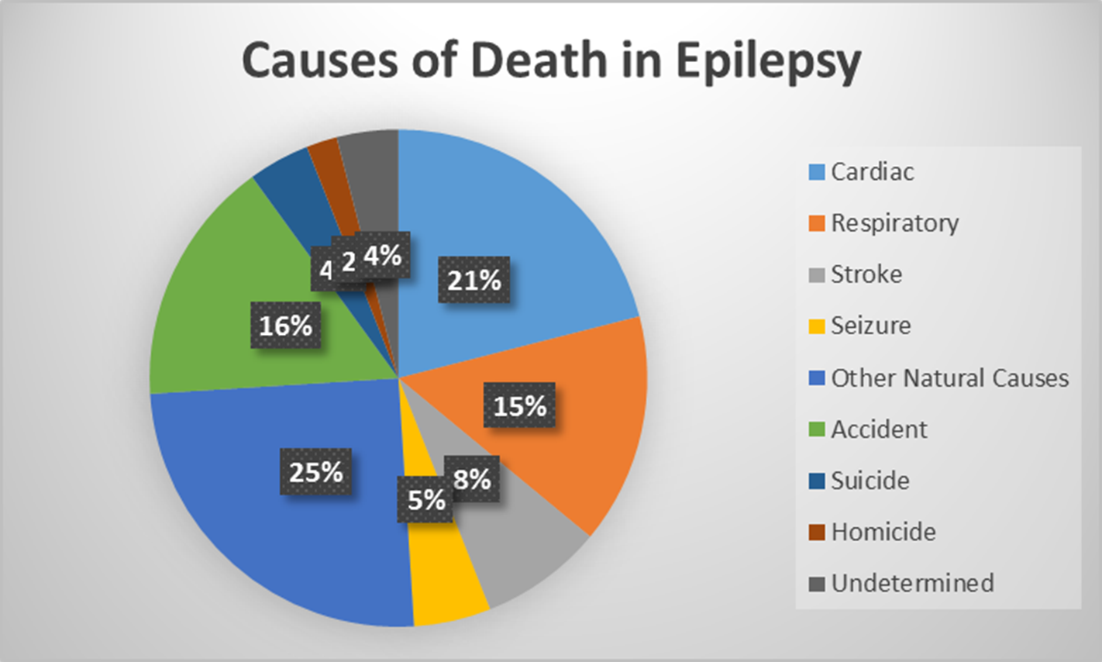
Mortality
Barooni 2007
SUDEP is the cause of death in 4-17% of unselected cases, 50% of refractory epilepsy
SUDEP most common with recurrent generalized seizures, polypharmacy, coexisting
neurologic disease

Slide 34
Mortality
The true incidence of epilepsy- related deaths is unknown
- U.S. national mortality records provide grossly incomplete data on epilepsy.

Slide 35
Mortality
Sudden unexpected death in epilepsy (SUDEP)
occurs from a nontraumatic death with no obvious cause of death by postmortem examination.
Mechanism not fully understood.
(proposed: cardiac arrhythmia, respiratory depression, cerebral autonomic dysfunction)

Slide 36
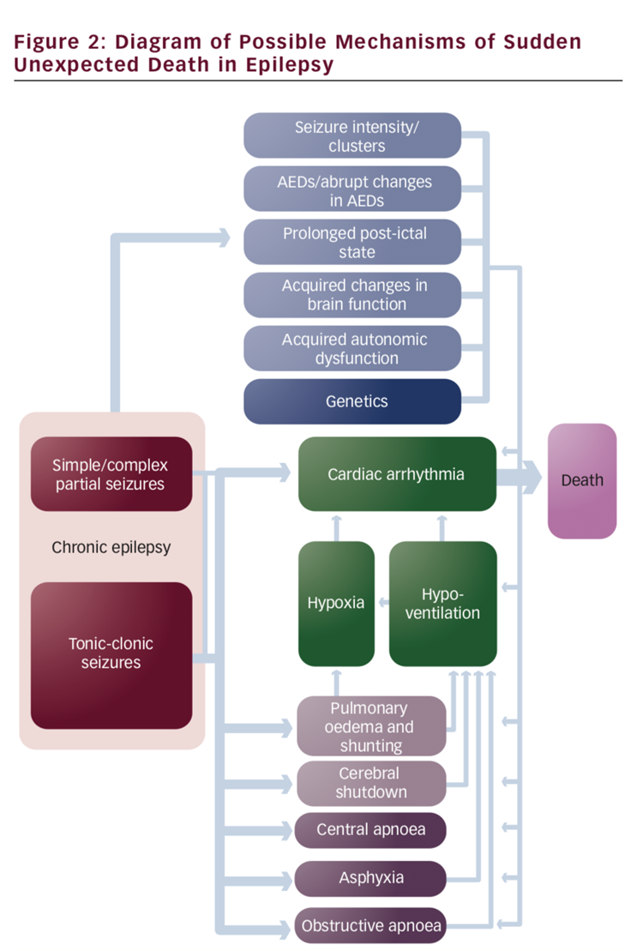
SUDEP - Mechanism
Mechanism not fully understood
Possibly multifactorial
proposed:
- cardiac arrhythmia,
- respiratory depression
- cerebral autonomic dysfunction (dysregulation of systemic or
cerebral circulation)
- seizure-induced hormonal and metabolic changes
(during and after seizures)

Slide 37
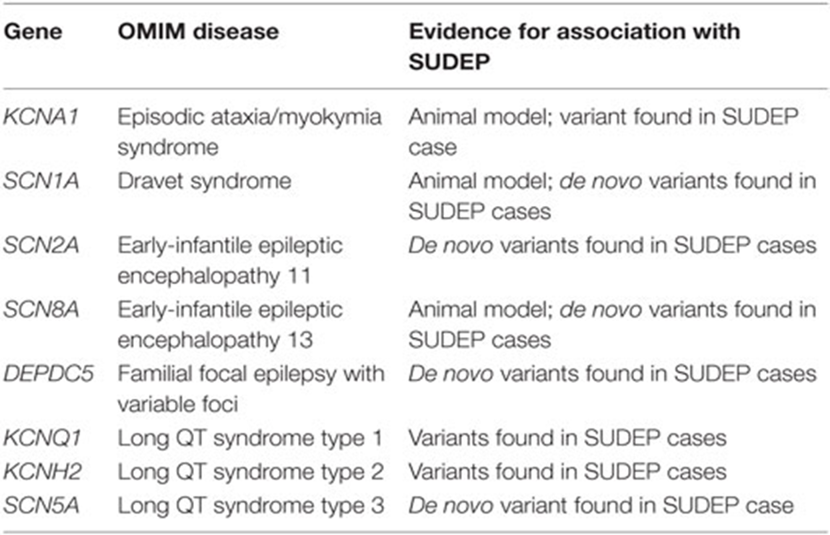
Genes associated with sudden unexpected death in epilepsy (SUDEP).
Bagnall et al. Genetics Basis of Sudden Unexpected Death in Epilepsy. Neurology 2017

Slide 38
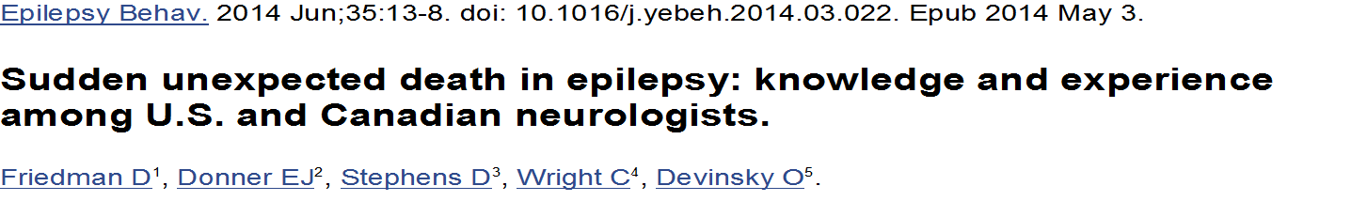
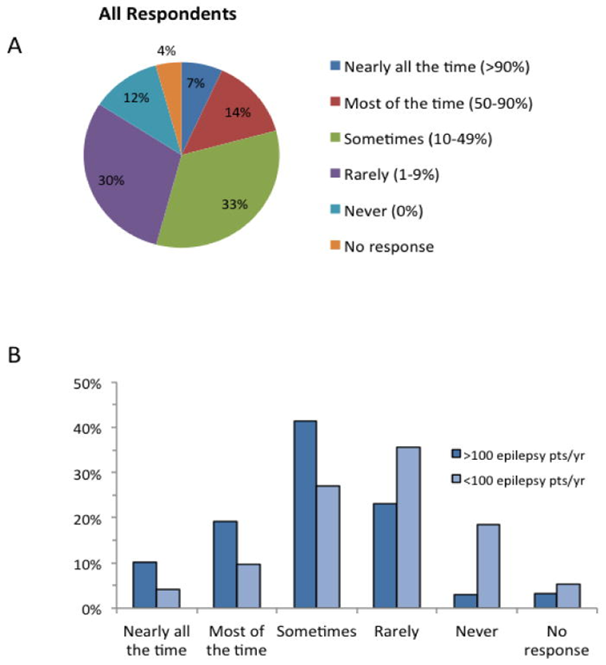

n= 1200 respondents
U.S. and Canadian neurologists rarely discuss SUDEP with all patients with epilepsy/caregivers.
Only 6.8 % discussed SUDEP nearly all the time.
Nearly 60% of the respondents stated that rxn was negative.
assessment of SUDEP risk factors revealed that most neurologists (82.8%) have limited knowledge about this subject.
Surveys of physicians in the UK and Italy: most physicians do not discuss SUDEP

Slide 39

Practice guideline summary: Sudden expected death in epilepsy incidence rates and risk factors
Harden C et al. Neurology April 2017

Slide 40
SUDEP -incidence
SUDEP risk in children with epilepsy:
0.22/1,000 patient-years
(95% Cl 0.16-0.31)
SUDEP risk in adults with epilepsy:
1.2/1,000 patient-years
(95% Cl 0.64-2.32)
Harden C et al. Neurology April 2017

Slide 41
SUDEP Incidence
(Based on twelve Class 1 studies)
Population | SUDEP/1,000 patient-years (confidence interval) | Confidence
Overall | 0.58 (0.31-1.08) | Low
Childhood | 0.22 (0.16-0.31) | Moderate
Adulthood | 1.2 (0.64-2.32) | Low
Harden C et al. Neurology April 2017

Slide 42
Incidence recommendation 1:
SUDEP incidence in children
Level B
There is a rare risk of SUDEP.
In 1 year, SUDEP typically affects 1 in 4,500 children with epilepsy; in other words, annually, 4,499 of 4,500 children will not be affected by SUDEP.
Harden C et al. Neurology April 2017

Slide 43

Incidence recommendation 2: SUDEP incidence in adults
Level B
There is a small risk of SUDEP.
In 1 year, SUDEP typically affects 1 in 1,000 adults with epilepsy; in other words, annually, 999 of 1,000 adults will not be affected by SUDEP.

Slide 44

SUDEP Risk factors (Based on 6 Class I and 16 Class II articles
Factor | Odds Ratio (Cl) | Confidence level
Presence of GTCs vs lack of GTCS | 10 (17-14) | Moderate
Frequency of GTCS | OR 5.07 (2.94-8.76) for 1-2 GTCS per year and OR 15.46 (9.92-24.10) for >3 GTCS per year | High
Not being seizure-free for 1-5 y | 4.7 (1.4-16) | Moderate
Not adding an AED when patients are medically refractory | 6 (2-20) | Moderate
Nocturnal supervision (risk reduction) | 0.4 (0.2-0.8) | Moderate
Use of nocturnal listening device (risk reduction) | 0.1 (0.0.3) | Moderate

Slide 45
SUDEP Risk factors (Based on 6 Class I and 16 Class II articles)
Major risk factor:
Presence and frequency of GTCS.
- if with >3 GTCS per year, with 15-fold
increased risk of SUDEP.
- moderate confidence in the evidence
from 2 Class II studies.

Slide 46
AAN/AES: Practice Guideline: SUDEP Incidence Rates and Risk factors
The evidence is low that the following factors are associated with altering SUDEP risk:
Nocturnal seizures (associated with increased risk)
Any specific AED (none associated specifically with increased risk)
LTG use in women (associated with increased risk)
Never having been treated with an AED (associated with increased risk)
Number of AEDs used overall (associated with increased risk)
Heart rate variability (not associated with increased risk)
Extratemporal epilepsy (associated with increased risk)
Intellectual disability (associated with increased risk)
Male gender (associated with increased risk)
Anxiolytic drug use (associated with increased risk)

Slide 47
AAN/AES: Practice Guideline: SUDEP Incidence Rates and Risk factors
The evidence is very low that the following factors are associated with altering SUDEP risk:
Overall seizure frequency when evaluated by using all seizure types
Medically refractory epilepsy vs not having well-controlled seizures defined as no seizures for the past year
Monotherapy vs polytherapy
CBZ, PHT, or VPA levels that are above, below, or within the reference range
Psychotropic drug use
Mental health disorders, lung disorders, or alcohol use

Slide 48
AAN/AES: Practice Guideline: SUDEP Incidence Rates and Risk factors
The evidence is very low or conflicting that the following factors are associated with altering SUDEP risk:
LTG use in people with highly refractory epilepsy
Frequent changes in AEDs
Therapeutic drug monitoring
Undergoing a resective epilepsy surgical procedure**
Engel outcome of epilepsy surgery**
VNS use for more than 2 years**
**Although current research does not rule out the possibility of a beneficial effect or, further, the potential effect of epilepsy surgery on reducing GTCS frequency and epilepsy severity on reducing SUDEP risk.

Slide 49
AAN/AES: Practice Guideline: SUDEP Incidence Rates and Risk factors
The evidence is very low or conflicting that the following factors are associated with altering SUDEP risk:
Epilepsy etiology - idiopathic or localization related
Structural lesion on MRI
Duration of epilepsy
Age at epilepsy onset
Postictal EEG suppression

Slide 50
SUDEP – Practice Guidelines Recommendations (AAN, AES)
Level B: Epilepsy with GTCS – physicians should actively manage epilepsy therapies to reduce seizures.
Level C: with frequent GTCS and nocturnal seizures, physicians should advise (if permitted) to use nocturnal supervision or nocturnal precautions.
Level B: Clinicians should tell patients that seizure freedom particularly from GTCS, strongly associated with decreased risk of SUDEP.

Slide 51
Mortality
Status Epilepticus fatalities
estimates vary widely
median estimate: 0.94/100,000 annually
(Rosenow F et al, Epilepsia 2007)
Accidental deaths
drowning, traffic accidents, trauma, falls,
burns, aspiration
1.2% - 6.5 % in community based studies.

Slide 52
Mortality
Suicides
Suicides per 100,000 population in US is 12.4*
Suicide increased risk with:
1. mental illness
2. drug addiction
3. Temporal lobe epilepsy
4. personality disorder
5. early onset epilepsy (adolescence)
* Calculated from data from U.S. Centers for Disease Control and Prevention.

Slide 53
Conclusion: Epidemiology
Incidence and prevalence
Natural history of epilepsy
- recurrence after a single seizure
- intractability
- remission
- relapse after medication
withdrawal
- mortality

Slide 54
Board Questions

Slide 55
Question 1
The incidence of epilepsy is the number of new cases occurring in a given time. What is the incidence of epilepsy?
a. 4-10 cases/1000 population
b. 50 cases/100,000 per year
c. 250 cases/100,000 per year
d. 200,000 cases

Slide 56
Question 2
Which one of the following is not an epilepsy related death:
a. Cerebrovascular accident
b. Sudden unexpected death in epilepsy
c. Suicides
d. Drowning
e. Adverse drug effects

Slide 57
Question 3
The risk for SUDEP is higher in which of the following patient with epilepsy?
A 24 year old female with history of GTCs on 3 seizure medications with no seizures for a year.
A 17 year old male with depression with 4-6 focal seizures per month.
A 6 year old girl with once a month GTCs on Valproic acid.
A 10 year old boy with a right frontal focal cortical dysplasia on Lamotrigine, Oxcarbazepine with 2 focal seizures per month being worked up for epilepsy surgery.

Slide 58
Question 4
Risk of suicide is highest in association with the following except:
a. Substance abuse
b. Temporal lobe epilepsy
c. Frontal lobe epilepsy
d. Mental illness
e. Adolescence

Slide 59
Question 5
5. Which of the following statement is correct:
a. In 1 year, SUDEP typically affects 1 in 4,500 children with epilepsy.
b. In the practice guidelines for SUDEP, clinicians should tell patients that seizure freedom particularly from focal seizures are strongly associated with decreased risk of SUDEP.
c. The number of AEDs used overall is a major risk factor for SUDEP.
d. The age of epilepsy onset is a major risk factor for SUDEP.

