Slide 1

NONEPILEPTIC PAROXYSMAL
DISORDERS IN ADULTS
Amar B. Bhatt, MD, FAES
Assistant Professor of Neurology, Epilepsy Section
Rush University Medical Center

Slide 2
DISCLOSURES
Disclosure of Financial Relationships
None
Off-Label Usage
  None

Slide 3
Overview
Differential Diagnosis of Seizures
Non-epileptic events (physiologic)
Non-epileptic events (psychogenic)
Frontal Lobe Seizures and Focal Aware Seizures

Slide 4
Differential Diagnosis of Seizures
Detailed history is crucial (in lay person terms)
Cell phone home videos are extremely helpful
Non-epileptic ≠ Psychogenic

Slide 5
Non-epileptic Events
Physiologic
  Cerebrovascular
  Sleep disorders
  Cardiac/Syncope
  Movement disorders
  Migraine
  Behavioral
Psychogenic
  Conversion disorder / PTSD
  Panic attacks / Anxiety
  Factitious disorder and malingering

Slide 6
Cerebrovascular
TIA and stroke → negative symptoms
Epileptic seizures → positive symptoms
Both may be stereotyped
Both may be new onset in elderly
Both may present with limb shaking (esp. in setting of critical carotid stenosis)

Slide 7

Notes:
Consent on file for video; Hypnic jerk (benign myoclonus of sleep)

Slide 8
Sleep Disorders
Hypnic Jerks (Benign Myoclonus of Sleep)
Narcolepsy
Parasomnias
Sleep paralysis
Obstructive sleep apnea
Hypersomnia

Slide 9
In the differential diagnosis of nocturnal events, which of the following parasomnias are more likely to occur much later during a night of sleep?
Somnambulism
Confusional Arousals
Nightmares
Night Terrors
Sleep Related Eating Disorder
Notes:
The correct answer is C. Nightmares and REM behavior disorder occur during REM. Somnambulism, confusional arousals, night terrors, and sleep related eating disorder occur during NREM sleep, typically N3. Sleep cycles progress more often to deep sleep (N3) earlier in the night, and the later cycles progress more often to REM. Therefore, parasomnias occurring during REM tend to occur later at night.

Slide 10
Parasomnias
Early in the night (NREM)
  Sleepwalking
  Sleep Related Eating Disorder
  Confusional Arousals
  Night terrors
Late in the night (REM sleep)
  REM Behavior Disorder
  Nightmares

Slide 11
Cardiac/Syncope
Arrhythmia
Valvular Disease
Vasovagal Syncope
Orthostasis

Slide 12
Syncope vs. Seizure
Convulsive Syncope | Bilateral Tonic Clonic Seizure
“Aura” of lightheadedness, palpitations, tunnel vision, tunnel hearing | Aura with typical epileptic semiology (or no aura, if primarily generalized)
Brief duration (<1 min) | Longer duration (2-3 min)
May respond to sitting / lying down (orthostasis) | Usually not positional
Possibly decreased tone | Increased tone
Generalized or multifocal myoclonus | Synchronous clonic activity
No post-event confusion* | Post-event confusion
*post-event (situationally appropriate) disorientation is common in any LOC

Slide 13
Shaking in syncope is common!
56 healthy volunteers had syncope induced using hyperventilation, orthostasis and valsalva
90% had myoclonic activity
  Usually multifocal
  Less commonly was generalized
79% had other movements
Lempert et al, Ann Neurol, 1994

Slide 14
The EEG findings in syncope are best characterized by:
Burst suppression
Normal background with abnormal EKG
Generalized slow activity, then attenuation
Focal slow activity, then attenuation
Focal attenuation, then slow activity
Notes:
The correct answer is C. Syncope has very characteristic EEG changes, and thus the EEG should not be normal. Generalized slow activity (typically theta → delta → generalized attenuation → delta → theta → normal) is most typical, though the attenuation may or may not be seen. Burst suppression is usually seen with drug-induced coma or cardiac arrest. The EEG changes should not be focal, since global cerebral perfusion is diminished.

Slide 15
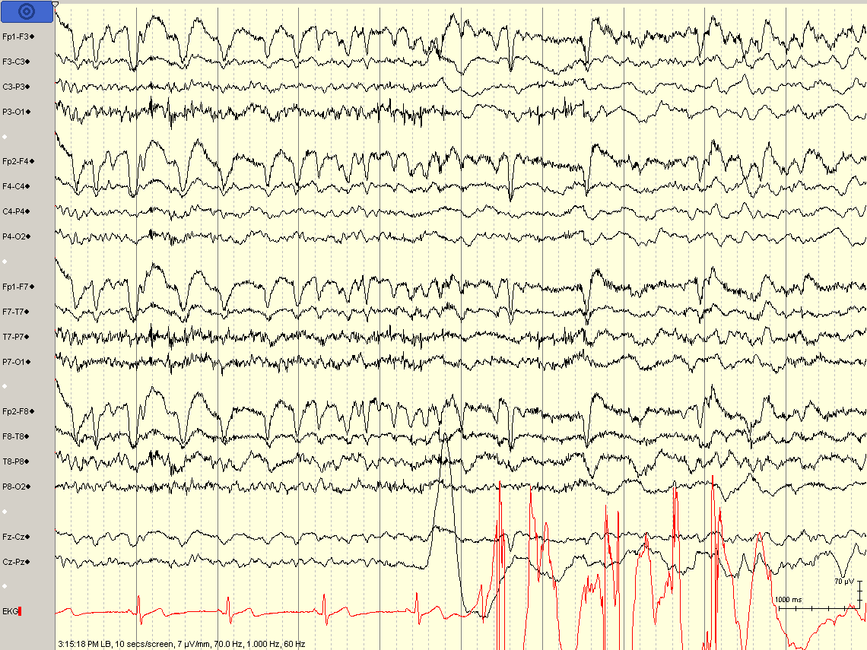

Slide 16
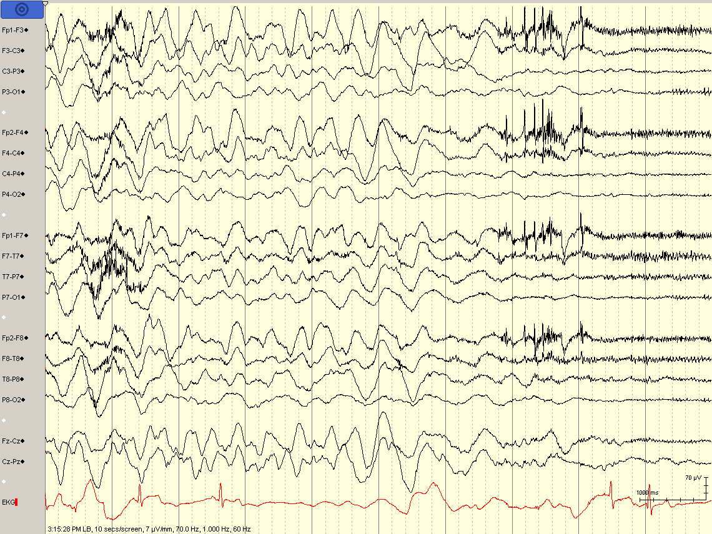
Notes:
EEG during tilt table test induced syncope

Slide 17
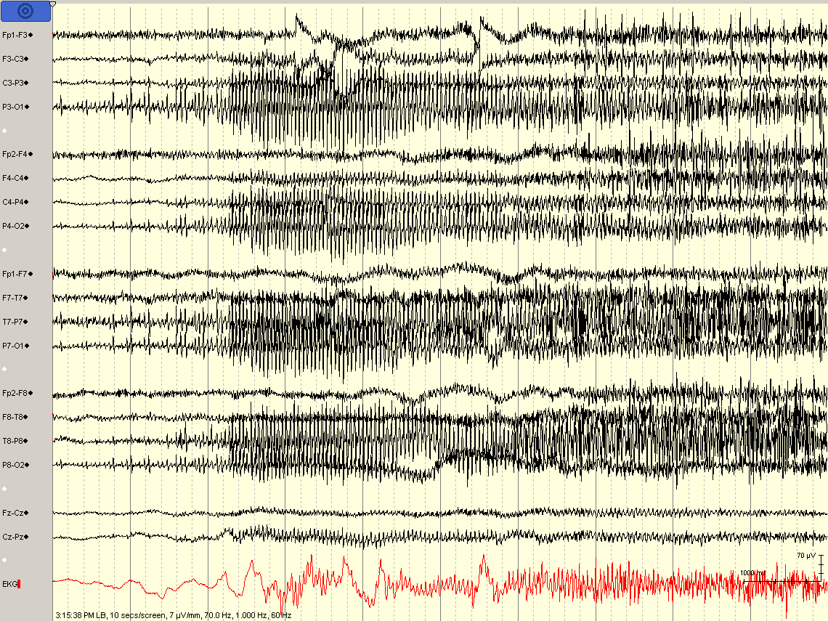

Slide 18
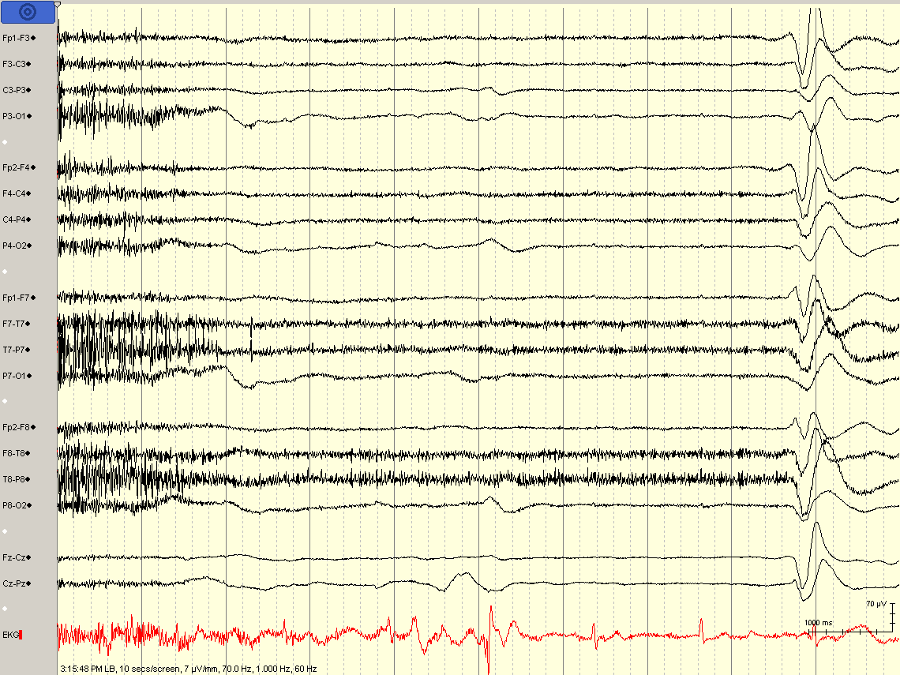

Slide 19
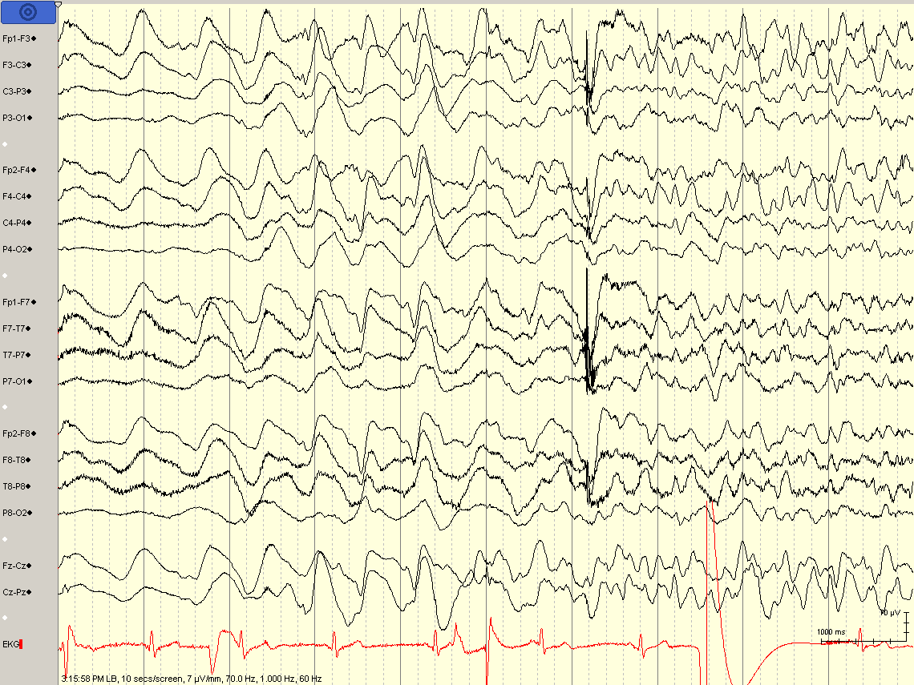

Slide 20
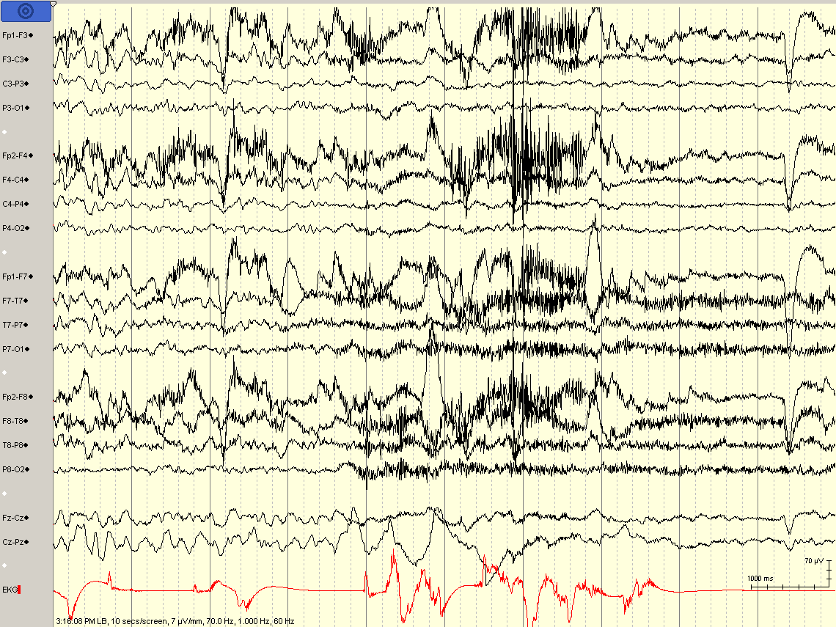

Slide 21
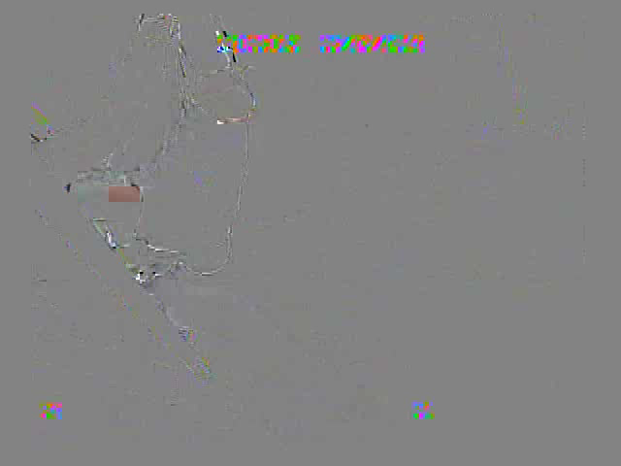
Notes:
Consent on file for video; confirmed pseudosyncope (no EEG or EKG changes)

Slide 22
Psychogenic pseudosyncope (PPS)
In “idiopathic syncope,” psychogenic causes are not necessarily investigated
Video-EEG (or TCDs) usually required; often performed with Tilt Table Testing
Eyes may be open during true syncope (and closed during PPS)
Patients typically have increase in HR and BP with PPS
Raj et al, Autonomic Neuroscience, 2014

Slide 23
Non-epileptic Events
Physiologic
  Cerebrovascular
  Sleep disorders
  Cardiac/Syncope
  Movement disorders
  Migraine
  Behavioral
Psychogenic
  Conversion disorder / PTSD
  Panic attacks / Anxiety
  Factitious disorder and malingering

Slide 24
Psychogenic non-epileptic events
Also called psychogenic non-epileptic seizures (PNES) or pseudoseizures
The words “pseudo” or “seizure” or “spell” have negative connotations and should be avoided
Includes “seizures” starting from “sleep” (i.e., pseudo-sleep)

Slide 25
Psychogenic non-epileptic events
Video is as important as EEG correlation
Detailed history and correlation with typical events is key
Pathology usually is PTSD / conversion disorder (NOT malingerers or factitious)*
*though secondary gain may perpetuate it

Slide 26
Etiology and Predisposing Factors
Trauma (Combat, Abuse)
Personality Disorders (esp. borderline)
Poor Coping Skills
Comorbidities (PTSD, Anxiety, Depression)
Illness Perception
  Alexithymia (inability to name/express emotions)
  External locus of control
Reuber, Epilepsy and Behavior, 2008

Slide 27
PNES: Patient education
Avoid “pseudo-seizure” or “seizure” (“non-epileptic” may be too technical)
Use easy-to-understand examples that patients may understand
  stress-induced migraines, ulcers, fainting
  PTSD in veteran and victims of abuse/violence
Validate the diagnosis
  Clearly state that the patient is not faking it and is not doing it on purpose
  Not saying this implies the opposite, in most cases
  Written brochure on PNES will help validate it as a “real” diagnosis (patients assume we give this diagnosis because “we can’t really figure it out”)
Do not abandon patient
  Establish clear follow up with neurology and psychiatry
  Assess patient’s understanding and insight at the follow-up visit
Notes:
1. Would you imply to a veteran who has flashbacks and dissociative episodes that he/she is crazy and it’s all in his/her head?
2. At follow up, usually I hear patient’s understanding to be “nothing” or “the EEG was normal” or “they couldn’t figure anything out,” even if they saw psychiatry

Slide 28
PNES: Provider education
Provide clear education and documentation to other providers
Many neurologists, psychiatrists, and PCPs still believe these patients are malingering / factitious (which is WRONG)
Psychiatrists will be hesitant to treat without clear statement of:
  confirmed diagnosis of PNES
  normal EEG without any evidence of seizures or epilepsy
  neurologist’s opinion that medications are not indicated
  neurologist managing meds (and tapering them off, if appropriate)
Lack of neurology follow up often results in “neurologist shopping” and inappropriate restarting of medication

Slide 29
Characteristic PNES Semiology
gradual onset or termination
occurrence during “pseudosleep”
discontinuous movements
asynchronous (out-of-phase) activity
side-to-side head movement
pelvic thrusting
opisthotonic posturing
stuttering
weeping
preserved awareness during bilateral motor activity
postictal whispering
eye closure of long duration
less severe physical injuries - controversial
Gedzelman and LaRoche, Neuropsychiatr Dis Treat, 2014

Slide 30
Which of the following symptoms are commonly seen in psychogenic non-epileptic events (but NOT typically seen in generalized / bilateral tonic clonic seizures)?
Synchronous limb jerking
Post event confusion
Tip of the tongue bite
Urinary incontinence
Bowel incontinence
Notes:
The correct answer is C. Generalized tonic clonic seizures typically have a posterior/lateral tongue bite. Psychogenic non-epileptic events may have asynchronous flapping or flailing of the limbs, and may lack post event confusion. Urinary incontinence is more common in generalized tonic clonic seizures, but can be seen with psychogenic nonepileptic events, so it is not necessarily a reliable differentiating feature. Bowel incontinence is not reliably reported in either.

Slide 31
PNES vs. Seizure
Convulsive PNES | Generalized / Bilateral Tonic Clonic Seizure
Variable or multiple symptom types | Stereotyped symptoms
Prolonged duration (>5 minutes) | Duration usually 2-3 minutes
Waxing and waning intensity | Tonic activity → Clonic activity that slows down and stops
May have explosive frequency (without apparent functional interference) | Usually infrequent
Asynchronous or variable shaking (flailing, flopping, or lateral movements) | Synchronous clonic activity
Post event confusion minimal in comparison to event | Post-event confusion
Keeping eyes closed (or resisting opening) | Eyes open
Rapid, shallow (or normal) breathing (during or after event) | Slow, deep stertorous respiration (post-ictal)
Medial/anterior/tip tongue bite | Lateral/posterior tongue bite

Slide 32
Predictive Value of PNES Semiology
Prospective study of eyewitness reports of 48 PNES and ES signs, compared to (EEG-blinded) epileptologist video review
Eyewitness reports not reliable (equivalent to guessing)
Reliable for PNES (high spec, low sens):
  Preserved awareness
  Eye flutter
  Bystanders can intensify or alleviate
Reliable for ES (high sens, low spec):
  Abrupt onset
  Eye-opening/widening at onset
  Postictal confusion/sleep
Syed et al, Ann Neurol, 2011
Notes:
Analyzed 120 events in 35 patients (36 PNES, 84 ES); further validated findings in 36 additional patients
Reliable PNES indicators (high spec, low sens):
Preserved awareness (sens 56%; spec 93%)
Eye flutter (sens 50%; spec 100%)
Bystanders can intensify or alleviate (sens 55%; spec 94%)
Reliable ES indicators (high sens, low spec):
Abrupt onset (sens 94%; spec 55%)
Eye-opening/widening at onset (sens 100%; spec 84%)
Postictal confusion/sleep (sens 81%; spec 70%)

Slide 33
Which of the following respiration patterns is commonly seen in psychogenic non-epileptic events (but NOT typically seen in generalized / bilateral tonic clonic seizures)?
Short inspiratory phases
Long expiratory phases
Long duration of respirations
Loud snoring
Slow respiratory rate
Notes:
The correct answer is A. Psychogenic nonepileptic events typically have rapid, shallow breathing (with short inspiration and short expiration) or even normal breathing. Slow, long duration, loud snoring and stertor are typical of generalized tonic clonic seizures.

Slide 34
Post-event breathing pattern
 | Bilateral Tonic Clonic Seizure | PNES
Inspiratory and expiratory phases | Long | Short
Respiratory rate | Regular | Increased and irregular
Duration of altered breathing | Long (mean 347 s) | Short (mean 94 s)
Snoring (stertor) | Loud | Absent
Post-event agitation | Possible | Rare
Azar et al, Epilepsia, 2008
Notes:
15 in GTCS group, 16 in PNES group, and 9 additional in frontal lobe sz group; Mean duration of altered breathing: 347 sec in GTCS, 94 sec in convulsive PNES

Slide 35
Treatment trials in PNES
CBT effective (series of 21 patients, 12 weeks)
  17 completed program, 11 became event free
  Statistically significant improvement in multiple surveys/scales of depression, trauma, impulsivity, and psychosocial functional status
Pilot RCT (34 patients, 16 weeks)
  CBT vs. sertraline vs. both vs. treatment as usual
  [CBT] and [CBT + sertraline] arms showed significant improvement in event frequency and some psychosocial scales
Lafrance et al, Epilepsy Behav, 2009
Lafrance et al, JAMA Psychiatry, 2014

Slide 36
Which of the following features suggest a poorer prognosis in patients with psychogenic nonepileptic events?
Female gender
Lower intelligence quotient
Identifiable psychological trauma
Short duration of illness
No ongoing anti-epileptic drug use
Notes:
The correct answer is B. The following factors are associated with better prognosis: short duration of illness (as opposed to the mean duration of illness, which is 7-16 years), minimal psychiatric comorbidities, identifiable trauma, living independently, normal IQ, less dramatic event symptoms, no history of ICU / “status epilepticus” admissions, female gender, and no ongoing anti-epileptic drug use.

Slide 37
Good Prognostic Factors*
Short duration (mean dx delay 7-16 yrs)
Minimal psych comorbidities
Identifiable trauma
Living independently
Normal IQ
Less dramatic event symptoms
No ICU / “status epilepticus” admissions
Female gender
No ongoing seizure medication use
*Prognosis Variable (not systematically studied)
  1/3 of patients become event free
  1/4 or more become chronic
  Many will relapse after 2-5 years
Bodde et al., Seizure, 2009
Reuber, Epilepsy and Behavior, 2008

Slide 38

Notes:
Consent on file for video. Left frontal seizures confirmed on ictal SPECT and scalp EEG.

Slide 39
Frontal Lobe Seizures
Semiology “too” bizarre to be psychogenic
May have normal ictal and interictal EEG
Typically short and stereotyped
Often nocturnal (out of real sleep, not pseudosleep)
May have pelvic thrusting and hypermotor activity
Diagnostic clues:
  Medication responsiveness
  evolution to bilateral tonic clonic seizures
Notes:
Referring to complex partial frontal lobe seizures

Slide 40
What percentage of focal aware (simple partial) seizures have scalp EEG correlate?
0%
25%
50%
75%
100%
Notes:
The correct answer is B. Typically, 70-90% of simple partial seizures do not have scalp EEG correlate. One should be cautious in interpreting subjective events without EEG change as psychogenic. Stereotyped events with anatomically sensible semiology should lead the neurologist to further investigation. For example, event capture off medications may show progression to complex partial or secondarily generalized tonic clonic seizures. Additionally, response to ASDs, correlated abnormalities on structural or functional imaging, or invasive EEG monitoring may also help confirm an epileptic diagnosis.

Slide 41
Focal Aware Seizures
(Simple Partial Seizures)
Focal seizures without alteration of awareness (includes isolated auras)
70-90% do not have scalp EEG correlate
Predominantly subjective events without EEG change should be interpreted with caution
Verma and Radtke, J Clin Neurophysiol, 2006
Notes:
*need references for ~30% of focal motor SPS have scalp EEG correlate AND ~10% of non-motor SPS have scalp EEG correlate
*Stereotyped events with anatomically sensible semiology should lead the neurologist to further investigation. Event capture off medications may show progression to complex partial or secondarily generalized tonic clonic seizures. Additionally, response to ASDs, correlated abnormalities on structural or functional imaging, or invasive EEG monitoring may also help confirm an epileptic diagnosis.

Slide 42
Summary
History and video-EEG monitoring are crucial in differentiating epileptic seizures from non-epileptic events
Not all non-epileptic events are psychogenic
Most psychogenic patients are conversion disorder
Neurologists must not abandon psychogenic patients
Lack of EEG changes not enough to diagnose non-epileptic events
  video as important as EEG
  be cautious about frontal lobe and focal aware seizures

Slide 43
References
Azar NJ, Tayah TF, Wang L, Song Y, Abou-Khalil BW. Postictal breathing pattern distinguishes epileptic from nonepileptic convulsive seizures. Epilepsia. 2008 Jan;49(1):132-7. Epub 2007 Jul 25. PubMed PMID: 17651411.
Bodde NM, Brooks JL, Baker GA, Boon PA, Hendriksen JG, Mulder OG, Aldenkamp AP. Psychogenic non-epileptic seizures--definition, etiology, treatment and prognostic issues: a critical review. Seizure. 2009 Oct;18(8):543-53. doi: 10.1016/j.seizure.2009.06.006. Epub 2009 Aug 13. Review. PubMed PMID: 19682927.
Gedzelman ER, LaRoche SM. Long-term video EEG monitoring for diagnosis of psychogenic nonepileptic seizures. Neuropsychiatr Dis Treat. 2014 Oct 15;10:1979-86. doi: 10.2147/NDT.S49531. eCollection 2014. Review. PubMed PMID: 25342907; PubMed Central PMCID: PMC4206377
LaFrance WC Jr, Baird GL, Barry JJ, Blum AS, Frank Webb A, Keitner GI, Machan JT, Miller I, Szaflarski JP; NES Treatment Trial (NEST-T) Consortium. Multicenter pilot treatment trial for psychogenic nonepileptic seizures: a randomized clinical trial. JAMA Psychiatry. 2014 Sep;71(9):997-1005. doi: 10.1001/jamapsychiatry.2014.817. PubMed PMID: 24989152.
LaFrance WC Jr, Miller IW, Ryan CE, Blum AS, Solomon DA, Kelley JE, Keitner GI. Cognitive behavioral therapy for psychogenic nonepileptic seizures. Epilepsy Behav. 2009 Apr;14(4):591-6. doi: 10.1016/j.yebeh.2009.02.016. Epub 2009 Feb 20. PubMed PMID: 19233313.
Lempert T, Bauer M, Schmidt D. Syncope: a videometric analysis of 56 episodes of transient cerebral hypoxia. Ann Neurol. 1994 Aug;36(2):233-7.
Raj V, Rowe AA, Fleisch SB, Paranjape SY, Arain AM, Nicolson SE. Psychogenic pseudosyncope: diagnosis and management. Auton Neurosci. 2014 Sep;184:66-72. doi: 10.1016/j.autneu.2014.05.003. Epub 2014 May 16. Review. PubMed PMID: 24882462.
Reuber M. Psychogenic nonepileptic seizures: answers and questions. Epilepsy Behav. 2008 May;12(4):622-35. doi: 10.1016/j.yebeh.2007.11.006. Epub 2007 Dec 27. Review. PubMed PMID: 18164250.
Verma A, Radtke R. EEG of partial seizures. J Clin Neurophysiol. 2006 Aug;23(4):333-9. Review. PubMed PMID: 16885707.

