Slide 1

Interictal and Ictal Patterns
Mohamad Z. Koubeissi, MD
Professor of Neurology
Director, Epilepsy Center
The George Washington University

Slide 2
DISCLOSURES
Disclosure of Financial Relationships: None related to the current talk

Slide 3
Interictal Epileptiform Discharges
Distinctive waveforms or complexes resembling those recorded in a proportion of human subjects suffering from epileptic disorders and in animals rendered epileptic experimentally”.
  The International Federation of Societies for Electroencephalography and Clinical Neurophysiology (1)
EEG abnormalities associated with a predisposition (i.e. association is not absolute) to experiencing or developing epileptic seizures (2).
Detection of epileptiform abnormalities increases the likelihood of an epileptic seizure disorder.
Need to be taken together with the clinical history and other diagnostic test results
(1) (1974) A glossary of terms most commonly used by clinical electroencephalographers. Electroencephalogr Clin Neurophysiol 37:538-548. (2) Sam MC, So EL (2001). Epilepsia 42:1273-1278.
Notes:
According to the International Federation of Societies for Electroencephalography and Clinical Neurophysiology, “epileptiform” abnormalities “applies to distinctive waveforms or complexes resembling those recorded in a proportion of human subjects suffering from epileptic disorders and in animals rendered epileptic experimentally”{Chatrian, 1983 #2}. Another definition of epileptiform waveforms or patterns is that they are EEG abnormalities that are associated with a predisposition to experiencing or developing epileptic seizures. The word predisposition is used to indicate that the association between epileptiform abnormalities and seizure disorders is not absolute. Presence of epileptiform discharges does not necessarily indicate that the patient has a seizure disorder {Sam, 2001 #145}. However, the detection of epileptiform abnormalities does increase the likelihood of an epileptic seizure disorder being present. When the finding is taken together with the clinical history and other diagnostic test results, epileptiform abnormalities help in establishing the diagnosis of epileptic seizure disorders.

Slide 4
EEG of asymptomatic first-degree relatives of patients with JME, CAE, and rolandic epilepsy
Possible genetic roles in all three syndromes, yet genes remain unknown
Metanalysis: 15 studies, a total of 3,858 asymptomatic relatives.
Prevalence of 'abnormal' EEG waves :
  42% for CAE
  33% for RE
  21% for JME
Close to what would be expected based on Mendelian inheritance
However, EEG signature traits were as low as 5%
Tashkandi et al. (2019) Epileptic Disord 21(1):30-41
Notes:
Prevalence of non-specific EEG 'abnormalities'/variants in the general population ranges from 0.1 to 10%
Underlying this 100-fold-wide range is a spectrum of what is considered 'abnormal' or variant. The prevalences of 'abnormalities'/variants in asymptomatic siblings in RE, CAE and JME significantly exceed even the highest value in the general population and fall within Mendelian expectations. These results suggest that EEG 'abnormalities'/variants shared with the general population are enriched in the three syndromes and are endophenotypes inherited in a genetically simple near-Mendelian fashion. Future work with modern EEG variant definitions should uncover genetic variants contributing to neuronal hypersynchrony in epilepsy.

Slide 5
Spikes/Sharp Waves
Have pointed peaks when recorded at 30 mm per second.
  Spike duration = 20 to 70 msec
  Sharp wave duration = 70 to 200 msec
Both types of waves often occur in the same clinical disorder or the same patient.
Distinct from the background
Disrupt the background
Polyphasic
Main component is surface negative
Often followed by a slow wave with variable amplitude
Have a field
Asymmetrical slopes
Notes:
Spikes/Sharp Waves
Spikes are transient waveforms with pointed peaks when recorded at conventional page run speed of 30 mm per second (see Fig. 1). By definition, duration of spikes varies from 20 to 70 msec, whereas sharp waves are wider with duration between 70 to 200 msec. {Chatrian, 1983 #2}. The distinction in this regard between spikes and sharp waves is somewhat arbitrary. The two types of waves often occur in the same clinical disorder or the same patient.
Spikes/sharp waves should have amplitudes of a sufficient nature to distinguish them from the background. They are often polyphasic, but the main component is surface negative. Surface positive IED are rare, and can occur at the site of craniotomy {Matsuo, 1977 #157}. Central positive sharp waves can be observed in infants with intraventricular hemorrhage or periventricular white matter injury, but the discharges are a better indication of encephalopathy than of epileptogenicity {Marret, 1986 #158}.
Spikes/sharp waves are often followed by a slow wave that has variable amplitude, either smaller or larger than the spike/sharp wave discharges themselves. In that situation, the spike/sharp wave with its after going slow wave may be referred to as a “spike-and-slow-wave complex” (i.e., a complex is a series of two or more individual waves). The accompaniment of spikes/sharp waves by an after going slow wave may not be constant in the same patient and at the same location. Some spikes/sharp waves may be followed by an after going slow wave, whereas others may not.

Slide 6
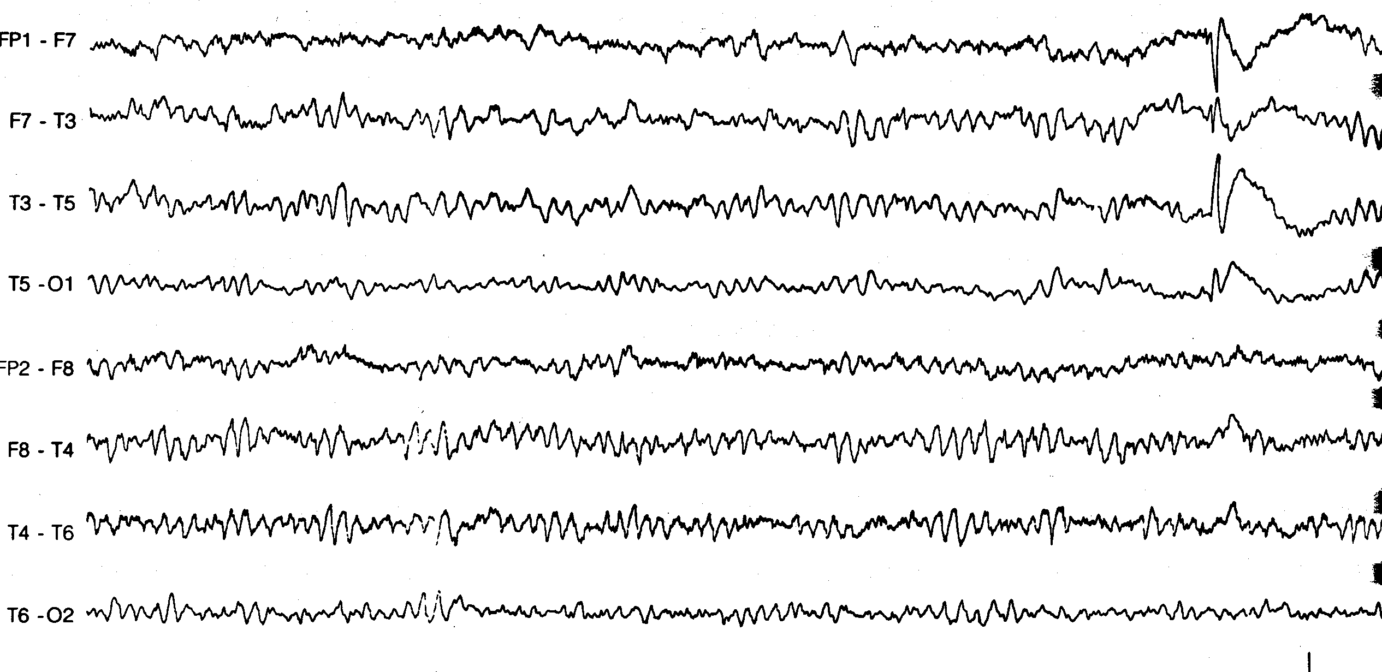

Slide 7
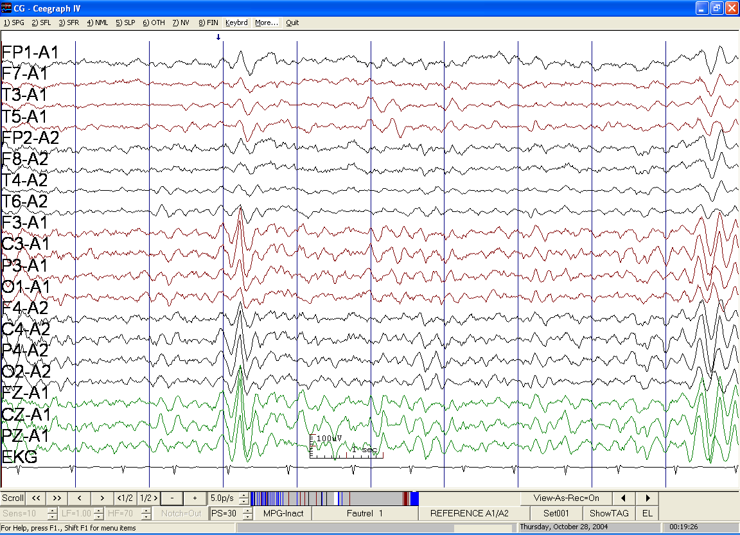
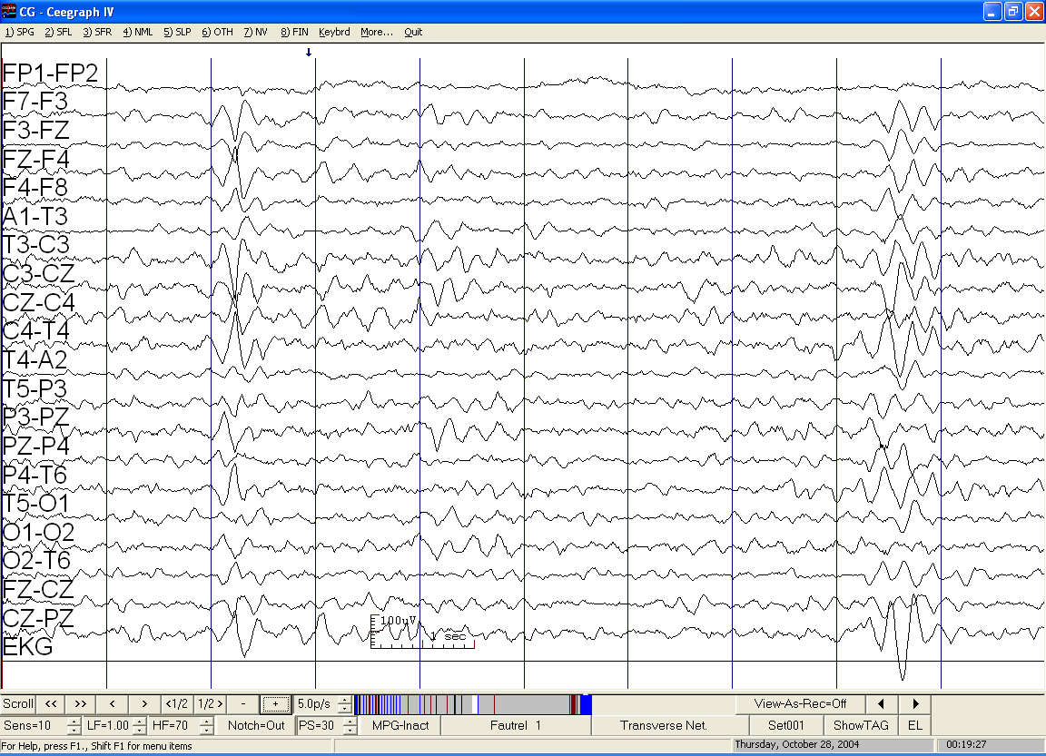
Notes:
Exactly same V wave in 2 different montages (same scales) in a 13 yo girl

Slide 8
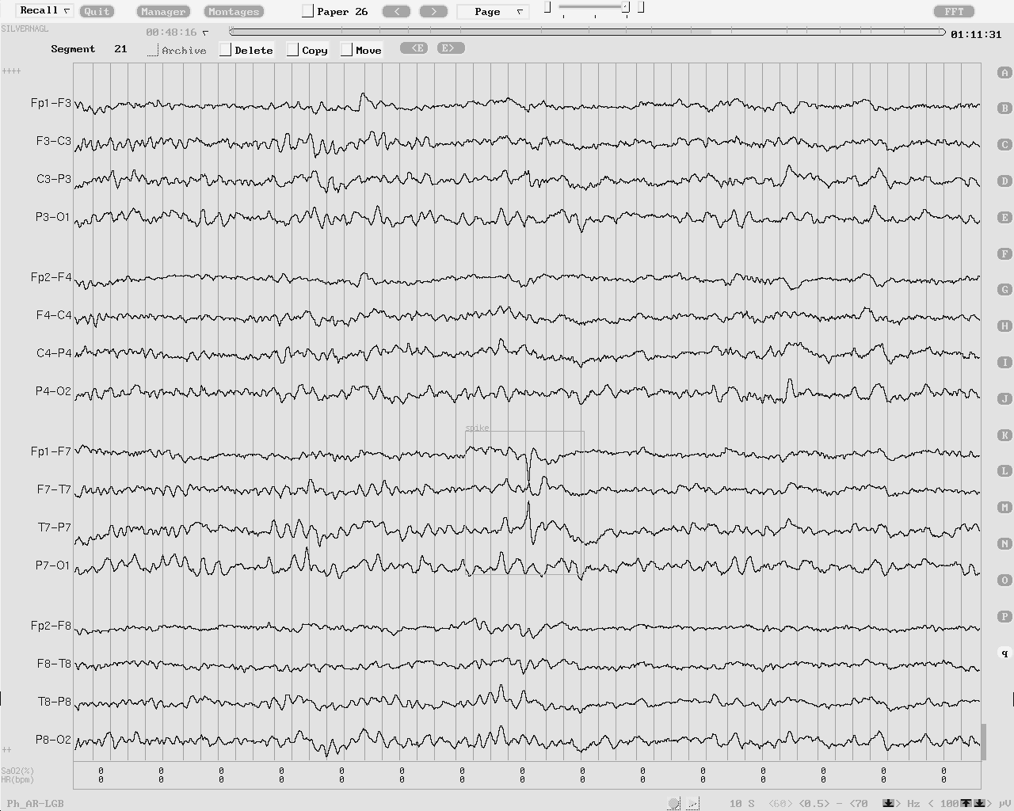
1 sec
Notes:
Left mid-temporal spike in a 33 year-old woman who had been experiencing spells of smelling burnt rubber, followed by lip smacking and behavior of confusion. This spike discharge is not followed by an aftergoing slow wave. MRI showed a cavernous angioma at the left temporal lobe, despite lack of left temporal slowing during wake EEG.

Slide 9
Spike/Sharp Wave Locations
Temporal > Frontal > Centrotemporal > Parietal > Occipital > Central /paracentral.
Association with epilepsy is better for temporal than rolandic or occipital spikes (1)
Anterior Temporal Spikes
90% Epilepsy
Rolandic Spikes
38% Epilepsy
(1) Fois A et al. (1988) Epilepsia 29:620-623
Notes:
Common locations of focal spike/sharp wave discharges, in the approximate order of frequency, are temporal, frontal, centrotemporal, parietal, occipital, and midline central and/or paracentral. The clinical correlation of focal spikes/sharp waves is with focal epilepsy. The degree of association with epilepsy is not the same for all locations of focal spikes/sharp waves{Kellaway, 1980 #156. For instance, the association is better for temporal spikes/sharp waves than for rolandic or occipital spikes/sharp waves. Approximately 90% of children with anterior temporal spikes have seizures, whereas seizures are present in only 38% of those with rolandic spikes. The temporal lobe tissues, especially the hippocampus and the amygdala, are some of the most epileptogenic tissues of the brain. The temporal lobes are also frequently involved in pathologic conditions, such as hypoxia, strokes, tumors, trauma, and vascular malformations. In contrast, many children with occipital IED do not have epilepsy {Fois, 1988 #171}, and occipital IED are encountered in non-epileptic persons with migraine disorders {Slatter, 1968 #173}. About 60% of children with occipital spikes do not have epileptic seizure disorders. “Needle spikes” in the occipital regions can be observed in the EEG of children who have congenital blindness but who do not develop seizures {Kellaway, 1955 #172}. These occipital spikes are low in amplitude and narrow but sharp in configuration.

Slide 10
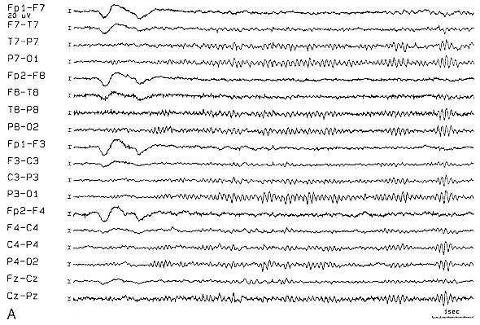
Notes:
Interictal recording in a subject with left mesial temporal lobe epilepsy shown on A P bipolar montages without (A) sphenoidal electrodes.

Slide 11
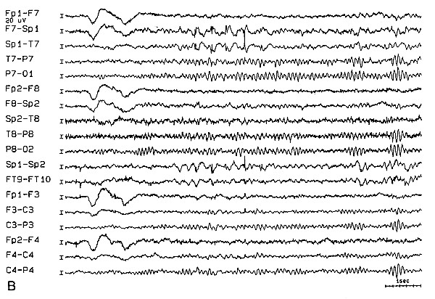
Notes:
Same MTLE patient shown with (B) sphenoidal electrodes. A series of sphenoidal sharp waves escapes detection on the standard montage.

Slide 12

Hyperventilation in a 63 year old woman
There is a spike hidden under this panel. Can you guess its location?
Notes:
Temporal spike with abnormal background. 63 years. Abnormal temporal spikes are accompanied by focal background abnormalities. Hyperventilation here elicited 3-5 Hz low to medium voltage waves in the left anterior-midtemporal region (F7-T3) and rare low voltage delta activity in the same area. Note the normal right temporal background activity; the only alteration is a mild fluctuation of its amplitude and some slow eye movements.

Slide 13
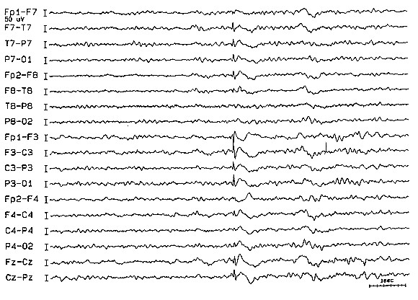
Where is the spike location?

Slide 14
Spike/Sharp Wave Locations
Occipital IED are encountered in migraine (1)
About 60% of children with occipital spikes do not have epilepsy.
Occipital “Needle spikes” are seen in the EEG of children with congenital blindness, but no seizures (2).
(1) Slatter KH (1968). Brain 91:85-98. (2) Kellaway P (1955) Electroencephalogr Clin Neurophysiol Suppl Suppl. 4:212-213.
Notes:
Common locations of focal spike/sharp wave discharges, in the approximate order of frequency, are temporal, frontal, centrotemporal, parietal, occipital, and midline central and/or paracentral. The clinical correlation of focal spikes/sharp waves is with focal epilepsy. The degree of association with epilepsy is not the same for all locations of focal spikes/sharp waves{Kellaway, 1980 #156. For instance, the association is better for temporal spikes/sharp waves than for rolandic or occipital spikes/sharp waves. Approximately 90% of children with anterior temporal spikes have seizures, whereas seizures are present in only 38% of those with rolandic spikes. The temporal lobe tissues, especially the hippocampus and the amygdala, are some of the most epileptogenic tissues of the brain. The temporal lobes are also frequently involved in pathologic conditions, such as hypoxia, strokes, tumors, trauma, and vascular malformations. In contrast, many children with occipital IED do not have epilepsy {Fois, 1988 #171}, and occipital IED are encountered in non-epileptic persons with migraine disorders {Slatter, 1968 #173}. About 60% of children with occipital spikes do not have epileptic seizure disorders. “Needle spikes” in the occipital regions can be observed in the EEG of children who have congenital blindness but who do not develop seizures {Kellaway, 1955 #172}. These occipital spikes are low in amplitude and narrow but sharp in configuration.

Slide 15
Focal Spikes
Scalp surface-positive IED can be seen
  After brain surgery
  In newborns with periventricular hemorrhage or leukomalacia
  In young children with multifocal IED and global encephalopathy
Notes:
Most focal spikes/sharp waves are surface-negative at the scalp. Scalp surface-positive spikes/sharp waves are not common in the adult patient. They are more frequently encountered in newborns with periventricular hemorrhage or leukomalacia, in young children with multifocal spikes/sharp waves, especially in the background of global encephalopathy such as ischemic injury or lipid storage diseases {Bergen, 1979 #460; Cukier, 1974 #461}.
The identification of focal spikes/sharp waves is a very important component in the diagnosis of benign age-related epilepsy syndromes (see chapter on pediatric EEG). Focal spikes/sharp waves in the benign epilepsy syndromes have distributions, morphology, and activating factors that are characteristic for each syndrome. The most common benign focal epilepsy syndrome is Benign Epilepsy of Childhood with Centrotemporal Spikes (Benign Epilepsy with Centrotemoral Spikes BECT, or Benign Rolandic Epilepsy). Other childhood syndromes of focal epilepsy are Benign Childhood Epilepsy with Occipital Paroxysms and the syndrome of Early-onset Childhood Seizures with Occipital Spikes or the Panayiotopoulos syndrome {Caraballo, 2000 #174}.

Slide 16
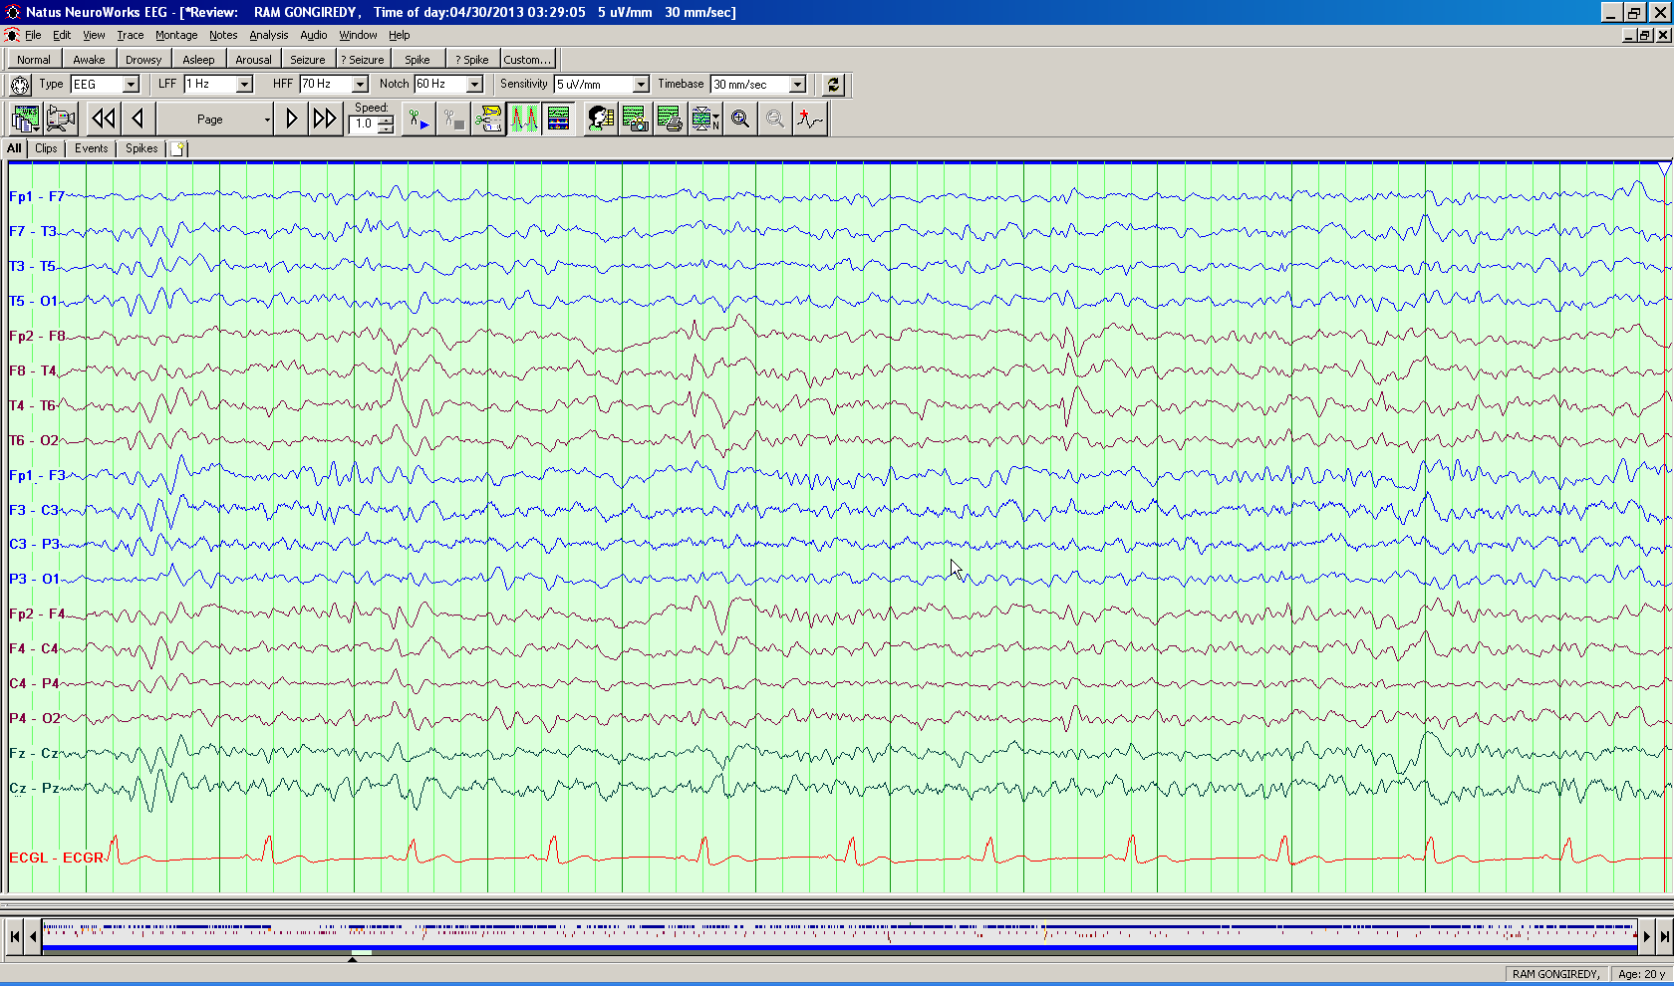
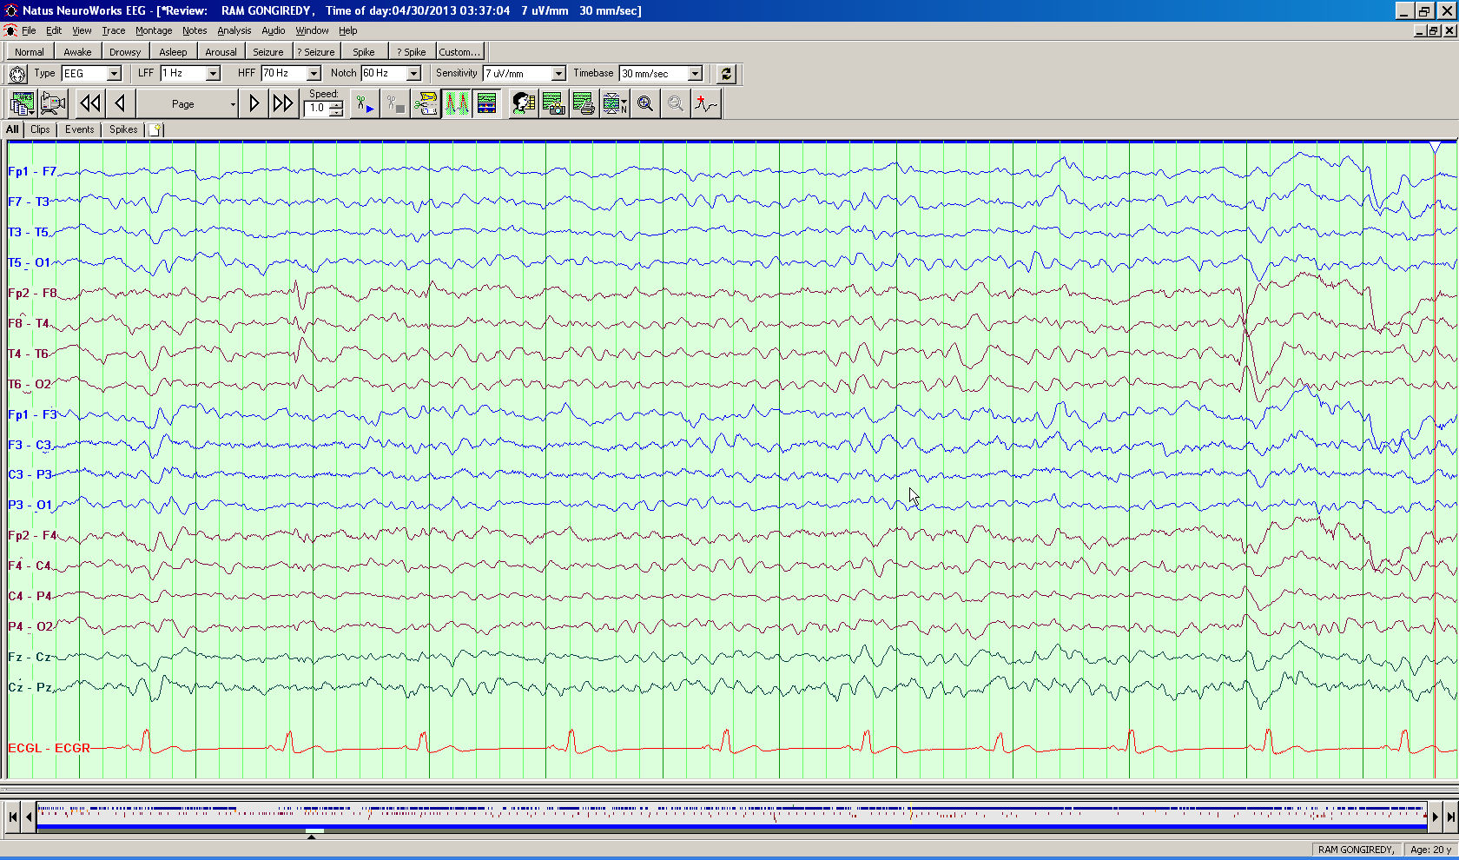
*
Notes:
Scalp recorded EEG from a 20 year old status post 2 receptive neocortical surgeries of the right frontal temporal regions shows, and the first panel a positive spike over T4 and in the second and negative spike maximum over F8 and T4

Slide 17
Focal Spikes
Spikes have typical features in
  Benign Epilepsy with Centrotemporal Spikes
    Negative over T and C
    Positive end of the dipole over frontal regions
  Benign Childhood Epilepsy with Occipital Paroxysms
  Early-onset Childhood Seizures with Occipital Spikes (Panayiotopoulos syndrome) (1)
(1) Caraballo R et al (2000) Neurology 55:1096-1100.
Notes:
Most focal spikes/sharp waves are surface-negative at the scalp. Scalp surface-positive spikes/sharp waves are not common in the adult patient. They are more frequently encountered in newborns with periventricular hemorrhage or leukomalacia, in young children with multifocal spikes/sharp waves, especially in the background of global encephalopathy such as ischemic injury or lipid storage diseases {Bergen, 1979 #460; Cukier, 1974 #461}.
The identification of focal spikes/sharp waves is a very important component in the diagnosis of benign age-related epilepsy syndromes (see chapter on pediatric EEG). Focal spikes/sharp waves in the benign epilepsy syndromes have distributions, morphology, and activating factors that are characteristic for each syndrome. The most common benign focal epilepsy syndrome is Benign Epilepsy of Childhood with Centrotemporal Spikes (Benign Epilepsy with Centrotemoral Spikes BECT, or Benign Rolandic Epilepsy). Other childhood syndromes of focal epilepsy are Benign Childhood Epilepsy with Occipital Paroxysms and the syndrome of Early-onset Childhood Seizures with Occipital Spikes or the Panayiotopoulos syndrome {Caraballo, 2000 #174}.

Slide 18
BECTS

Slide 19
Temporal Intermittent Rhythmic Delta Activity (TIRDA)
Intermittent sinusoidal trains of rhythmic 1 to 4 Hz waves at the temporal lobe, lasting for about 5 seconds
Most commonly 2 to 3 Hz
Appears either during wake or drowsiness and sleep.
Highly correlated with temporal lobe seizures
Temporal depth electrode recording during TIRDA showed active spiking activity in mesial temporal structures
Two-thirds of the patients had a pathological lesion at the temporal lobe.
Notes:
TIRDA consists of intermittent sinusoidal trains of rhythmic 1 to 4 Hz waves at the temporal lobe, lasting for about 5 seconds (see Fig. 4) {Reiher, 1989 #180; Normand, 1995 #181} The most common rate of the discharge is 2 to 3 Hz. The predominant location is the anterior temporal lobe, but posterior TIRDA can also be observed. TIRDA appears either during wake or drowsiness and sleep.
Reiher and colleagues {Reiher, 1989 #180} have demonstrated that TIRDA has very high correlation with history of temporal lobe seizures. In a case-control study, all patients were shown to have complex focal epilepsy {Normand, 1995 #181}. Majority of the patients with TIRDA also had temporal spikes/sharp waves on their EEGs. Temporal depth electrode recording during the occurrence of TIRDA on the scalp showed active spiking activity at the amygdalo-hippocampal structure. Association with underlying structural lesions is also high. Two-thirds of the patients had a pathological lesion at the temporal lobe.

Slide 20
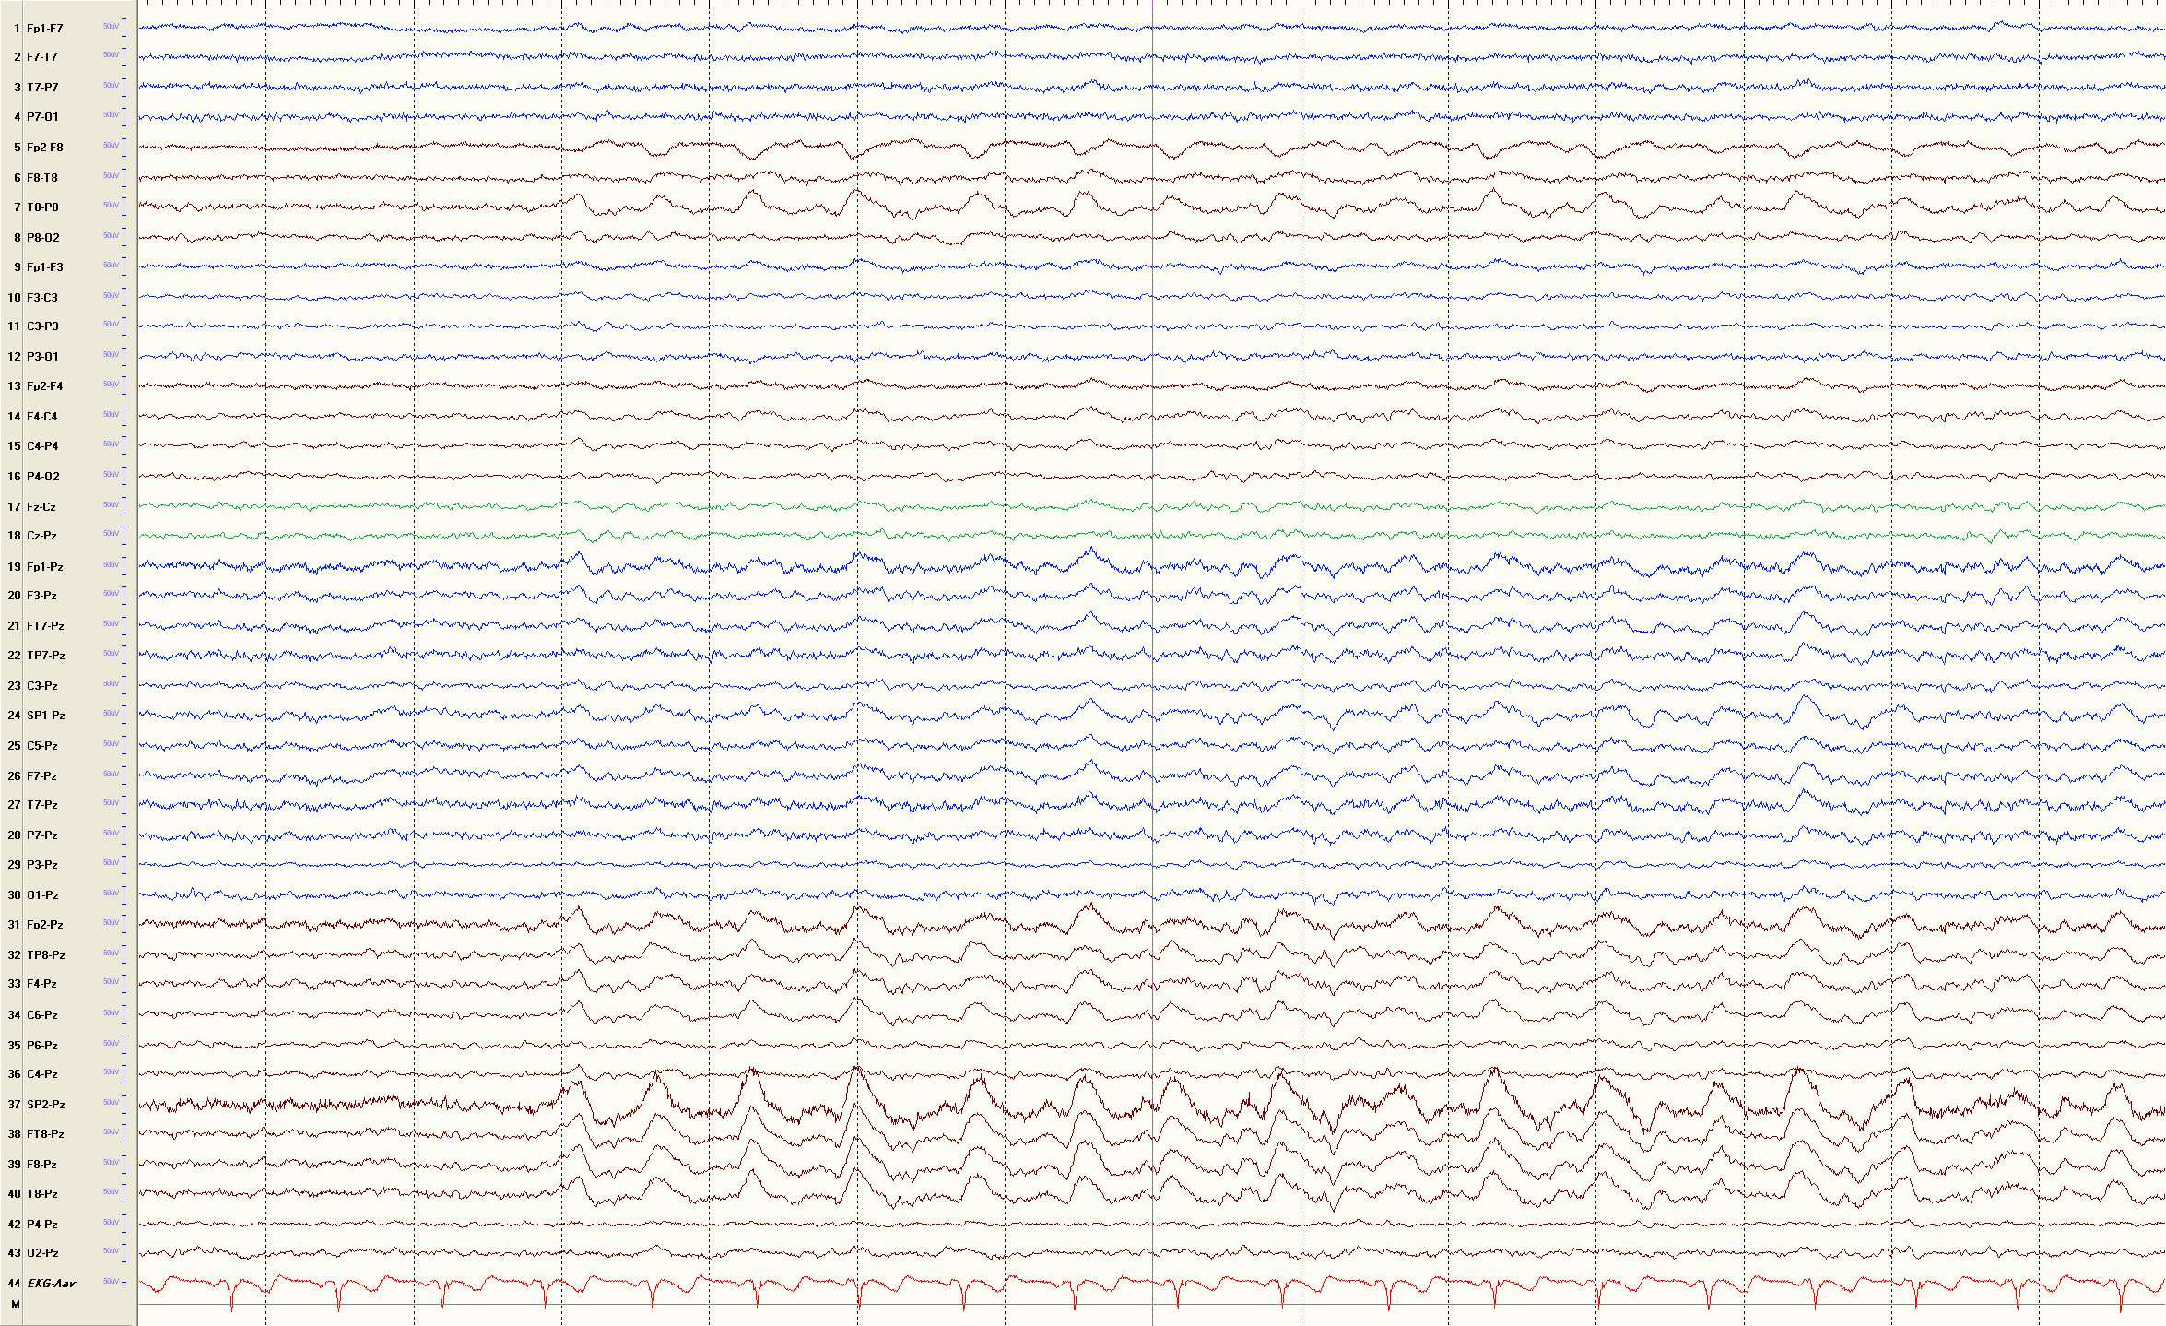
*

Slide 21
Secondary Bilateral Synchrony
Focal or regional spikes leading directly to bisynchronous spikes and/or spike-waves.
Focal interparoxysmal abnormality in same region.

Slide 22
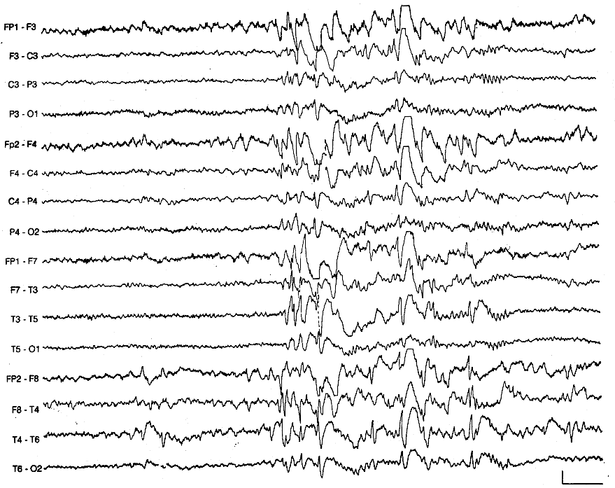
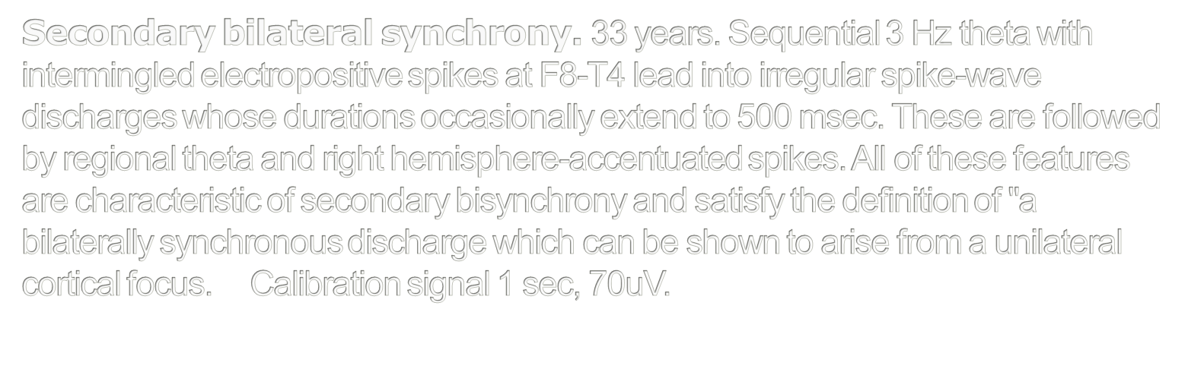

Slide 23
Generalized IEDs.
3-Hz spike-and-wave discharges
Bursts last 1-3 seconds, but can be longer
Activated by hyperventilation or drowsiness
Synchronous in timing and symmetric in amplitude
Shifting asymmetries may be seen - usually no more than 20 milliseconds difference
Maximum over midline frontal region.
EEG signature of absence epilepsy
Can interfere with mental functions in a subtle manner
Notes:
Generalized IED
The generalized IED are 3-Hz spike-and-waves, atypical spike-and-slow-waves, slow spike-and-wave discharges, hypsarrhythmia, and generalized repetitive fast discharge (GRFD).
3-Hz Spike-and-Wave
3-Hz spike-and-wave discharges are bursts of generalized complexes of spikes and after going slow waves that repeat rhythmically at a rate of three cycles per second (Fig. 5). Each burst lasts usually between one and three seconds, but longer paroxysms can occur, especially when activated by hyperventilation or drowsiness. The bursts are synchronous in timing and symmetric in amplitude between hemispheres. Very slight degrees of asynchrony between hemispheres could sometimes be detected, but usually by no more than 20 milliseconds. The amplitude of the complexes is very high and maximal towards the midline frontal region.
3-Hz spike-and-wave discharges constitute the EEG signature of absence epilepsy. It is now known that even a brief burst of 3 Hz spike-and-wave can interfere with mental functions in a subtle manner. The subtle effect may not be apparent by visual observation, but neuropsychological testing demonstrates that one or two second bursts do briefly interrupt continuous motor tasks {Penry, 1975 #178}. Bursts of three-second duration or longer are more consistently accompanied by clinical signs of absence seizures, such as behavioral arrests, staring, or eye fluttering.
Hyperventilation is a standard procedure for activating absence seizures in the physician’s office or for activating 3-Hz spike-and-wave bursts during EEG recording. However, the clinician must be aware of the phenomenon of pseudo-absence that occurs in some children without epilepsy {Lafleur, 1977 #183} This non-epileptic phenomenon has EEG features that may be mistaken for 3-Hz spike-and-wave of absence epilepsy. EEG in pseudoabsence shows bursts of very high voltage semi-rhythmic to rhythmic delta waves that are slower than the usual hyperventilation build-up. The slowing is widely distributed, with amplitude often maximal at the anterior head regions. Similar to 3-Hz spike-and-wave discharges, these bursts of delta slow waves stand out of the background. However, careful analysis of the bursts in pseudo-absence spells shows that spikes are lacking, so that there are no repetitive and rhythmic complexes of spike-and-waves as in 3-Hz spike-and-wave discharges of absence seizures. The bursts of slow waves during a pseudo-absence spell may include theta slow waves, and the rate of the delta wave activity tends to fluctuate. The clinical appearance of pseudo-absence spells mimics absence seizures {Epstein, 1994 #182}. During a pseudo-absence spell, the child may stop hyperventilating, stare, ignore communication, and swallow, yawn or smile. Therefore, the clinician should consider obtaining an EEG record even when the patient exhibits absence spells activated by hyperventilation procedure performed at the office.

Slide 24
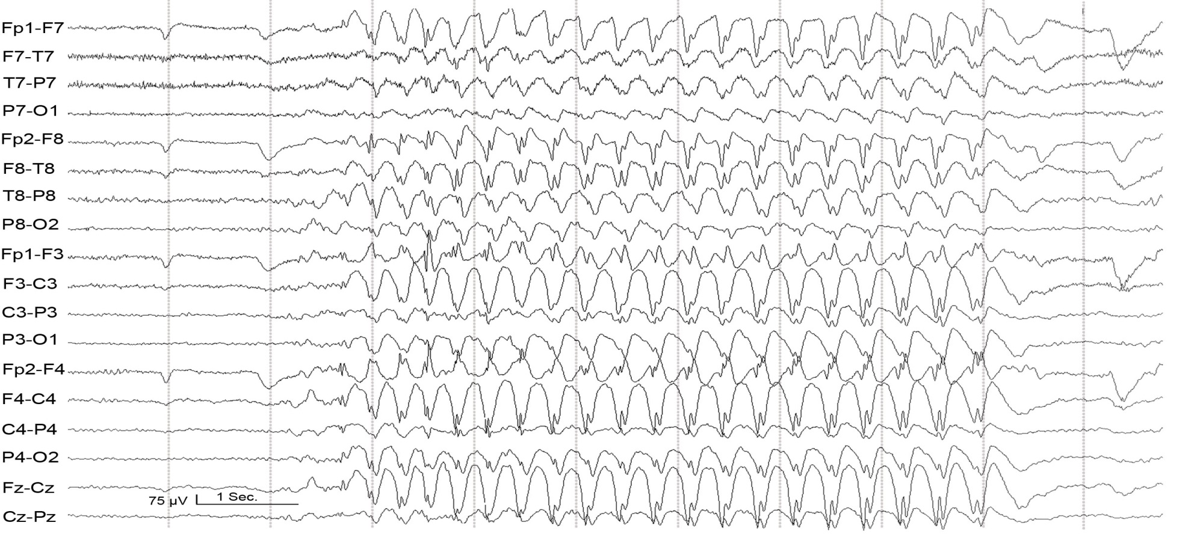

Slide 25
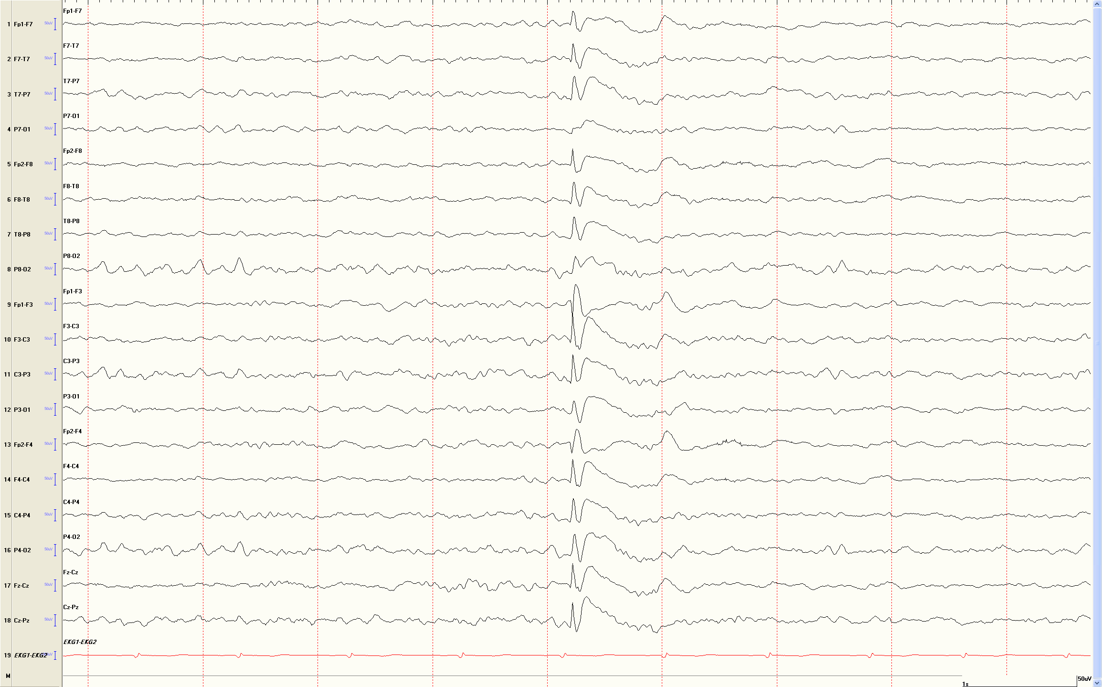
*
Notes:
JME

Slide 26
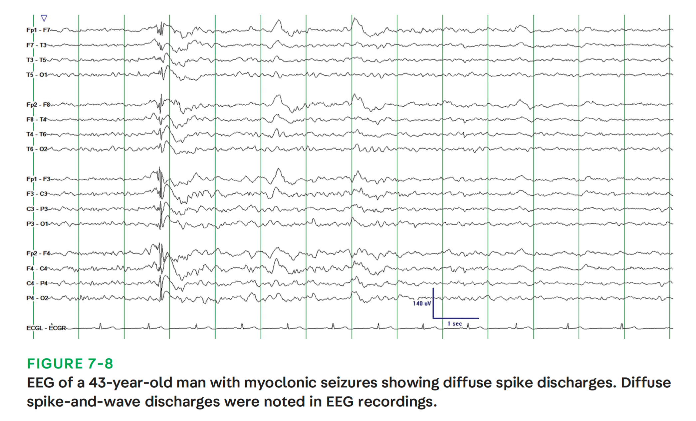
Chen and Koubeissi. 2019. Continuum

Slide 27
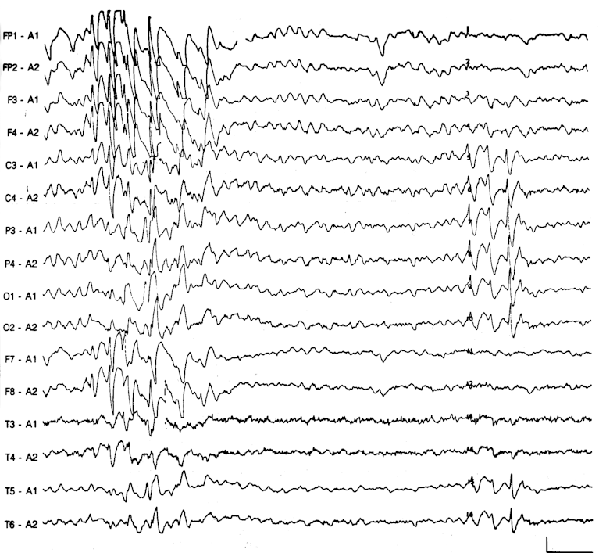
Notes:
The varying field of slow spike-waves.
29 years.
In the initial burst, the spike-waves, initially 3 Hz then 2 Hz, appear principally in the frontal regions whereas the subsequent burst is centered posteriorly.
Calibration signal 1 sec, 100uV.

Slide 28
Generalized IEDs.
Generalized Atypical Spike-and-Slow-Waves
Resemble 3 Hz spike-and-wave discharges, but have variable rates
Complexes vary in amplitude and morphology
Enhanced by drowsiness and non-REM sleep
Correlate with primary generalized epilepsies
In generalized epilepsies, focal spikes of low amplitude may appear during drowsiness
Notes:
Generalized atypical spike-and-slow-wave discharges are bilaterally synchronous complexes that resemble 3 Hz spike-and-wave discharges, but differ in that they have variable rates, although mostly close to 4 Hz. Also the spike component of the complexes is often polyphasic{Gastaut, 1968 #462} (see Fig. 6). Moreover, the complexes vary greatly in amplitude and morphology within the each burst, or from one burst to another. Atypical spike-and-slow-wave pattern is more likely to occur as a single discharge of one complex, whereas 3-Hz spike-and-wave pattern typically occurs as repetitive complexes for more than one second. Drowsiness and non-REM sleep enhances the occurrence of generalized atypical spike-and-slow-wave discharges, and the discharges may not occur during wake in some patients.
The clinical correlation of generalized atypical spike-and-slow-wave abnormality is with primary generalized epilepsies. Some of the primary generalized epilepsies associated with this epileptiform pattern are benign myoclonic epilepsy of early childhood. myoclonic-astatic epilepsy of early childhood, juvenile myoclonic epilepsy of Janz, juvenile absence epilepsy, atypical absence epilepsy, epilepsy with grand mal on awakening, and photosensitive epilepsy {Binnie, 1990 #179}.
In patients with 3-Hz spike-and-waves and patients with generalized atypical spike-and-slow waves, it is not uncommon for focal spikes of low amplitude to appear during drowsiness, usually at the frontal or temporal regions. These focal spikes do not indicate focal epileptic seizure disorder, so long as they are not abundantly present at a single location during wake or sleep.

Slide 29
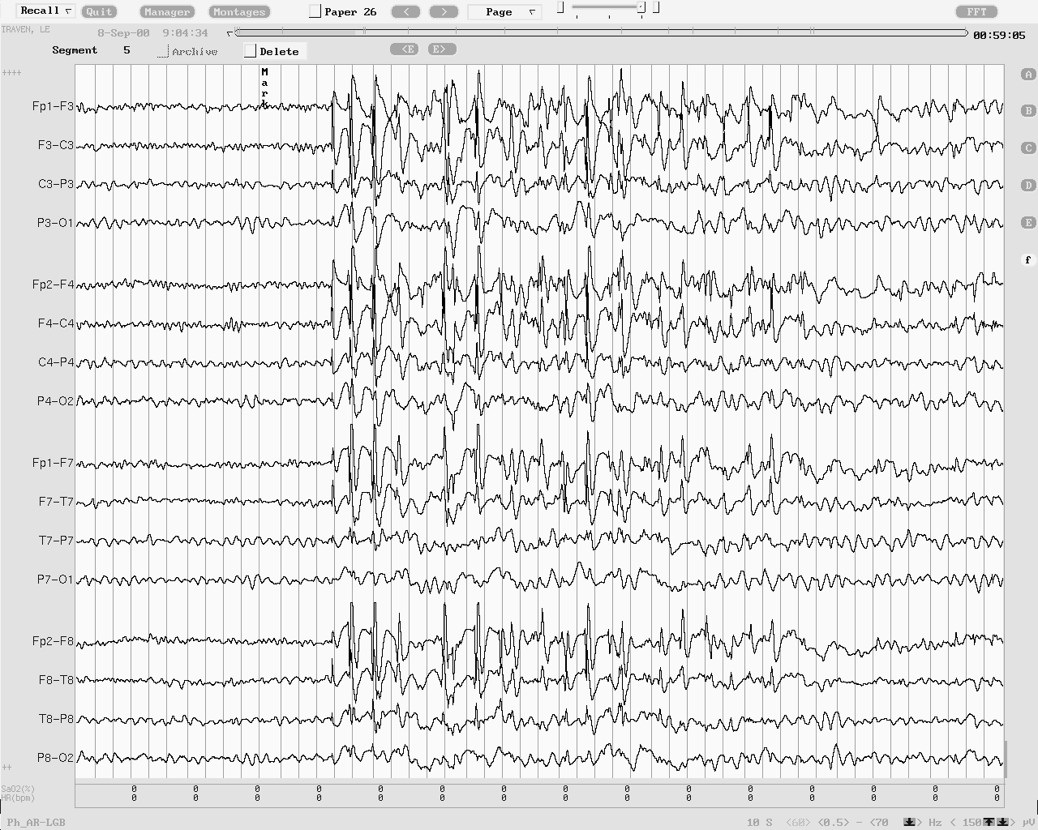
1 sec
Notes:
Generalized atypical spike-and-slow-wave complexes in a 19 year-old woman who since age 13 years has had sporadic generalized tonic-clonic seizures upon awakening in the morning. The patient did not have history of myoclonic jerks or absence spells, but the recorded paroxysms, such as the one shown in this figure, were sometimes accompanied by brief arrest of activity.

Slide 30
Generalized IEDs.
Slow Spike-and-Waves
Frequency is around 1.0 to 2.5 Hz
Not as rhythmic in repetition
Mostly sharp waves: wide duration and blunt peaks
Fluctuating asymmetry of amplitude is common
Drowsiness or Non-REM sleep may activate trains → ESES?
May be enhanced by hyperventilation, but not photic stimulation
Seen in Lennox-Gastaut syndrome
Notes:
Slow Spike-and-Waves (Sharp-and-Slow-Wave Complexes)
As the name indicates, the slow spike-and-wave discharge pattern consists of complexes that occur slower than the “prototypical” 3 Hz spike-and-wave discharge pattern of absence epilepsy (Fig. 7). The rate of slow spike-and-wave complexes is around 1.0 to 2.5 Hz. Moreover, the complexes are not as rhythmic in repetition, and the spikes often are actually sharp waves because of the wide duration and blunt peaks {Gastaut, 1982 #463}. Compared with 3 Hz spike-and-wave, persistent or fluctuating asymmetry of amplitude between hemispheres occurs more commonly with the slow spike-and-wave pattern. Slow spike-and-wave pattern is also more likely to occur during wake as a single discharge of one or a few complexes, whereas 3-Hz spike-and-wave pattern typically occurs as repetitive complexes for longer than one second. Drowsiness or Non-REM sleep may activate trains of repeating slow spike-and-wave complexes, sometimes to the point of raising the issue of electrical status epilepticus during sleep (ESES). Hyperventilation, but not photic stimulation, may enhance the occurrence of slow spike-and-waves, but not as reliably as in 3-Hz spike-and-wave pattern. The slow spike-and-wave pattern is commonly seen as one of the EEG features of Lennox-Gastaut syndrome, and pattern is also seen in adults with the syndrome.

Slide 31
Generalized IEDs.
Generalized Repetitive Fast Discharge (GRFD)
Also known as paroxysmal fast rhythm, generalized paroxysmal fast activity, or “runs of rapid spikes”
Alpha or beta frequency range
Last typically less than 10 seconds
Electrodecrement consists of very fast and very low amplitude activity
GRFD may be preceded or followed by generalized slow spike-and-wave discharge
Often associated with Lennox-Gastaut syndrome
Most GRFD occur during sleep
May be an ictal rhythm - could be accompanied by tonic seizures
Notes:
Generalized Repetitive Fast Discharge (GRFD)
GRFD is also known as paroxysmal fast rhythm, generalized paroxysmal fast activity, or “runs of rapid spikes” {Jasper, 1941 #169; Halasz, 1991 #170}. The pattern consists of bursts of repetitive spikes occurring at rates in the alpha or beta frequency range (see Fig. 8). The bursts are generalized in distribution and typically lasting less than 10 seconds. They are usually low to medium in amplitude. A particular pattern of GRFD referred to as electrodecrement appears as sudden and brief generalized attenuation of background EEG. Electrodecrement consists of very fast and very low amplitude activity, so much so that individual spikes are not readily obvious. Consequently, the burst appears as sudden loss of background EEG waveforms. Bursts of GRFD may be preceded by generalized slow spike-and-wave discharge. GRFD may also be followed by paroxysms of spike-and-wave complexes or generalized slowing. Patients with GRFD very frequently have separate bursts of generalized spike-and-wave complexes, especially slow spike-and-wave discharges. Moreover, GRFD is often associated with catastrophic epilepsy syndromes, especially in children, such as the Lennox-Gastaut syndrome {Brenner, 1982 #176; Halasz, 1991 #170}.
Most GRFD occur during sleep. GRFD can also be considered as an ictal rhythm, because it could be accompanied by tonic seizure activity. However, the tonic seizure activity may be so mild so that it escapes visual detection. It may take the form of tonic slow eye opening. GRFD may also be accompanied by transient apnea or bradycardia in some children.

Slide 32
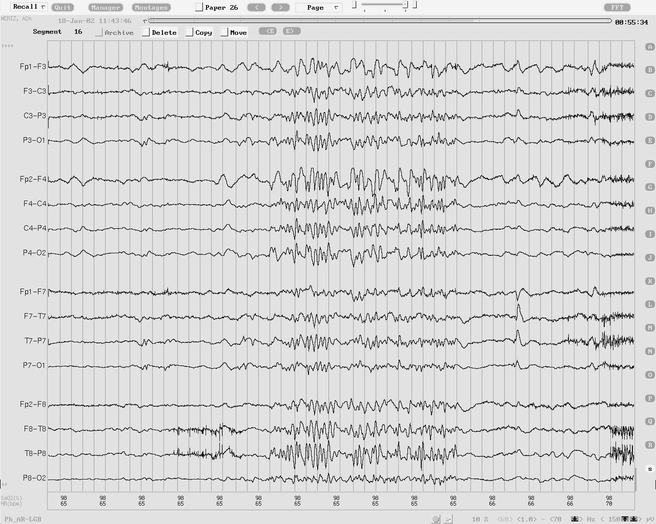
1 sec

Slide 33
Generalized IEDs.
Photo-epileptiform discharges
IEDs elicited by intermittent photic stimulation
Can be self-limited or self-sustaining
Four types
  (1) generalized (most common)
  (2) bilateral posterior dominant
  (3) bilateral occipital
  (4) focal unilateral discharge (least common)
70 to 77% of generalized photo-epileptiform discharges have seizure disorders, but bilateral occipital photo-epileptiform discharges are less commonly associated with epilepsy.
Notes:
Photo-epileptiform discharges are spikes/sharp waves and complexes of spike-and-waves that are elicited by intermittent photic stimulation. Photo-epileptiform discharges have been divided into two types: the self-limited type for discharges that do not exceed the stimulation, and the self-sustaining type when they outlast the stimulation {Kasteleijn-Nolst Trenite, 2001 #184}. Self-sustaining discharges were believed to be more highly associated with seizure disorders than self-limited discharges, but two studies showed no difference between these two types of photo-epileptiform discharges {Jayakar, 1990 #186; So, 1993 #185}.
Photo-epileptiform discharges can also be divided into four categories according to their distribution: (1) generalized photo-epileptiform discharge (Fig. 9); (2) bilateral posterior dominant photo-epileptiform discharge (Fig. 10); (3) bilateral occipital photo-epileptiform discharge; and (4) focal unilateral discharge {So, 1997 #187}. Of the four categories, generalized photo-epileptiform discharges are the most common, and focal unilateral discharges are the least common. Whereas 70 to 77% of individuals with generalized photo-epileptiform discharges have seizure disorders, bilateral occipital photo-epileptiform discharges are less commonly associated with epilepsy. Focal photo-epileptiform discharges usually occur in the occipital region, and they have a high association with structural abnormality in the posterior hemisphere ipsilateral to the discharges.
In general, the type of seizure disorder associated with photo-epileptiform discharges is primary generalized seizure disorder. Focal seizure disorders are rarely associated with photo-epileptiform discharges. Focal seizures activated by photic stimulation usually begin at the occipital region.

Slide 34
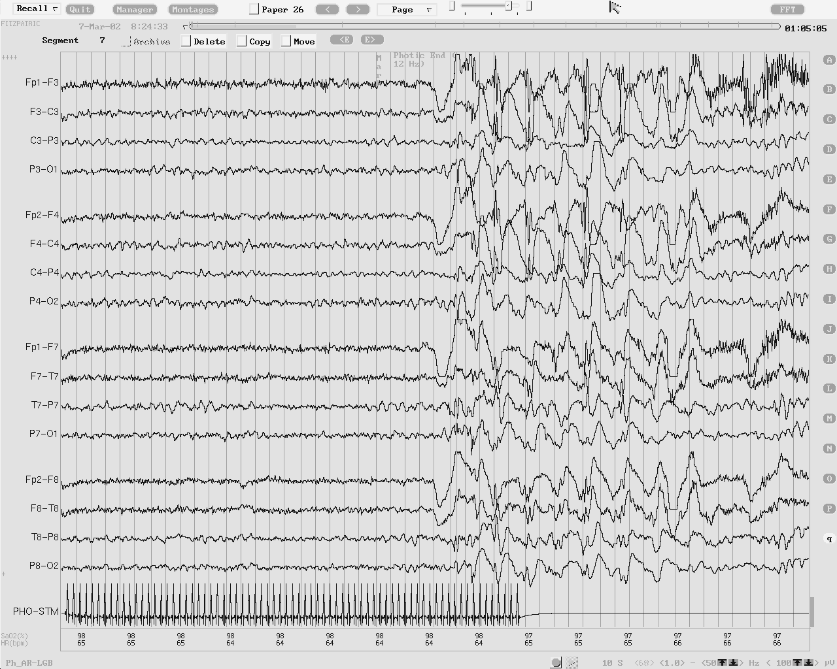
Notes:
Example of generalized photoepileptiform discharge.

Slide 35
Importance of Ictal Recordings
Evaluation of paroxysmal episodes
Characterizing and quantifying each seizure type
Syndromic classification
Indispensable for presurgical evaluation
Epileptic
Non-Epileptic
Physiologic
(e.g. syncope)
Psychogenic
Psychiatric
(e.g. Panic attack, PTSD)
(1) Koubeissi, M. and E. So (2013). Interictal and Ictal EEG. EEG in Clinical Practice. J. a. P. Ebersole, T.

Slide 36
Ictal Discharges – General Considerations
Seizure patterns can be isomorphic or metamorphic
An electrographic deviation from the baseline
  Frequency - Field
  Morphology - Amplitude
The most recognizable EEG seizure pattern consists of rhythmic, organized discharge that may or may not have apiculate waveforms.
(1) Koubeissi, M. and E. So (2013). Interictal and Ictal EEG. EEG in Clinical Practice. J. a. P. Ebersole, T.
Notes:
Seizure patterns can be isomorphic or metamorphic. Isomorphic patterns lack clear evolution between multiple phases during the ictal discharge, so the ictal morphology will not change remarkably throughout the seizure. A typical example is the spike-and-slow wave discharge in generalized epilepsy. Although the morphology of the ictal discharge in generalized epilepsy is isomorphic, the frequency of the repetitive waveforms changes as the seizure evolves. On the other hand, the morphology of the metamorphic seizure pattern evolves through different stages of the seizure. This pattern is typical of focal seizures, but is seen in both primary and secondarily generalized tonic-clonic seizures.
An acceptable definition of the ictal discharge is an electrographic deviation from the baseline, usually but not always in association with symptoms or signs in the patient. Ictal discharges are generally marked by change of patterns, which may manifest as an increase or decrease of the frequency, field, morphology or amplitude as the seizure evolves. However, in certain situations, it may be difficult to distinguish EEG seizures from some physiological or non-ictal pathological findings. Specifically, certain EEG findings related to transition from sleep to wakefulness or transition between different depths of coma may resemble seizures. In addition, differentiating interictal findings such as frequent spiking from seizures may not be straightforward. The same pattern may represent ictal discharges in some patients (e.g. periodic lateralized epileptiform discharges) {Hughes, 2010 #465}. In comatose patients, some EEG discharges may not have a clear clinical correlate, which further makes their designation as ictal more difficult. However, EEG seizure patterns of at least more than 3 seconds often are associated with clinical seizure activity. The most recognizable EEG seizure pattern consists of rhythmic, organized discharge that may or may not have apiculated waveforms. The EEG seizure activity usually evolves through at least two patterns. These features help distinguish most ictal discharges.

Slide 37
Focal Aware Seizures
These can occur without a clear ictal correlate on the EEG
6 (or 10) cm² rule
21% of seizures are associated with EEG ictal discharge (1)
  33% with motor manifestations
  15% with no motor manifestations
Seizures may be motor, sensory, autonomic, or psychic
Semiology is an important indicator of the area of seizure onset
When recorded, seizure discharges are not different from focal impaired awareness seizures
May be focal fast frequency discharge, rhythmic slowing, or repetitive spike discharge. Irregular non-rhythmic delta or theta frequency discharge is less frequent.
(1) Devinsky, et al NEUROLOGY 1988;381347-1352
Notes:
Simple focal seizures frequently occur without a clear detectable ictal correlate on the EEG. The low electrographic yield of simple focal seizures is a consequence of the limited propagation of the ictal discharge in simple focal seizures. In one study, only 21% of all focal seizures were associated with discernible ictal discharge on the EEG {Devinsky, 1988 #342}. The percentage was higher in those seizures that involved motor manifestations (33%), and lower in seizures that had no motor manifestations (15%). This may be explained by the fact that motor phenomena frequently reflect wider propagation of the seizure discharge. The clinical manifestations of focal seizures include motor, sensory, autonomic, cognitive and psychic symptoms or signs, depending on the brain regions affected. The seizure semiology is often an important indicator of the area of seizure onset. For example, elemental auditory seizures strongly suggests onset in Heschl's gyrus, whereas elemental visual phenomena often originate from regions within or close to the primary visual cortex. Other ictal symptoms, however, are less specific in indicating the location of the seizure activity, such as olfactory or psychic auras. While such auras are often seen in temporal lobe epilepsy, they may also be seen in orbitofrontal, insular, or neocortical temporal epilepsy. When seizure discharges are recorded by scalp electrodes in simple focal seizures, they are often indistinguishable from those seen with complex focal seizures. Simple focal seizures may be associated with scalp-recorded focal fast frequency discharge in the alpha or beta frequency, focal rhythmic slowing in the delta or theta frequency, or, less commonly, focal repetitive spike discharge. Irregular non-rhythmic delta or theta frequency focal discharge is a less frequent pattern of ictal EEG activity.

Slide 38
Focal Impaired Awareness Seizures
EEG changes occur almost always – Exceptions: some frontal or parietal lobe seizures
Mesial temporal: Often theta-range temporal ictal discharge
Classic Teaching:
  Closer to ictal onset zone → higher frequency
  Deep or far generators → slower frequency
Common evolving discharge is that of rhythmic discharge, then developing into higher voltage and slower frequency discharge, then regular slow waves increasing in frequency
Notes:
The EEG almost always shows changes in association with complex focal seizures, with some exceptions in complex focal seizures of frontal or parietal lobe origin {Williamson, 1985 #456}. Inferring the location of the epileptogenic zone by using ictal scalp recordings is not always straightforward. The morphologic appearance of the ictal pattern is not specific to the area of seizure onset. For example, the theta-range temporal ictal discharge, often typical of mesial temporal generators, can be seen in other focal epilepsies that later spread to the temporal lobe{Koubeissi, 2009 #386}. One generally accepted rule is that the closer the recording electrode is to the ictal onset zone, the higher the recorded frequencies. In contrast, deep or far generators tend to be associated with slower frequency discharges on scalp EEG. Gloor suggested that when faster frequencies are recorded early in the seizure, they reflect proximity of the recording electrodes to the site of origin, whereas slower frequencies often represent propagation from a distant site {Gloor, 1975 #34}. Indeed, intracranial electrodes often record high frequency activity when implanted at or close to the epileptogenic zone, whereas scalp-recorded ictal discharges start as slow waveforms before progressing into higher frequencies.
In most complex focal seizures, evolving changes in the pattern of ictal EEG discharge is a fundamental feature that helps differentiate them from the stable monomorphic appearance of physiologic activities such as benign variants. An evolving pattern commonly encountered is that of rhythmic discharge early during the seizure, which then develops into higher voltage and slower frequency discharge as the seizure propagates to more brain regions. A later feature of the ictal discharge is that of regular slow waves which increase in frequency and become more organized as the seizure progresses. Focal synchronous spike and wave pattern can occur as an early or late feature of the seizure.
Postictal EEG changes also help in distinguishing EEG seizure discharge from benign variants. These changes may include generalized or focal slowing, amplitude attenuation or increase the focal spike frequency {Kaibara, 1988 #378; Gotman, 1985 #361}}. When present, focal postictal slowing has lateralizing or sometimes localizing value for the ictal onset zone {Walczak, 1992 #448}.
The latency between the first clinical sign of a seizure and the ictal EEG onset should always be assessed. If the clinical seizure onset precedes EEG onset, it may signify that the detected discharge localizes areas of seizure propagation, rather than the focus of seizure origin.

Slide 39
Temporal Lobe Seizures
Most common focal epilepsy
Originate from the hippocampus or other mesial temporal structures and propagate to involve the basal and lateral temporal lobe cortices, as well as frontal lobe regions.
If limited to the hippocampus, non scalp discharge
Workup of non-lesional cases
Extratemporal may look temporal
Temporal may look extratemporal
Notes:
Temporal Lobe complex focal seizures
Temporal lobe seizures have been most thoroughly studied because they comprise the most common type focal epilepsy. These seizures often originate from the hippocampus or other mesial temporal structures and propagate to involve the basal and lateral temporal lobe cortices, as well as frontal lobe regions. When the ictal discharge is limited to the hippocampus, scalp and sphenoidal electrodes may not detect deviations from the baseline EEG. However, with the involvement of neocortical areas, the scalp EEG and the sphenoidal EEG are more likely to detect an ictal discharge. The medial temporal structures are connected with numerous cortical regions. These include the orbitofrontal cortex, the insula, the frontal pole, the posterior cingulate area, as well as the temporal neocortex that includes the temporal pole, basal temporal cortex, lateral temporal cortex, and temporo-occipital region {Koubeissi, 2009 #386}. Thus, in non-lesional cases that have seizures that are semiologically and clinically consistent with temporal lobe epilepsy, intracranial electrode evaluation is often recommended to sample regions known to have connectivity with the mesial temporal structures. An example is in patients with extratemporal seizure foci but with seizures that are clinically and electrographically typical of mesial temporal lobe epilepsy {Koubeissi, 2009 #386}. The opposite scenario may sometimes occur when seizures of mesial temporal origin result in an initial scalp ictal discharge over a different brain region (see Fig. 11). Moreover, in some patients who have hippocampal sclerosis on one side but scalp-recorded seizure onset on the contralateral side, intracranial electrode recording may reveal seizure onset on the side of sclerosis without scalp EEG correlates{Mintzer, 2004 #407}.
A scalp-recorded 5- to 9-Hz rhythmic discharge at the inferior temporal scalp region has been reported to be highly associated with hippocampal onset seizures {Ebersole, 1996 #470}. A similar positive rhythm may be less commonly observed at the vertex or parasagittal region, either alone or in combination with the 5- to 9-Hz rhythmic discharge at the inferior temporal scalp region. On the other hand, seizures originating at the temporal neocortex are often associated with irregular, polymorphic, 2- to 5-Hz lateralized activity. This pattern is sometimes preceded by repetitive or periodic sharp wave discharges at the temporal region.
One of the early signs of ictal EEG changes in temporal lobe epilepsy is diffuse attenuation of the EEG and cessation of interictal epileptiform discharges {Murro, 1993 #411}. This pattern may have localizing value. Blume and colleagues studied 66 seizures of temporal lobe origin and found that the initial EEG changes consisted of attenuation in 10% of the seizures, rhythmic discharge without epileptiform features in 43%, and repetitive epileptiform discharges in 41% {Blume, 1984 #332}. A typical ictal discharge that evolves shortly after onset in temporal lobe epilepsy is that of a theta-range, rhythmic, organized spiking, often centered in the anterior-to-mid temporal region or over the sphenoidal electrodes (see Fig. 12). This temporal rhythm is seen in 50% to 80% of the medial temporal lobe seizures {Risinger, 2000 #422}. Some seizures, however, may not be accompanied by clear EEG correlates at their onset. Neocortical-onset seizures are less likely to be associated with lateralized scalp-recorded EEG onset than mesial temporal-onset seizures {Ebersole, 1996 #470}.
Contrasting intracranial with scalp recordings often shows better temporal resolution of intracranially-recorded seizures. Whereas the scalp-recorded ictal discharge of temporal lobe seizures may lag in time behind the clinical onset, intracranially-recorded ictal discharges are often concomitant with, or appear before, the clinical onset. Indeed, interictal and ictal discharges that are limited to the hippocampus are often undetectable by sphenoidal or scalp electrodes, and the seizure discharge becomes evident on scalp recordings only after it involves significant portions of the basal and lateral temporal neocortex (see Fig. 13). The frequency of scalp-recorded seizure discharges can be in the alpha, beta, or delta range {Blume, 1984 #332}. However, with intracranial electrodes, the recorded ictal discharges are often of higher frequency, in the beta or gamma range.

Slide 40
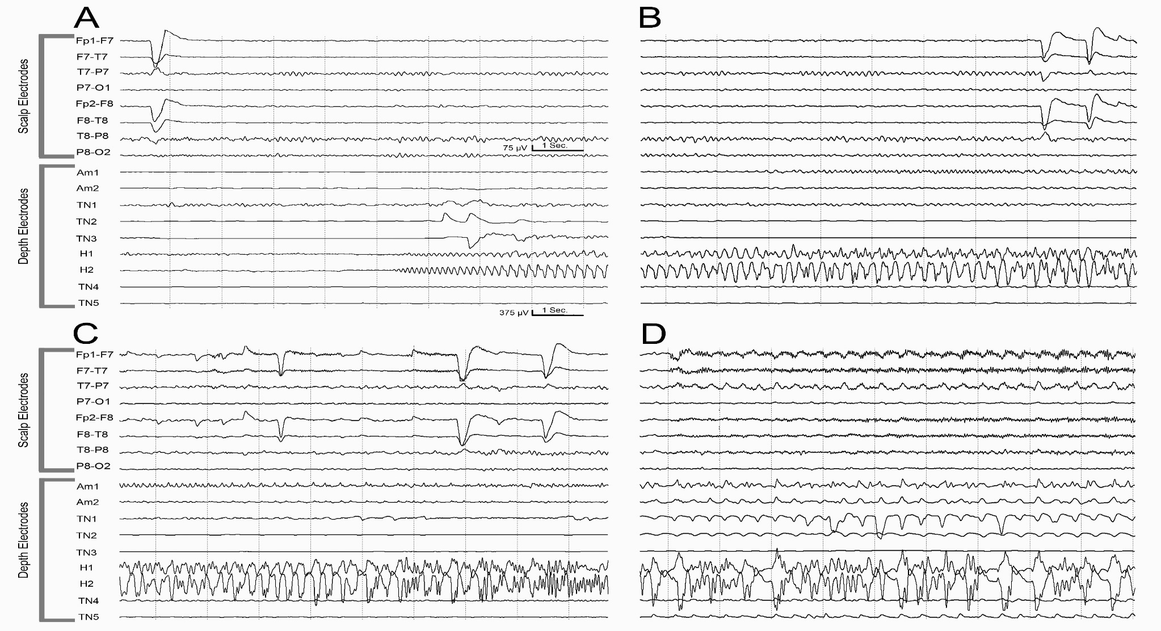
Notes:
Fig. 3: This patient is a 44 year-old woman with history of intractable epilepsy since age 19. Her seizures manifest an abdominal aura followed by alteration of awareness and oral automatisms, with infrequent secondary generalization. Her video-EEG monitoring with scalp electrodes captured habitual seizures that appeared to be of left temporal origin electrographically, but the ictal discharge occurred at least 20 seconds after the clinical onset. Since she had a normal brain MRI, invasive monitoring was recommended with depth electrodes in the left temporal lobe and other brain regions, including frontal, insular, and posterior cingulate regions. Simultaneous depth and scalp recordings confirmed ictal onset in the left hippocampus and explained the latency to the scalp EEG appearance. Seizure onset (A) in the hippocampus (H1, 2) was associated with normal tracings on scalp EEG. Seizure propagation (B) to the amygdala (AM1, 2), also did not result in clear changes on scalp EEG. Attenuation of the posterior basic rhythm (C) and some evolving rhythms started to manifest on the scalp EEG as the intracranial seizure discharge involved temporal neocortical (TN1) regions. Further synchronization of the ictal discharge over the temporal neocortex (TN 1-4) 30 seconds after seizure onset (D) resulted in a clear rhythmic ictal discharge over the scalp-recorded left temporal region.

Slide 41
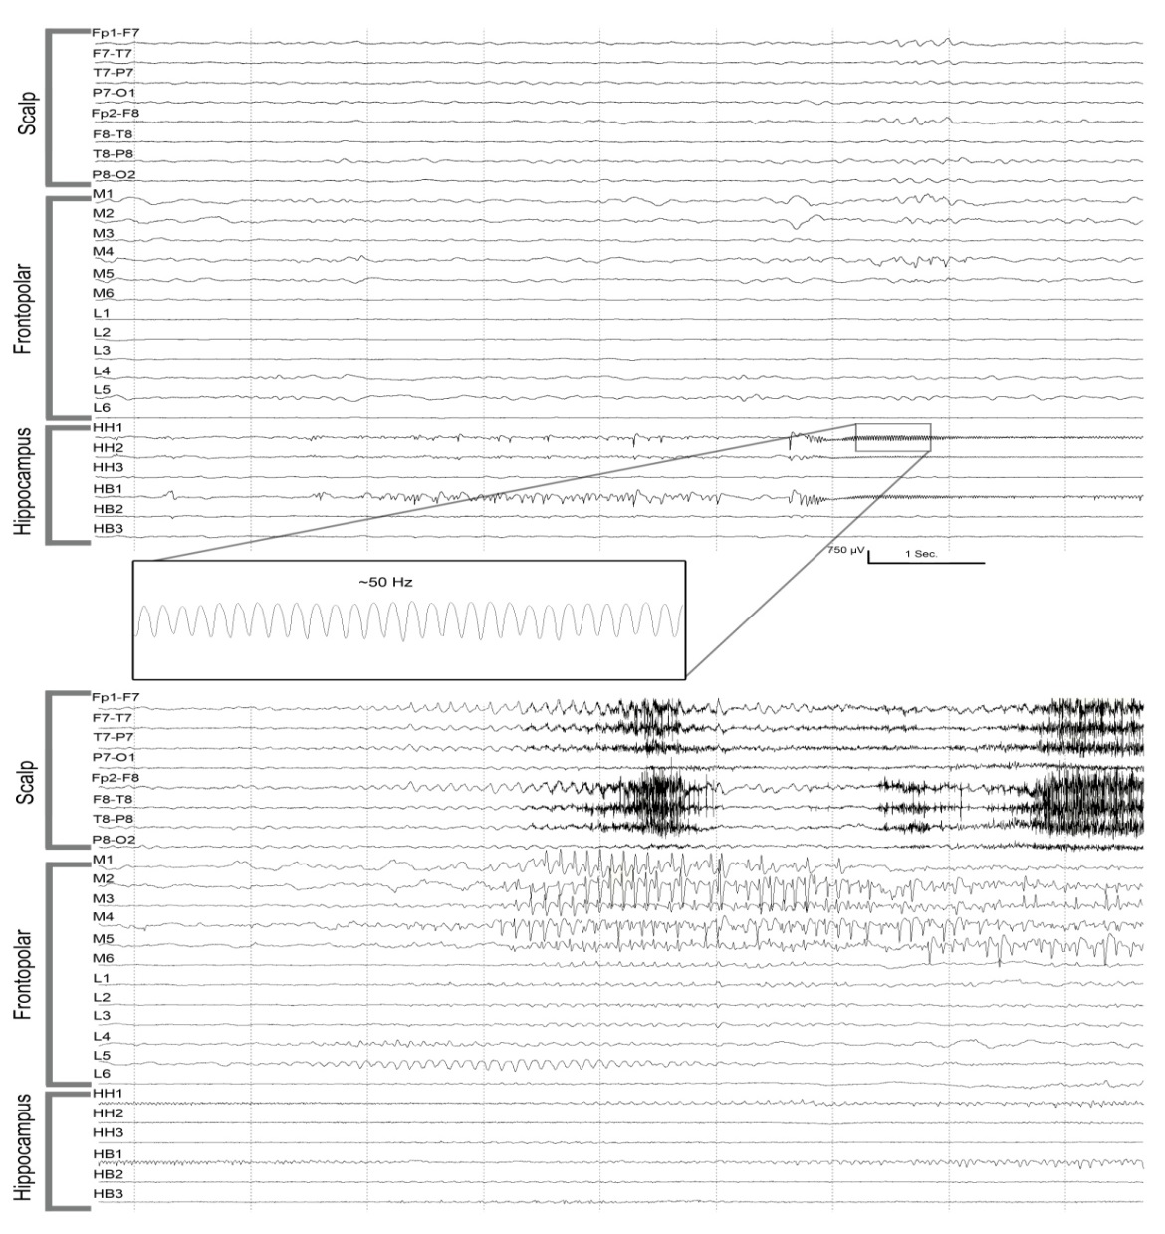
*
Notes:
Fig. 1: A 24-year-old man presented with history of intractable complex partial epilepsy since age 12. His risk factors include an episode of meningitis at age 7 years. Video-EEG monitoring with scalp electrodes suggested seizure onset in the left frontopolar region with later propagation to the left temporal region. Since his brain MRI revealed left hippocampal atrophy, invasive monitoring with depth electrodes was recommended. This figure shows his seizure onset in two consecutive EEG pages consisting of simultaneous scalp and depth electrode recordings. His seizure onset zone proved to be in the left hippocampus, with secondary spread to the left frontopolar region. The scalp recordings missed the initial high-frequency hippocampal discharge (inset), but showed a frontopolar ictal discharge only after seizure propagation to the frontal pole. M1-6 are medial frontopolar contacts, L1-6 are lateral frontopolar contacts, HH1-3 are in the head of the hippocampus, and HB1-2 are in the hippocampal body.

Slide 42
EEG in Extratemporal Epilepsy
In general, ETLE is less commonly associated with ictal discharges
A fast, beta-range ictal discharge may be more common
FLE tend to have abrupt hypermotor activity and rapid propagation
Only about half of FLE will have localizing EEG pattern
In 25% of FLE, ictal beta discharge is present: 90% of the patients becoming seizure-free
EEG of parietal lobe seizures often do not show localizing findings
Occipital lobe seizures may propagate to ipsilateral or contralateral temporal lobe
Notes:
A fast, beta-range ictal discharge may be more common in seizures of extra-temporal lobe origin than temporal lobe seizures, owing to the closer proximity of scalp electrodes to some extratemporal seizure foci. However, extratemporal lobe seizures in general are less likely to yield a clear ictal discharge than temporal lobe seizures {Williamson, 1985 #456}. Whereas temporal lobe seizures often have auras, slowly-developing automatisms, and postictal states, frontal lobe seizures tend to have abrupt hypermotor activity and rapid propagation with little or no auras or postictal confusion. These contribute to the decreased EEG yield in frontal lobe seizures {Palmini, 1993 #415}
Frontal lobe seizures have a myriad of clinical manifestations and are often poorly localized by scalp EEG {Williamson, 1985 #456}(seeFig. 14). Only about half of the complex focal seizures originating from the frontal lobe appear to show a clearly localizing EEG pattern, and many frontal lobe seizures are not associated with recognizable EEG change other than movement and muscle artifact {Laskowitz, 1995 #390}. However, the focal ictal beta discharge pattern at the onset of seizures is independently predictive of excellent outcome following lesional or nonlesional frontal lobe surgery, with 90% of the patients becoming seizure-free {Worrell, 2002 #471}. Only 25% of frontal lobe surgery patients have this type of discharge that could be visually detected without computer-aided power spectrum analysis of the EEG (see Fig. 15 A and B).
Parietal lobe seizures may be accompanied by sensory hallucinations and other phenomena. The sensations are commonly paresthesias, and rarely ictal pain. Extracranial EEG recordings of parietal lobe seizures often do not show localizing findings and complex focal seizures of parietal lobe origin may occur without clear scalp EEG correlate {Williamson, 1992 #455}.
Occipital lobe seizures are often associated with semiology that helps identify their site of origin, including elemental or complex visual hallucinations and other visual or eye movement phenomena such as eye deviation and blinking {Salanova, 1992 #427}. It is common for occipital lobe seizures or parietal lobe seizures to propagate to the ipsilateral temporal lobe, as well as to the contralateral temporal lobe (see Fig. 16). At that stage, the seizure signs and symptoms would include alteration of awareness and automatic behaviors typical of temporal lobe seizures. Propagation to the frontal lobe and the insula from occipital lobe foci has also been described, which may be associated with clonic or tonic activity. Scalp recordings of occipital seizures commonly show a clear focal ictal pattern over the occipital region..
Secondarily generalized seizures may evolve from complex focal seizures, which in turn may evolve from simple focal seizures. Scalp EEG of secondary generalized seizures is best distinguished from that of primary generalized seizures by their focal or lateralized onset, or focal or regional predominance of ictal discharges or postictal slowing.

Slide 43
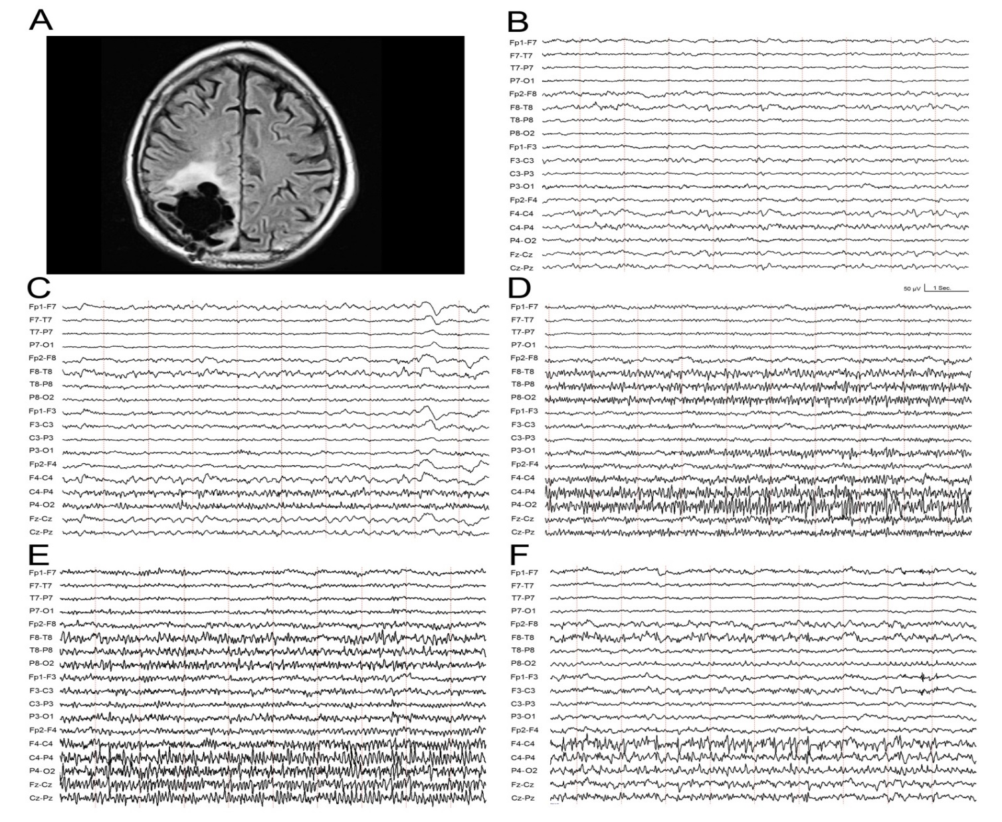
*
Notes:
Fig. 2: This EEG is from a 58 year-old man with a remote history of intracerebral hemorrhage that necessitated surgical evacuation and resulted in epileptic seizures. A fluid-attenuated inversion recovery MRI (A) shows the right parietal encephalomalacia. After years of seizure control, the patient presented with repetitive seizures manifesting as decreased responsiveness and left facial twitching. His electrographic seizure onset consisted of a low-voltage, alpha-range rhythmic discharge over P4 (B), which evolved in amplitude, frequency, morphology, and propagation within 30 seconds after seizure onset (C). Note the emergence of rhythmic activity in (C), specifically over Fz-Cz and F4-C4, denoting seizure propagation. (D) and (E) show seizure evolution 60 and 90 seconds after seizure onset, respectively, revealing further propagation within the right hemisphere, including the temporal region. Slowing and disorganization of the ictal discharge (F) approximately 120 seconds after seizure onset herald seizure offset.

Slide 44
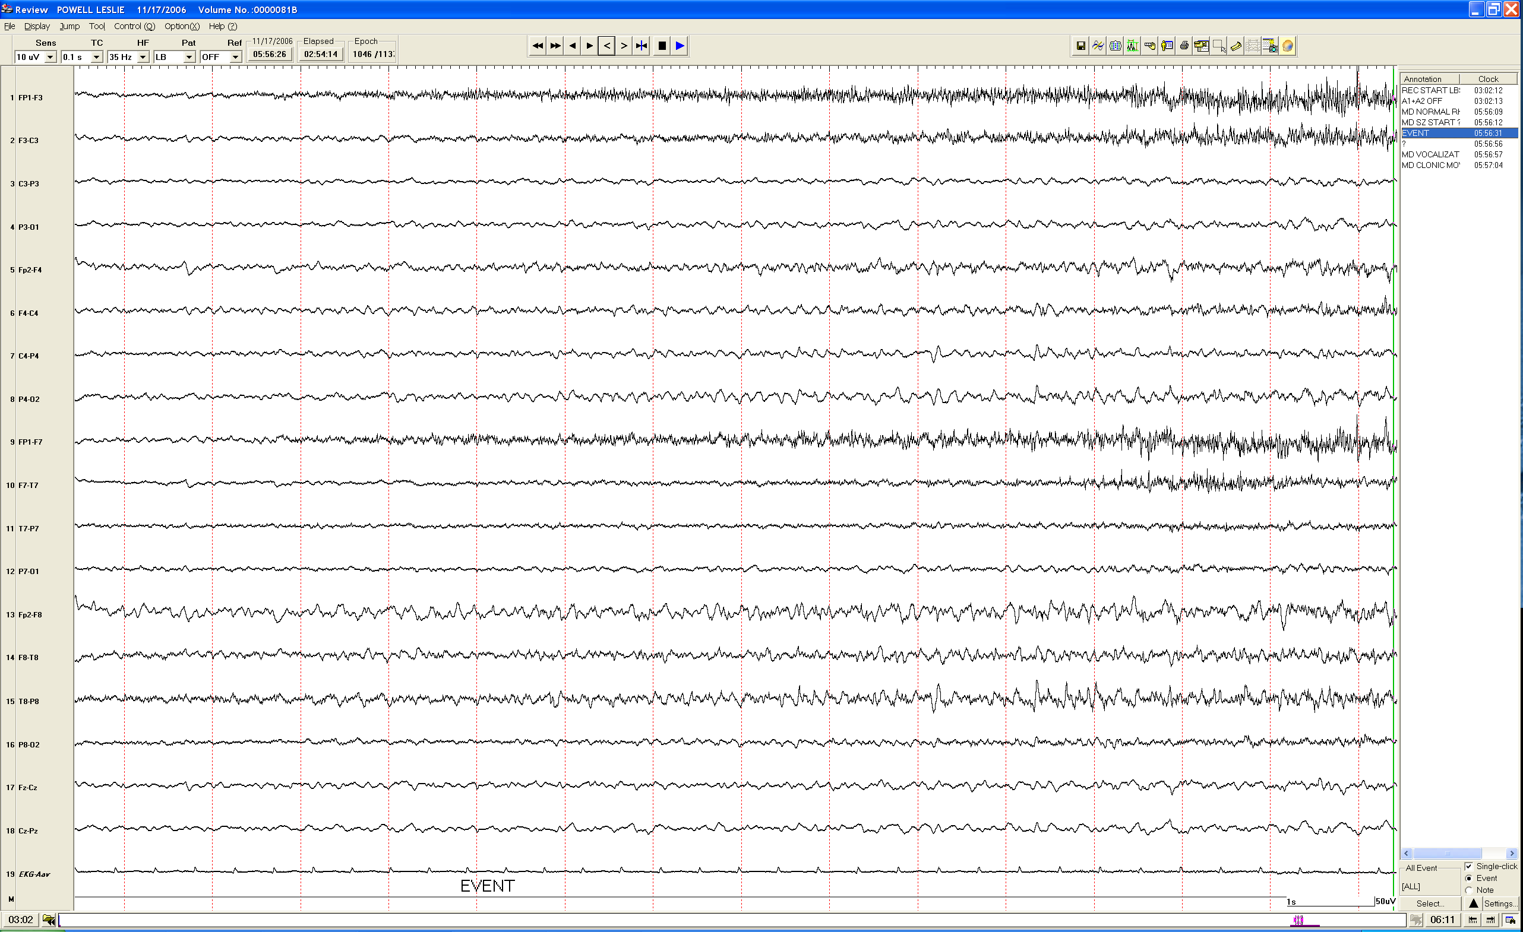
Fp1-F3
F3-C3
C3-P3
P3-O1
Fp2-F4
F4-C4
C4-P4
P4-O2
Fp1-F7
F7-T7
T7-P7
P7-O1
Fp2-F8
F8-T8
T8-P8
P8-O2
Fz-Cz
Cz-Pz
EKG
Push button event in a 28 year old woman with episodes of confusion and “weird thoughts”

Slide 45
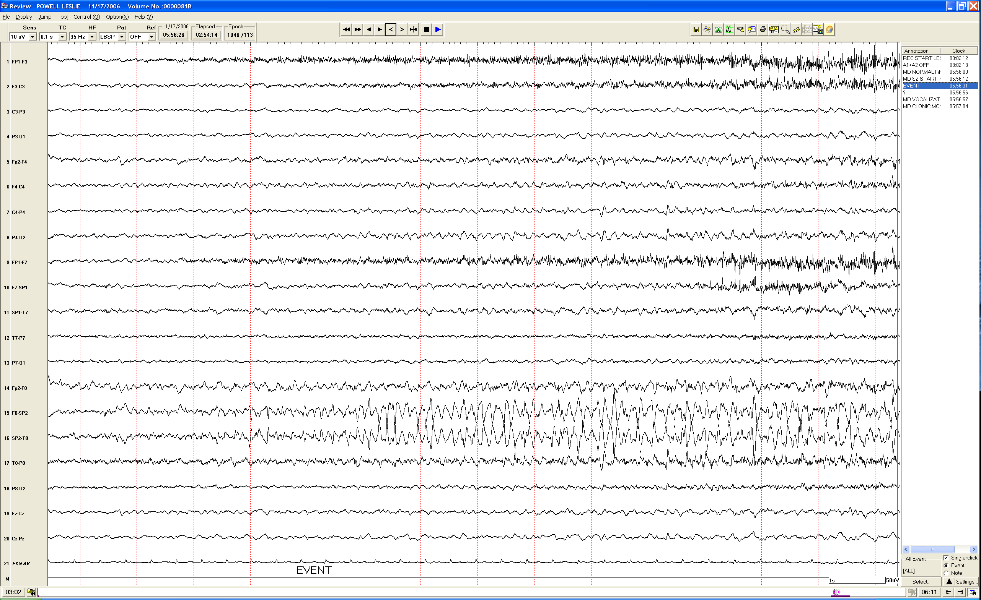
F8-Sp2
Sp2-T8
Same page with Sp2 included in montage

Slide 46
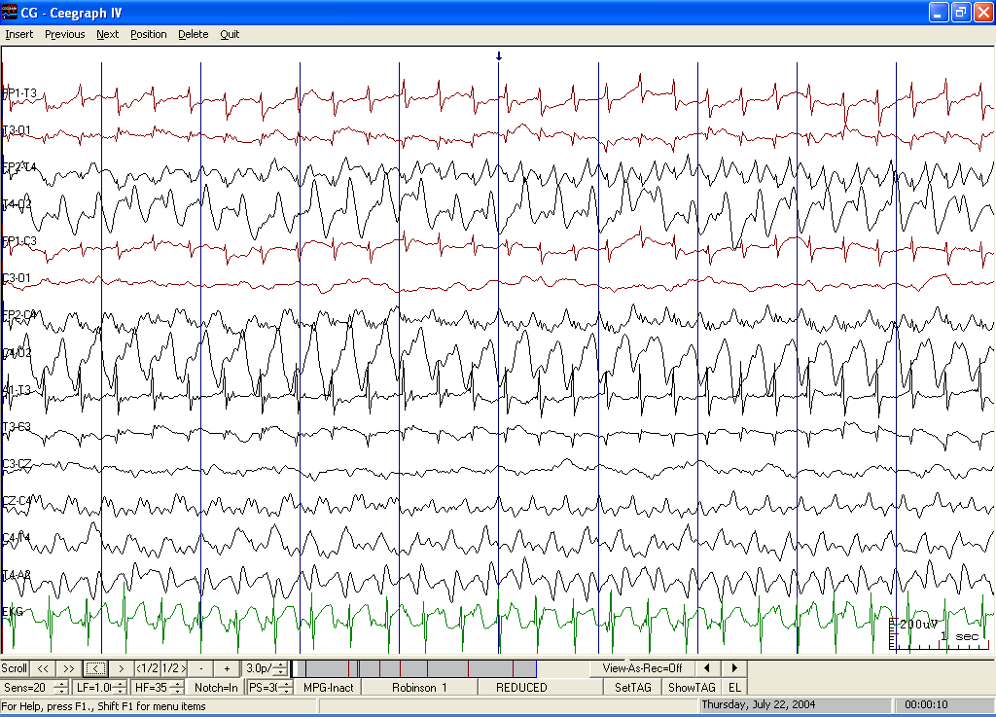
Fp1-T3
T3-O1
Fp2-T4
T4-O2
Fp1-C3
C3-O1
Fp2-C4
C4-O2
A1-T3
T3-C3
C3-Cz
Cz-C4
C4-T4
T4-A2
EKG
3 mo AAM with propionic acidemia, normal development, with 2 episodes of mouth twitching.
Notes:
NEITHER THE ACTIVITY ON THE LEFT NOR ON THE RIGHT IS AN EKG ARTIFACT. THE RATE OF THE ACTIVITY IS CLOSE TO THAT OF THE HEART BUT NOT IDENTICAL. THIS IS A RIGHT SIDED SEIZURE. THE LEFT ACTIVITY IS LIKELY AN ARTIFACT (POSSIBLY MUSCLE ARTIFACT SECONDARY TO CLINICAL SEIZURE ACTIVITY).
Referral Reason: ? seizure activity
Medications: Ativan,Dilantin
Technique: reduced array,asleep,international placement,bipolar+referental techniqe
Brief History: 3 mo AAM with propionic acidemia. Normal development,normal baseline neuro exam. Had two episodes of mouth movement. Slow activity - present bilaterally and symmetrically
OUTPATIENT THE RECORD SHOWED:
EPILEPTIFORM ACTIVITY: sharp waves - present in the cortical head regions on the right - 3 cps at onset, and about 7 cps at the end - high voltage activity - lasting about 2 minutes This was present at the start of the recording. The seizure appeared to begin just before the start of the record. The EEG pattern was accompanied by muscle artifact on the left. The repetition rate of the muscles artifact was slightly faster than that of the EKG.
ABNORMAL ACTIVITY: slow activity - present bilaterally - 2-5 cps - medium to high voltage activity - semirhythmical or irregular in appearance - continuous This could represent a post-ictal pattern. Throughout the balance of the recording, there were 4-6 second bursts of rhythmic 11-12 hz activity. This was more commonly on the right but at times occurred on the left, sometimes after activity occurred on the right. This could represent asymmetrically occurring spindles, but also could represent a subclinical epileptiform pattern.
SUMMARY: A markedly abnormal EEG because of: Sharp waves - present in the cortical head regions on the right
COMMENT: The EEG is consistent with the presence of a seizure disorder of focal origin. In addition, there is slowing of the EEG, which could be a post-ictal phenomenon alone. Further recording could help assess this, if clinically indicated.

Slide 47
Fp1-T3
T3-O1
Fp2-T4
T4-O2
Fp1-C3
C3-O1
Fp2-C4
C4-O2
A1-T3
T3-C3
C3-Cz
Cz-C4
C4-T4
T4-A2
EKG

Slide 48
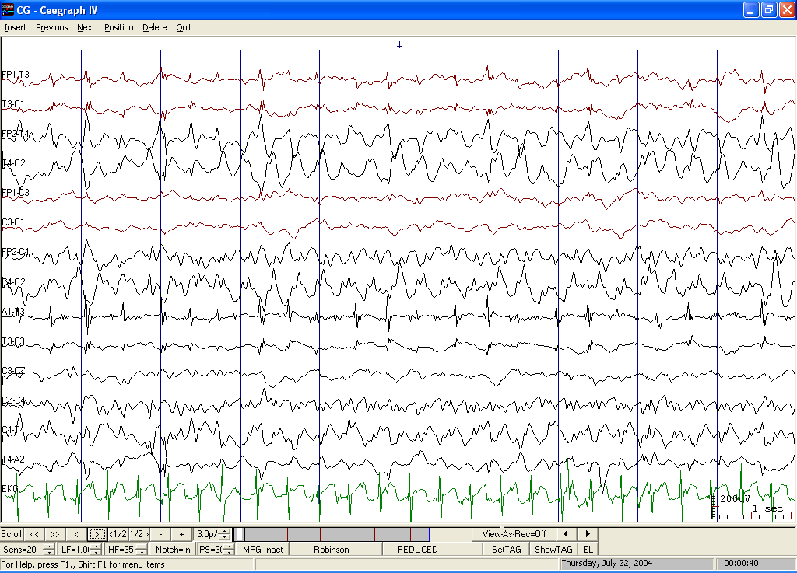
Fp1-T3
T3-O1
Fp2-T4
T4-O2
Fp1-C3
C3-O1
Fp2-C4
C4-O2
A1-T3
T3-C3
C3-Cz
Cz-C4
C4-T4
T4-A2
EKG
Notes:
SAME EEG AS PRECEDING ONE; 20 SECONDS LATER

Slide 49
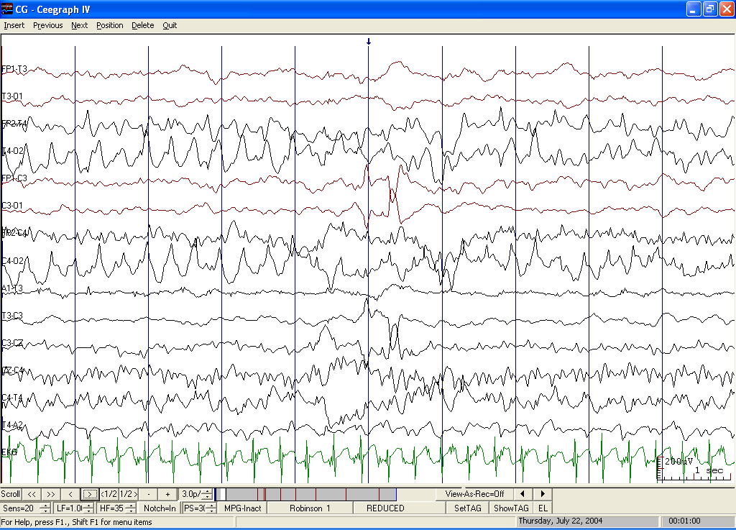
20 MORE SECONDS LATER
Notes:
20 MORE SECONDS LATER

Slide 50
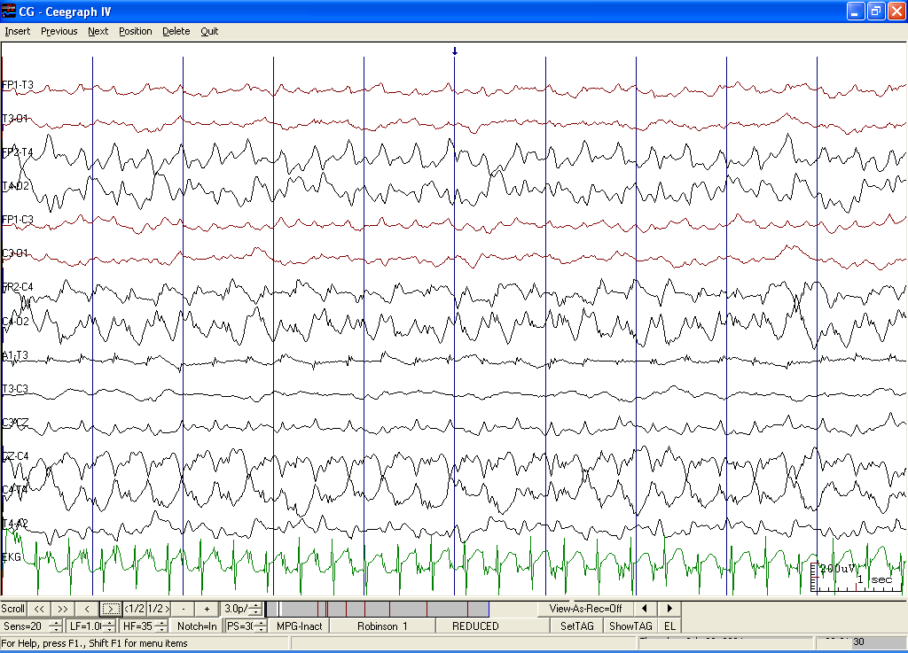
20 MORE SECONDS LATER
Notes:
20 MORE SECONDS LATER

Slide 51
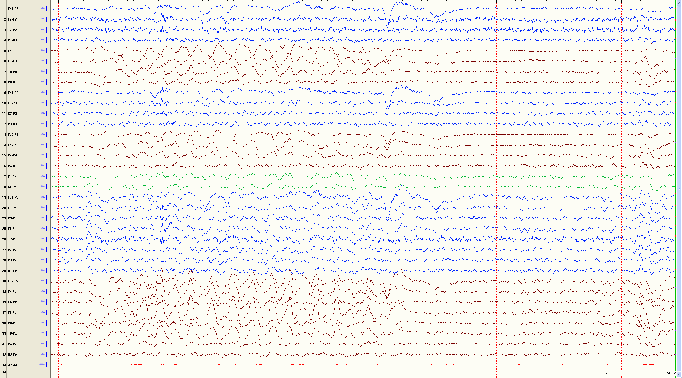
What’s under the panel?

Slide 52
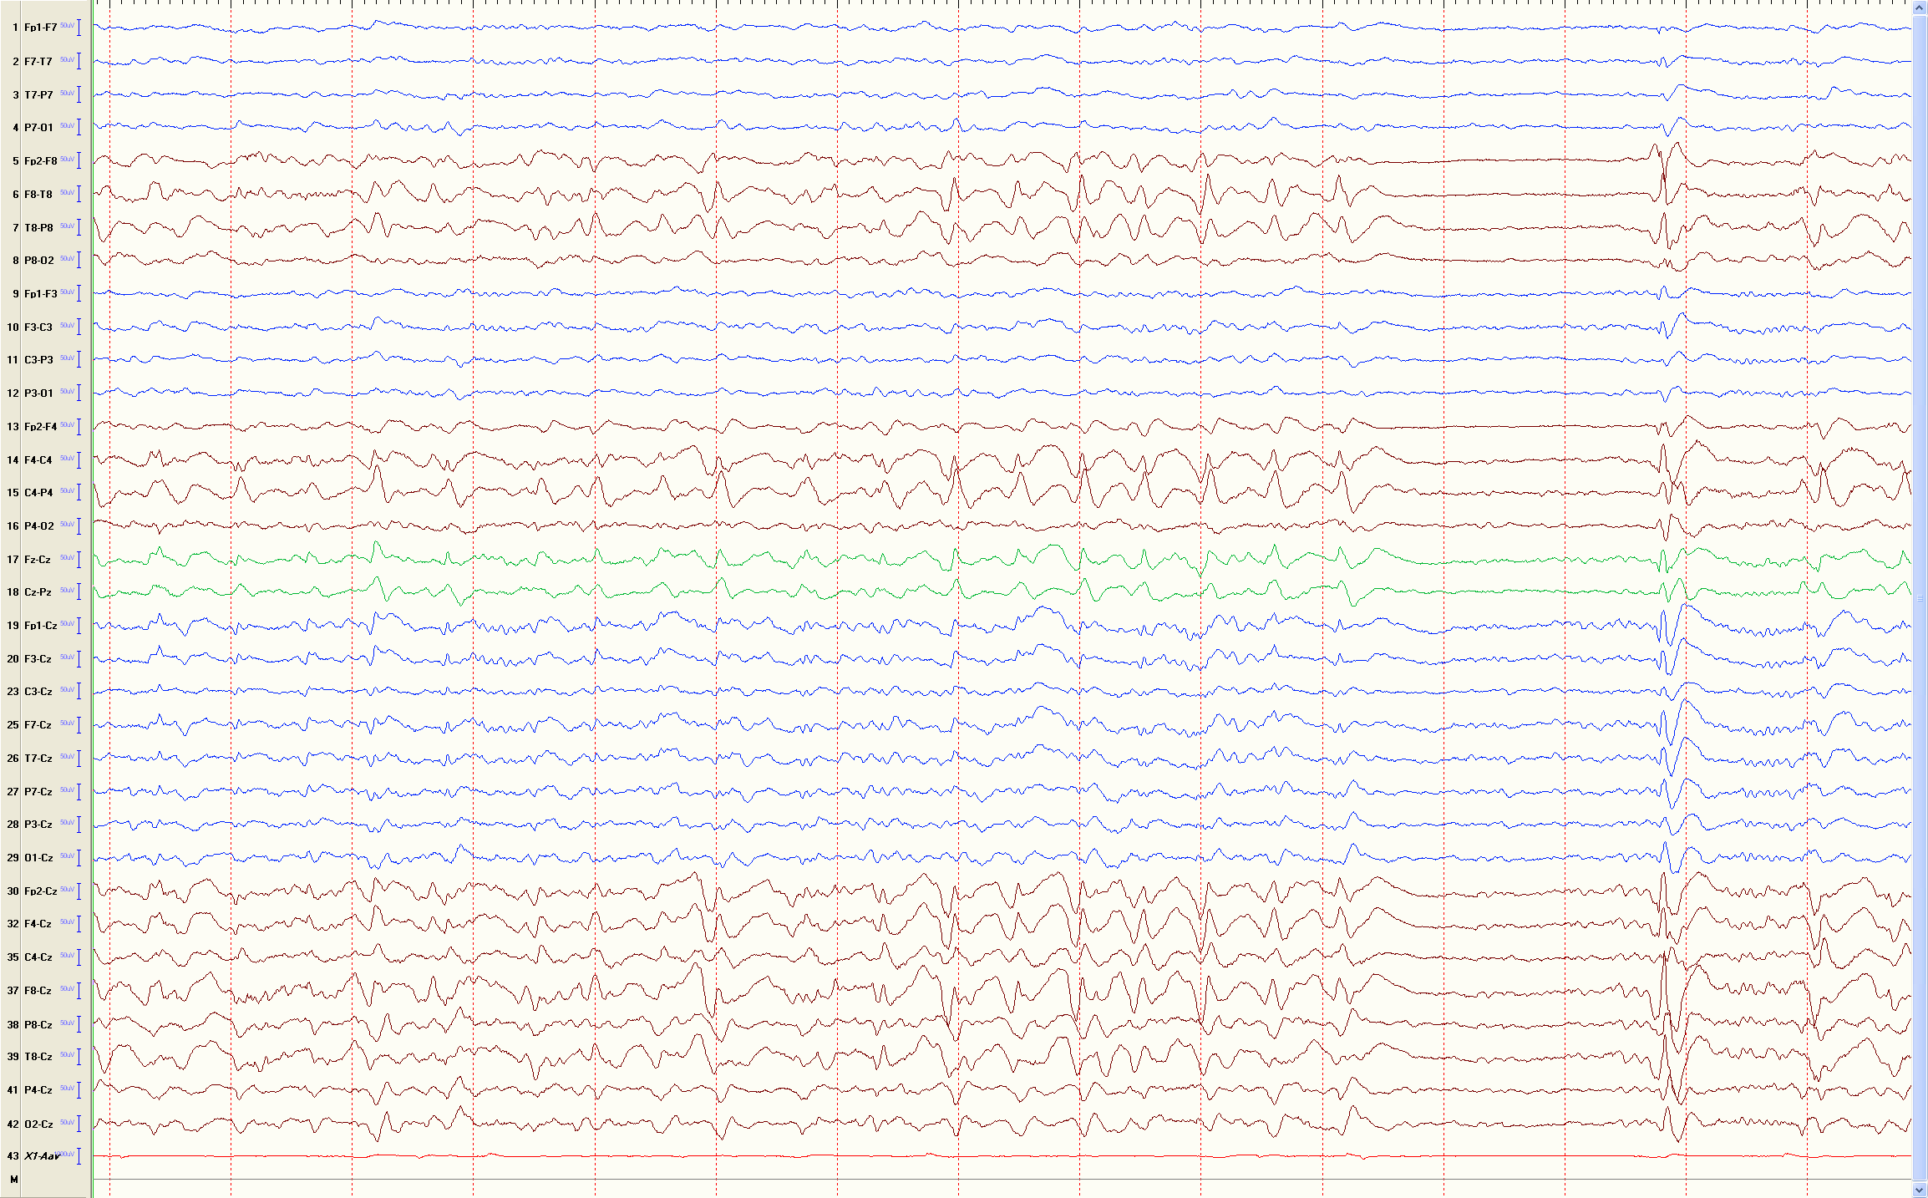
RH Seizure after Stroke

Slide 53
Generalized Epilepsy
Absence epilepsy:
  Discharges that last longer than 3 seconds will often have clinical correlates
  Abrupt onset and offset, with no postictal slowing
  Average frequency of 3 Hz, starting at approximately 3.5 Hz, and slowing down to 2.5 Hz
  Some ictal discharges may include polyspike components.
  Occasionally, the spikes may be more posteriorly prominent
Notes:
Absence epilepsy.
Absence seizures are often subtle in clinical manifestations and the distinction between interictal and ictal behavior may be difficult. Discharges that last longer than 3 seconds will often have clinical correlates. Testing the rapidity of motor or verbal responses may help assess the alteration of awareness in absence seizures. Browne et al. studied auditory reaction times and found them to be within normal limits immediately prior to the epileptic discharge {Browne, 1974 #334} However, less than half reaction times were normal at the start of the paroxysm, and only 4% of the reaction times were normal in the first second of the discharge. The term complex absence describes absence seizures with prominent automatisms {Panayiotopoulos, 1989 #417}.
The ictal discharge in absence seizures is typically of abrupt onset and offset, with no postictal slowing. Most patients with absence seizures are neurologically and cognitively intact and the EEG at baseline is within normal limits. The ictal pattern of childhood absence epilepsy consists of spike and slow wave complexes occurring at the average frequency of 3 Hz, starting at approximately 3.5 Hz, and slowing down to 2.5 Hz (see Fig. 5). Some ictal discharges may include polyspike components. Occasionally, the spikes may be more posteriorly prominent {Panayiotopoulos, 1989 #417}. Absence seizures in other epilepsy syndromes may show irregular spike-and-wave complexes, slow spike-and-wave activity, or generalized paroxysmal fast activity {Drury, 1993 #344}.
Juvenile myoclonic epilepsy (JME)
JME starts in teenage years and is marked by myoclonic seizures and generalized tonic-clonic seizures. The EEG often shows bursts of bilateral frontal-maximum polyspike-and-slow-wave discharge or in association with myoclonic jerks. The discharges within the burst have irregular morphology and frequency (see Fig. 17). Myoclonic jerks tend to occur shortly after arousal, and some occur during intermittent photic stimulation. Approximately one third of the patients will have a generalized photo-epileptiform discharges (photoparoxysmal response).
During myoclonic seizures, the EEG shows high voltage 10-16 Hz spike discharge, which may, at times, be preceded by irregular slow spike wave complexes (at 2-5 Hz) {Delgado-Escueta, 1984 #340}. Interestingly, some of the absence seizures seen in JME have an ictal discharge that consists of 3-Hz spike-and-slow waves, indistinguishable from other absence epilepsies. However, such discharges in JME may start as a rapid polyspike-and-wave activity before it slows down to 3 Hz. Panayiotopoulos and colleagues {Panayiotopoulos, 1989 #417} studied absence seizures in patients with JME by using continuous video-EEG monitoring. They found that the clinical seizure was often subtle, noticeable only if the patient was engaged in certain types of activities. Some EEG correlates of these seizures consisted of polyspike and wave complexes of irregular frequencies.
Generalized tonic-clonic seizures
Generalized polyspike and slow wave discharges may herald the tonic phase of the seizure. The tonic phase is associated with voltage attenuation with superimposed low voltage high frequency activity of 20-40 Hz. This pattern is often followed by generalized rhythms that gradually increase in amplitude while decreasing in frequency to approximately 10 Hz (i.e., the “epileptic recruiting rhythm”). This is followed by a slower pattern with intermittent slow wave discharges. Another early EEG change in generalized tonic-clonic seizures is that of paroxysmal fast activity at about 10 Hz that increases in voltage {Panayiotopoulos, 1989 #417}. This paroxysmal fast activity becomes intermixed with rhythmic slow activity after approximately 10 seconds, and the blend gives rise to polyspike-and-slow wave complexes. As the frequency of the slower rhythm reaches 4 Hz, the tonic muscle contractions start to give way to the clonic phase of the seizure. The clonic phase of the seizure consists of multiple spikes, each of which corresponds to a clonic jerk, whereas the slow wave that follows the spike corresponds to the muscle relaxation that follows the clonic jerk. The duration of postictal voltage attenuation is a function of seizure duration. After voltage attenuation, cerebral activity gradually returns, starting with some diffuse delta activity, which gradual increased in voltage and frequency until the normal background returns. The duration of the postictal phase varies, but it tends to be longer in younger children and after longer seizures.
Clonic-tonic-clonic seizures
Clonic-tonic-clonic seizures are often seen in individuals with genetic generalized epilepsy {Rubboli, 2009 #425}. The initial clonic jerks are associated with a diffuse 10-16 Hz spike discharge, which is followed by voltage attenuation with superimposed low-amplitude high frequency activity of 20 Hz or more during the tonic phase. During the second clonic phase, the EEG typically shows diffuse high voltage fast spikes interrupted by slow waves {Delgado-Escueta, 1984 #340}.
Generalized tonic-clonic seizures on awakening
Generalized tonic-clonic seizures on awakening represents a less common type of idiopathic generalized epilepsy, which semiologically have neither absence nor myoclonic jerks {Drury, 1993 #344}.These patients have generalized bursts of 3 Hz or faster polyspike-and-slow-wave discharges, which within each burst recur irregularly in morphology and frequency,

Slide 54
Generalized Epilepsy
Juvenile myoclonic epilepsy (JME):
  Bursts of bilateral frontal-maximum polyspike-and-slow-wave discharge
  Discharges may have irregular morphology and frequency
  Shortly after arousal or during photic stimulation
  One third of the patients will have a generalized photo-epileptiform discharges
  During myoclonic seizures, 10-16 Hz spike discharge
  Some absence seizures seen in JME have an ictal 3-Hz discharge
Notes:
Absence epilepsy.
Absence seizures are often subtle in clinical manifestations and the distinction between interictal and ictal behavior may be difficult. Discharges that last longer than 3 seconds will often have clinical correlates. Testing the rapidity of motor or verbal responses may help assess the alteration of awareness in absence seizures. Browne et al. studied auditory reaction times and found them to be within normal limits immediately prior to the epileptic discharge {Browne, 1974 #334} However, less than half reaction times were normal at the start of the paroxysm, and only 4% of the reaction times were normal in the first second of the discharge. The term complex absence describes absence seizures with prominent automatisms {Panayiotopoulos, 1989 #417}.
The ictal discharge in absence seizures is typically of abrupt onset and offset, with no postictal slowing. Most patients with absence seizures are neurologically and cognitively intact and the EEG at baseline is within normal limits. The ictal pattern of childhood absence epilepsy consists of spike and slow wave complexes occurring at the average frequency of 3 Hz, starting at approximately 3.5 Hz, and slowing down to 2.5 Hz (see Fig. 5). Some ictal discharges may include polyspike components. Occasionally, the spikes may be more posteriorly prominent {Panayiotopoulos, 1989 #417}. Absence seizures in other epilepsy syndromes may show irregular spike-and-wave complexes, slow spike-and-wave activity, or generalized paroxysmal fast activity {Drury, 1993 #344}.
Juvenile myoclonic epilepsy (JME)
JME starts in teenage years and is marked by myoclonic seizures and generalized tonic-clonic seizures. The EEG often shows bursts of bilateral frontal-maximum polyspike-and-slow-wave discharge or in association with myoclonic jerks. The discharges within the burst have irregular morphology and frequency (see Fig. 17). Myoclonic jerks tend to occur shortly after arousal, and some occur during intermittent photic stimulation. Approximately one third of the patients will have a generalized photo-epileptiform discharges (photoparoxysmal response).
During myoclonic seizures, the EEG shows high voltage 10-16 Hz spike discharge, which may, at times, be preceded by irregular slow spike wave complexes (at 2-5 Hz) {Delgado-Escueta, 1984 #340}. Interestingly, some of the absence seizures seen in JME have an ictal discharge that consists of 3-Hz spike-and-slow waves, indistinguishable from other absence epilepsies. However, such discharges in JME may start as a rapid polyspike-and-wave activity before it slows down to 3 Hz. Panayiotopoulos and colleagues {Panayiotopoulos, 1989 #417} studied absence seizures in patients with JME by using continuous video-EEG monitoring. They found that the clinical seizure was often subtle, noticeable only if the patient was engaged in certain types of activities. Some EEG correlates of these seizures consisted of polyspike and wave complexes of irregular frequencies.
Generalized tonic-clonic seizures
Generalized polyspike and slow wave discharges may herald the tonic phase of the seizure. The tonic phase is associated with voltage attenuation with superimposed low voltage high frequency activity of 20-40 Hz. This pattern is often followed by generalized rhythms that gradually increase in amplitude while decreasing in frequency to approximately 10 Hz (i.e., the “epileptic recruiting rhythm”). This is followed by a slower pattern with intermittent slow wave discharges. Another early EEG change in generalized tonic-clonic seizures is that of paroxysmal fast activity at about 10 Hz that increases in voltage {Panayiotopoulos, 1989 #417}. This paroxysmal fast activity becomes intermixed with rhythmic slow activity after approximately 10 seconds, and the blend gives rise to polyspike-and-slow wave complexes. As the frequency of the slower rhythm reaches 4 Hz, the tonic muscle contractions start to give way to the clonic phase of the seizure. The clonic phase of the seizure consists of multiple spikes, each of which corresponds to a clonic jerk, whereas the slow wave that follows the spike corresponds to the muscle relaxation that follows the clonic jerk. The duration of postictal voltage attenuation is a function of seizure duration. After voltage attenuation, cerebral activity gradually returns, starting with some diffuse delta activity, which gradual increased in voltage and frequency until the normal background returns. The duration of the postictal phase varies, but it tends to be longer in younger children and after longer seizures.
Clonic-tonic-clonic seizures
Clonic-tonic-clonic seizures are often seen in individuals with genetic generalized epilepsy {Rubboli, 2009 #425}. The initial clonic jerks are associated with a diffuse 10-16 Hz spike discharge, which is followed by voltage attenuation with superimposed low-amplitude high frequency activity of 20 Hz or more during the tonic phase. During the second clonic phase, the EEG typically shows diffuse high voltage fast spikes interrupted by slow waves {Delgado-Escueta, 1984 #340}.
Generalized tonic-clonic seizures on awakening
Generalized tonic-clonic seizures on awakening represents a less common type of idiopathic generalized epilepsy, which semiologically have neither absence nor myoclonic jerks {Drury, 1993 #344}.These patients have generalized bursts of 3 Hz or faster polyspike-and-slow-wave discharges, which within each burst recur irregularly in morphology and frequency,

Slide 55
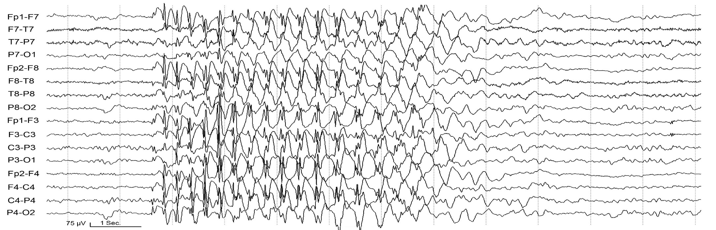
Notes:
Fig. 6: This is an 11 year-old boy presenting with an episode of loss of consciousness and falling to the ground with upper and lower extremity stiffening and jerking for 1-2 minutes. The episode occurred in the setting of sleep deprivation in the preceding night. While hyperventilating during the EEG recording, he had this episode which consisted of blank staring and behavioral arrest. He did not respond to calling his name, nor to the command to resume hyperventilation. The EEG showed 3-4 Hz generalized spike and slow waves lasting 5-6 seconds, eventually slowing to 2.5 Hz. After the seizure discharge abated, the patient responded and resumed the hyperventilation.

Slide 56
Conclusions
There is no evidence that the slower patterns result from propagation
Several patterns were associated with each pathology
All pathologies were associated with multiple SOPs
Polyspikes followed by LVFA was found only with MCD, but in only 20% of MCD
Impossible to assign a unique significance to any pattern
Notes:
Gotman: The study found several significant associations between SOPs and the different characteristics discussed above. What
is striking however, and is in agreement with earlier studies,2,4 is that there are practically no absolute “100%” results:

