Slide 1
MEDICATION ERRORS:
UNDERSTANDING THE CAUSES AND DESIGNING EFFECTIVE RISK MANAGEMENT STRATEGIES

Slide 2
Dr. shauna white executive director, board of pharmacy, department of health district of Columbia

Slide 3
COLLABORATORS
3

Slide 4
More resources available at:
https://dchealth.dc.gov/dcrx
4

Slide 5
Advisors
Donna Horn, MS, RPh, DPh, CHC
Ethics and Compliance Officer at Fresenius Medical Care, North America (FMCNA) supporting Fresenius Rx and Spectra Laboratories
Seth Krevat, MD
Assistant Vice President for Safety at MedStar Health’s National Center for Human Factors in Healthcare
Attending physician, Palliative Medicine, MedStar Georgetown University Hospital.
Misty Carney, B.S., PharmD., AAHIVP
Chief, Maryland AIDS Drug Assistance Program
Fadia Shaya, Ph.D., M.P.H.
Professor and Director of Informatics - University of Maryland School of Pharmacy
5

Slide 6
moderator
Fadia Shaya, Ph.D., M.P.H.
Professor and Director of Informatics - University of Maryland School of Pharmacy
6

Slide 7
Speakers
Allen J. Vaida PharmD, FASHP
Executive Vice President, Institute for Safe Medication Practices
Raj M. Ratwani, PHD
Vice President of Scientific Affairs, MedStar Health Research Institute
Associate Professor, Department of Emergency Medicine, Georgetown University School of Medicine
Center Director, National Center for Human Factors in Healthcare, MedStar Health
7

Slide 8
Discussion panel
Eileen R. Langstraat, Pharm.D., BCPS, CPPS
Medication and Patient Safety Coordinator - Kaiser Permanente
Georgia Z. Lewis, MSN, RN, CPNP-PC
Pediatric Nurse Practitioner - Signature Health
Marybeth Kazanas, PharmD, BCPS, LSSGB
System Director, Clinical Pharmacy Services - MedStar Health
8

Slide 9
overview
The purpose of this module is to engage health care providers (prescribers), pharmacists, and other health care professionals in evidence based practices to avoid medication errors and enhance patient safety. Successful attainment of knowledge by the learner will enable improved awareness and lead to changes in clinical practice measures to overcome common causes of medication errors.
9

Slide 10
Learning objectives
Upon completing the module the learner should be able to :
Establish an understanding of contributing factors and epidemiology of medication-related patient safety events
A discussion on current research on causality (root cause analysis) and human factors design features to mitigate them
A review of best practice approaches in reducing errors in the inpatient and ambulatory setting (clinic and pharmacy)
Identify systems level innovations in risk management strategies that can be used to minimize or prevent medication errors and equip professionals to manage the consequences when they occur
10

Slide 11
Current Safety Challenges with Medications in the Inpatient and Ambulatory Settings
Allen J Vaida, BSc, PharmD
Executive Vice President, Institute for Safe Medication Practices

Slide 12
Disclosure
Allen Vaida declares no conflicts of interest, real or apparent, and no financial interests in any company, product, or service mentioned in this program, including grants, employment, gifts, stock holdings, and honoraria.

Slide 13
Institute for Safe Medication Practices
Not-for-profit medication safety organization affiliated with ECRI
Operates a National Medication Errors Reporting Program for practitioners and consumers www.ismp.org
Follows up with reporters, manufacturers, FDA, and network of practitioners
Analyzes errors and reports on recommendations for prevention
Publishes recommendations

Slide 14
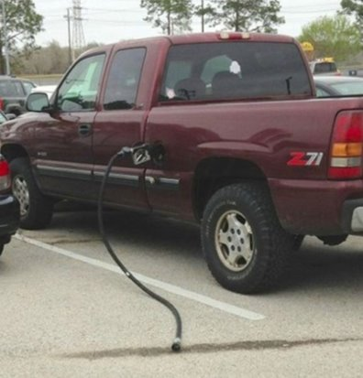
Assumptions
To Err is Human
Healthcare is complex and inherently risky
Medication errors are multifactorial
Focus should be on fixing the complex medication use systems in which we work
Error prevention is proactive and involves planning and ongoing effort

Slide 15
Capturing Errors and Analyzing Them
Voluntary reporting programs
Information from technology (infusion pumps, bar coding, EHR, electronic prescribing and pharmacy systems)
Focused reporting (triggers, specific medications)
Surveillance systems (AI)
Most important is using internal and external information

Slide 16
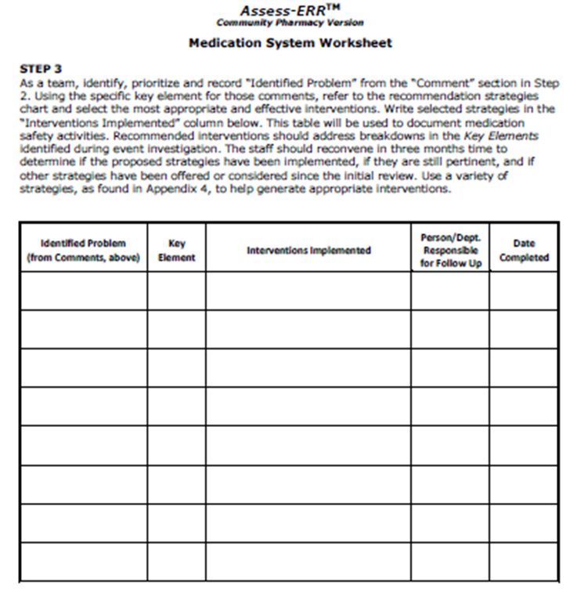
Assess-ERR™ Medication Error Worksheet https://www.ismp.org/resources/assess-err-worksheets

Slide 17
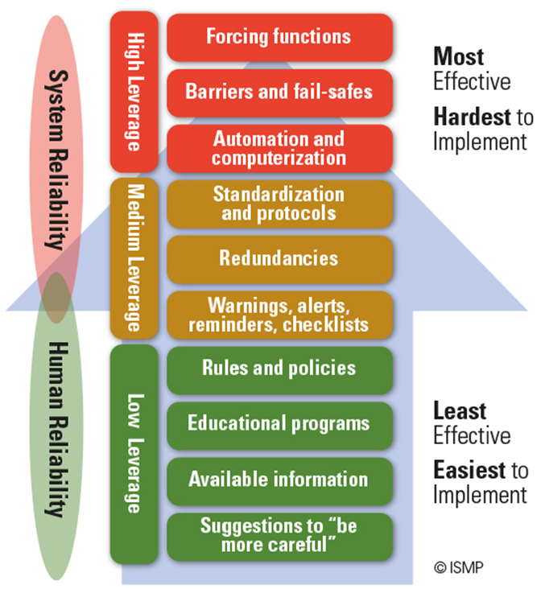
Hierarchy of Risk-Reduction Strategies
High-leverage strategies
Design out hazards
Medium-leverage strategies
Need periodic updating and reinforcement
Low-leverage strategies
Aim to improve human performance

Slide 18
Current Trends on Errors Reported to ISMP
Electronic prescribing systems without adequate safeguards
Similar named medication mix-ups - labeling of medication
Methotrexate for non-oncologic use given more than once a week
Wrong patient
Vaccine related errors

Slide 19
Name Confusion
Patient had been prescribed sulfasalazine 500 mg for rheumatoid arthritis. Her outpatient pharmacy began dispensing sulfadiazine 500 mg 6 times daily instead. She continued to fill sulfadiazine monthly. She presented to the ED with kidney stones.
Recurrent reports on mix-ups between dexamethasone and dexmedetomidine; Methylphenidate 10 mg and Methadone 10 mg
Tramadol was dispensed in place of Trazodone
Continued mix-ups between hydralazine 50 mg and hydroxyzine 50 mg
Wrong prescribing and dispensing errors with metolazone and methotrexate and methimazole (caused by entering “met” while ordering)

Slide 20
Using Only 3 Letters for Drug Look-up

Slide 21
Safeguarding for Name Mix-Ups
Provide indications on prescriptions, communicate with prescriber if unsure, counsel patients on all new prescriptions
New AI software becoming available that will ‘tag’ medications to disease states
Set up electronic systems (prescribing, pharmacy), dispensing cabinets in hospital clinics, long term care to require 4 to 5 characters.
Visually differentiate look-alike drug names (e.g., use of TALL MAN LETTERS with bolding, highlighting) in the pharmacy computer system
Counsel patients on all new prescriptions

Slide 22
SURVEY Question
Patient had been prescribed sulfasalazine 500 mg for rheumatoid arthritis. Her outpatient pharmacy began dispensing sulfadiazine 500 mg 6 times daily instead. She continued to fill sulfadiazine monthly. She presented to the ED with kidney stones.
A higher-level strategy to help prevent drug name mix-ups is:
Incorporate an alert in prescriber and dispensing systems for all reported name mix-ups
Keep a chart of frequently confused drug names at computer terminals in the pharmacy
Include the indication on prescriptions

Slide 23
SURVEY Question
Patient had been prescribed sulfasalazine 500 mg for rheumatoid arthritis. Her outpatient pharmacy began dispensing sulfadiazine 500 mg 6 times daily instead. She continued to fill sulfadiazine monthly. She presented to the ED with kidney stones.
A higher-level strategy to help prevent drug name mix-ups is:
Incorporate an alert in prescriber and dispensing systems for all reported name mix-ups
Keep a chart of frequently confused drug names at computer terminals in the pharmacy
Include the indication on prescriptions
Answer: C. Most similar drug names are for different indications.

Slide 24
Fatal Methotrexate Errors
Analysis of inadvertent daily methotrexate administration over 18 months between 2018 and 2019¹
~50% involved older patients who were confused about the frequency of administration
50% were made by healthcare providers who inadvertently prescribed, labeled, or dispensed methotrexate daily when weekly was intended.
FDA sponsored study suggests that up to 4 per 1,000 patients may mistakenly take the drug daily instead of weekly²
Suggests the number of dose frequency errors could be far greater
ISMP. QuarterWatch. 2019 Dec 4. www.ismp.org/resources/scope-injury-therapeutic-drugs
Herrinton LJ, et al. Pharmacoepidemiol Drug Saf. 2019;28[10]:1361-8

Slide 25
FDA Updates Product Labeling
ISMP has received numerous reports of fatal errors when methotrexate is inadvertently taken daily instead of weekly. For example, a patient misunderstood the directions on their prescription label and took methotrexate 2.5 mg every 12 hours over several consecutive days, instead of every 12 hours for 3 doses each week. FDA has updated the product labeling and removed the option to administer weekly doses in divided doses given every 12 hours for 3 doses.
Inform all appropriate clinical staff in your organization about this change. Make sure any printed information you give to patients reflects this change.

Slide 26
Strategies – Technology
Use a weekly dosage regimen default for oral methotrexate in electronic systems when medication orders are entered
For both prescriber and pharmacy systems
Require a hard stop verification of an appropriate oncologic indication for all daily oral methotrexate orders
Health systems may need to work with their software vendors and information technology departments to ensure that this hard stop is available
ISMP. ISMP Targeted Medication Safety Best Practices for Hospitals; 2020. www.ismp.org/guidelines/best-practices-hospitals.

Slide 27
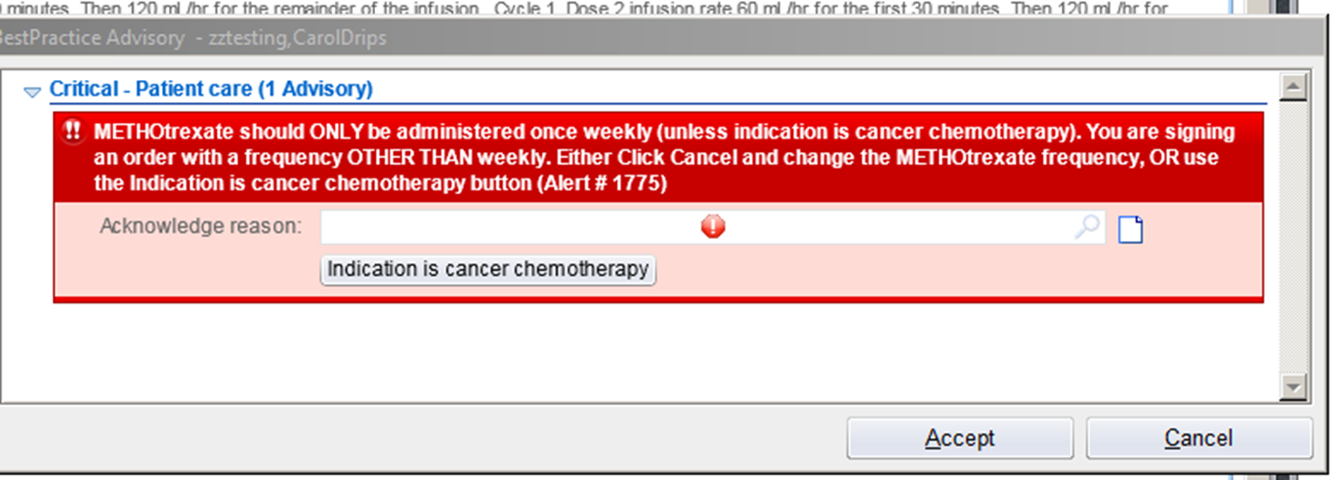
Case Report
Patient was prescribed, via telephone, metolazone 2.5 mg daily. Pharmacy technician accidentally selected methotrexate 2.5 mg daily by searching using the first three letters of the drug name and the strength. Patient took methotrexate daily and died less than a month later.
No hard stop to verify an appropriate oncologic indication

Slide 28
Other Strategies
Dispense only a 4-week supply of methotrexate at a time
Create a forcing function (using technology) to provide patient education
Every (new and refill) oral methotrexate prescription is reviewed with the patient
Use teach-back method to provide patient education
Education should be mandatory
Consider using ISMP’s free methotrexate learning guide for consumers (https://consumermedsafety.org/medication-safety-articles/item/847-teaching-sheets)

Slide 29
SURVEY Question
Using the rank order or error reduction strategies, which may be the most effective for the previous case?
Use a weekly dosage regimen default for oral methotrexate in electronic systems, both prescriber and pharmacy systems, when medication orders are entered.
Have another individual check your prescription before sending it
Require a hard stop verification of an appropriate oncologic indication for all daily oral methotrexate orders
A and C

Slide 30
SURVEY Question
Using the rank order or error reduction strategies, which may be the most effective for the previous case?
Use a weekly dosage regimen default for oral methotrexate in electronic systems, both prescriber and pharmacy systems, when medication orders are entered.
Have another individual check your prescription before sending it
Require a hard stop verification of an appropriate oncologic indication for all daily oral methotrexate orders
A and C
Answer: D. A hard stop verification in electronic system is the best strategy. Using a weekly default is also a high-level strategy although the default may not be corrected if the medication is for oncologic use. A double check may help but is not as effective.

Slide 31
Wrong-Patient Errors
Giving a correctly dispensed prescription to the wrong patient is a common error
Most common complaint received through the ISMP National Consumer Medication Errors Reporting Program
Roughly a quarter of the events ISMP has received involve patients ingesting the wrong medication
This error happens about once for every 1,000 prescriptions dispensed
Cohen MR, Smetzer JL, Westphal JE, et al. Risk models to improve safety of dispensing high-alert medications in community pharmacies. J Am Pharm Assoc. 2012;52(5):584-602.

Slide 32
How Wrong Patient Errors Occur
Same family members (Jr, Sr)
Inconsistent use of at least two patient identifiers
“Is your name” versus “give me your name”
Similar or same names – same birth dates
Mail order – pharmacies across states –
Not checking the bag at the pharmacy

Slide 33
Addressing WRONG PATIENT ERRORS
Use of at least two patient identifiers – hard stops in systems that must be verified
Patient armbands and barcoding whenever feasible
Mandatory patient counseling at the pharmacy

Slide 34
ISMP Vaccine Error Reporting Program
January 2017 through December 2018
Total of 1,143 vaccine error reports
87.8% of errors reached patients
Most errors occurred in Medical clinics (36.5%) and Physician practices (24.4%)
About 1.4% of reports involved clusters of events. That is the same event happening to multiple individuals at the same location
Wrong vaccine (24.2%) and wrong age (17.4%) were the most common error types

Slide 36
Vaccine Type Errors
Administering a vaccine earlier than recommended
Wrong diluent or diluent alone
Confusion between DTaP (children) and Tdap (adults)
9 other cases where insulin was given to multiple patients instead of influenza vaccine (or something else)
Indianapolis school officials say 16 students were hospitalized as a precaution after they were mistakenly injected with insulin during a tuberculosis skin test. The Metropolitan School District of Lawrence Township says the students from the McKenzie Center for Innovation & Technology were taken to local hospitals Monday for observation after being injected with a "small dosage" of insulin by Community Health Network personnel.

Slide 37
Storage of Vaccines
Plan for combined storage of single component vaccines and any associated diluents, and two-component vaccines, during onsite and offsite immunization activities.
Vaccine vials and syringes should be separated into bins or other containers according to vaccine type and formulation, and never stored together.
Adult and pediatric formulations of the same vaccine should be separated.
Vaccines with similar names or abbreviations, or overlapping components (e.g., DTaP, DT, Tdap, Td) should not be stored in bins or containers next to each other.

Slide 38
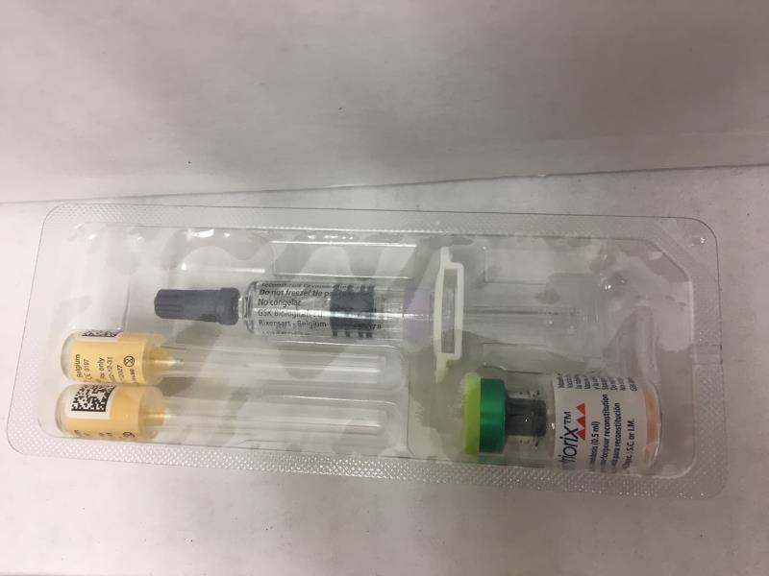

Slide 39
Preventing Vaccine Errors
Use commercially available ready to administer syringes
Implement barcode scanning
Labeling of all drawn up syringes
Standardized charting process
Utilize patient or caregiver as second check
https://ismp.org/sites/default/files/attachments/2018-07/Teaching-table-corrected.pdf

Slide 40
SURVEY Question
What are practices on preventing medication errors you can incorporate in your practice setting?
Share errors that occur with all staff members for the purpose of learning
Review external information (e.g., FDA, ISMP, journals) on reported errors for process improvement projects
Start with the most high-leverage error reduction strategies
All the above

Slide 41
SURVEY Question
What are practices on preventing medication errors you can incorporate in your practice setting?
Share errors that occur with all staff members for the purpose of learning
Review external information (e.g., FDA, ISMP, journals) on reported errors for process improvement projects
Start with the most high-leverage error reduction strategies
All the above
Answer: D. Error prevention is a multifactorial process. Utilize information from externally reported errors in the literature to implement safeguards in your practice. Use the Hierarchy of Risk-Reduction Strategies chart and remember that more than one strategy is most often layered to achieve success.

Slide 42
References
E. A. Flynn, K. N. Barker, B A. Berger, et al. Dispensing errors and counseling quality in 100 pharmacies. J Am Pharm Assoc. 2009;49:171–180.
C Cheung K-C, van, der Veen W, Bouvy ML, et al. Classification of medication incidents associated with information technology. J Am Med Inform Assoc 2014;21:e63–e70.
A Salazar, SJ Karmiy, KJ Forsythe, et al. How often do prescribers include indications in drug orders? Analysis of 4 million outpatient prescriptions. Am J Health-Syst Pharm. 2019; 76:970-979
K Aldhwaihi, F Schifano, C Pezzolesi, etal. A systematic review of the nature of dispensing errors in hospital pharmacies. Integrated Pharmacy Research and Practice 2016:5 1–10
Hickman T-TT, Quist AJL, Salazar A, et al. Outpatient CPOE orders discontinued due to ‘erroneous entry’: prospective survey of prescribers’ explanations for errors. BMJ Qual Saf 2018;27:293–298.
Abraham J, Kannampallil TG, Jarman A, et al. Reasons for computerized provider order entry (CPOE)-based inpatient medication ordering errors: an observational study of voided orders. BMJ Qual Saf 2018;27:299–307.

Slide 43
A Human Factors Approach to Medication Safety
Raj Ratwani, PhD
Center Director, MedStar Health National Center for Human Factors in Healthcare
Associate Professor of Emergency of Medicine, Georgetown University School Medicine
@RajRatwani
@MedicalHFE

Slide 44
Disclosures
Research is supported by the Agency for Healthcare Research and Quality (AHRQ), National Library of Medicine (NLM), and the Office of National Coordinator for Health Information Technology (ONC)

Slide 45
What is Human Factors?
Designing systems, devices, software, and tools to fit human capabilities and limitations
Using methods to gather unique information on:
Hidden needs of the end-user
Unexpected interactions between the system and the end-user
Creating deliberate design to promote safe, efficient, effective, and timely clinical care by:
Making it easier to do the right thing
Making it harder to do the wrong thing
Notes:
Broadening the lens, human factors is all about fitting human capabilities.
This sometimes means gathering information that is hidden even from the end-user
This also means designing to promote safety, efficiency, effectiveness, and timeliness.

Slide 46
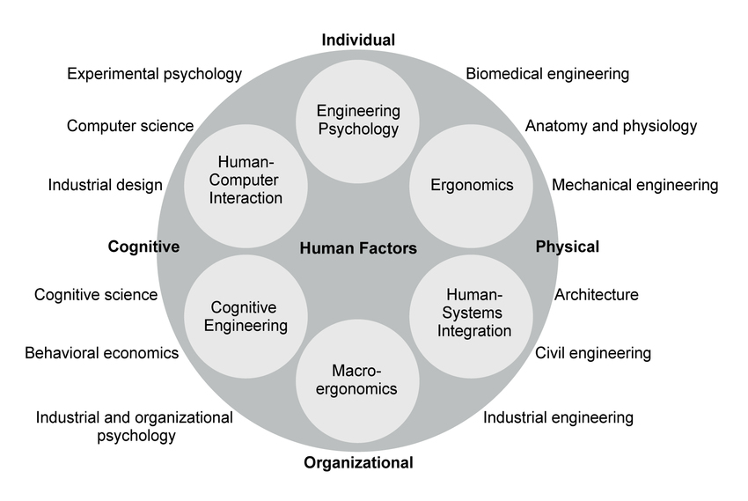

Slide 47
Focus on System Factors
Technology
Medical devices
EHRs
Apps and sensors
Person
Perception
Reasoning
Action
Tasks
Procedures
Workflows
Workarounds
Organization
Policies
Culture
Commitment
Environment
Interruptions
Noise /distraction
Design

Slide 48
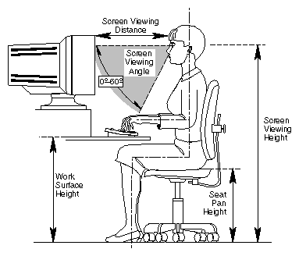
Central Tenet of Human Factors
“We don’t redesign humans;
We redesign the system within which humans work”

Slide 49
Survey question
A human factors approach focuses on:
A. Blaming individuals for the mistakes they make.
B. Ignoring work system factors and hoping for the best.
C. Identifying system factors that contribute to errors.
D. Blaming leadership for a poor work culture.

Slide 50
Survey question
A human factors approach focuses on:
A. Blaming individuals for the mistakes they make.
B. Ignoring work system factors and hoping for the best.
C. Identifying system factors that contribute to errors.
D. Blaming leadership for a poor work culture.
Answer: C

Slide 51
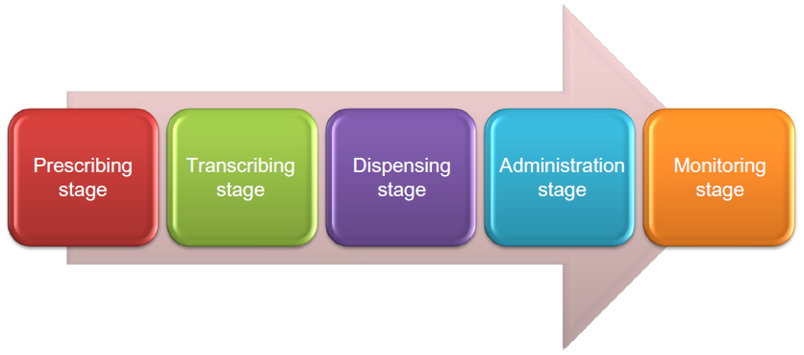
Human Factors and Medication Safety
System Factor | Medication Specific Elements
Person | Memory, Fatigue, Perceptual confusion
Technology | CPOE, Dispensing machines, EMAR, BCMA
Environment | Distractions, Interruptions, Stress
Tasks | Multi-tasking, Fragmented tasks, Workarounds
Organization | Unclear policies, Unsupportive & poor safety culture

Slide 52
Examples

Slide 53
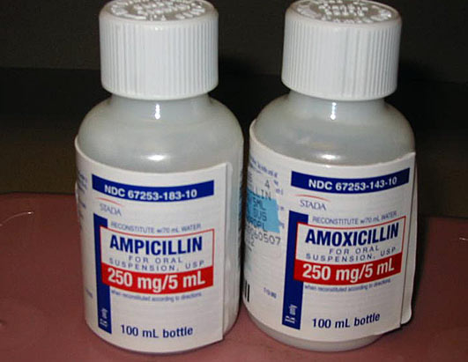
Palese be as cerfaul as pisobsle as you raed tihs!
Notes:
Bottles are the same, dosages are the same, look alike/sound alike drugs.

Slide 54
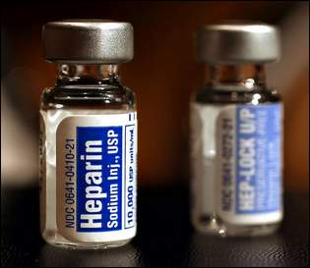
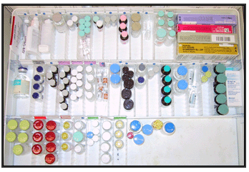
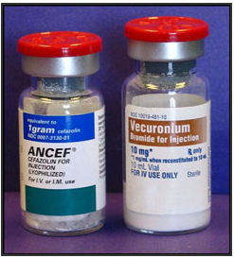
ISSUE: WRONG MEDICATIONS SELECTED FROM CARTS, DISPENSING MACHINES,ETC
System Factors: Person, environment, task
Human factors solutions: minimize chances for perceptual confusion
Create distinct labels and tops
Organize by use
54

Slide 55
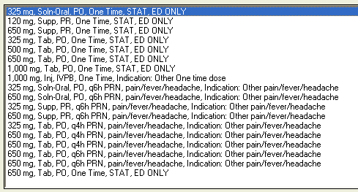
Issue: Wrong med, route, dose selected from the EHR
System Factors: Technology, Person, Environment, Task
Human factors solutions: remove irrelevant items, increase readability

Slide 56
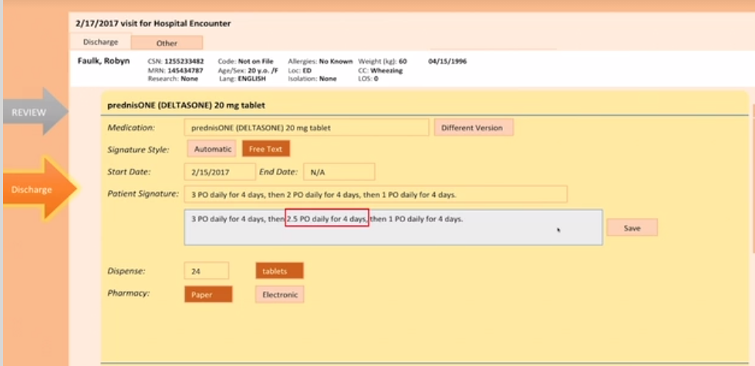
Issue: Challenges with taper orders
EHR Function | Usability & Safety Metrics | Vendor A- Site 1 | Vendor A- Site 2 | Vendor B- Site 3 | Vendor B- Site 4
Prednisone Taper (60mg, reduce by 10mg every 2 days for 12 days) | Time (sec) | 148.6 | 152.7 | 175.1 | 178.7
 | Clicks | 34.9 | 20 | 42.3 | 28.2
 | Error Rate | 16.7% | 41.7% | 50% | 40%
System Factors: Technology, Task, Person
Human factors solutions: support work through cognitive aids; develop intuitive interfaces
Ratwani et al. (2018) A Usability and Safety Analysis of Electronic Health Records. Journal of the American Medical Informatics Association.

Slide 57
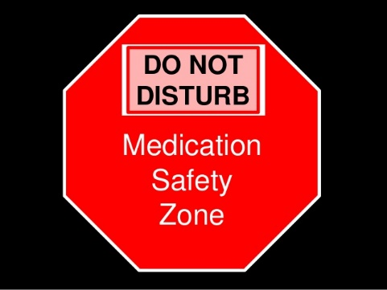
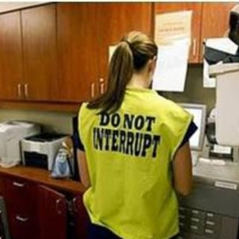
Issue: Medication administration errors due to interruptions and distractions
System Factors: Environment, Person, Task
Human Factors Solutions: reduce interruptions through workflow redesign; modify environment
Error Rate (%)
Length of Interruption

Slide 58
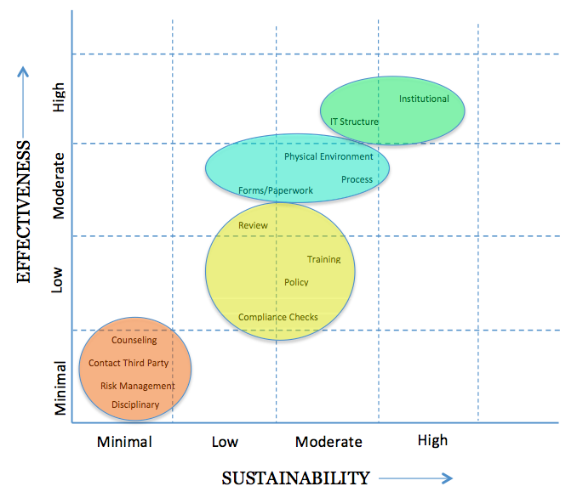
Rigorous Solutions
Strong Actions
Architectural/physical plant changes
New devices with usability testing
Engineering control (forcing function)
Simplify process
Standardize equipment or process
Tangible involvement by leadership
Intermediate Actions
Redundancy
Software enhancements, modifications
Eliminate/reduce distractions
Simulation-based education, with periodic refresher sessions/observations
Checklist/cognitive aids
Eliminate look and sound-alikes
Standardized communication tools
Enhanced documentation/communication
Weaker Actions
Double checks
Warnings
New procedure/memorandum policy
Training
www.npsf.org/RCA2

Slide 59
Survey question
The most sustainable solutions to safety hazards are:
A. Those focused on training and discipline.
B. Those focused on providing more warnings.
C. Those focused on creating new policies.
D. Those focused on system changes such as modifying the environment or technology.

Slide 60
Survey question
The most sustainable solutions to safety hazards are:
A. Those focused on training and discipline.
B. Those focused on providing more warnings.
C. Those focused on creating new policies.
D. Those focused on system changes such as modifying the environment or technology.
Answer: D

Slide 61
Application

Slide 62
Human Factors Application
Identify Areas of Risk
- Safety reports, legal claims
- Patient and clinician feedback
Analyze Work as Performed to Identify System Factors
- Observations and interviews
- Usage data
Iteratively Develop Sustainable Interventions
- Include the actual “users”
- Pilot test solutions and measure outcomes

Slide 63
Hydromorphone Free Emergency Department
Risk identification: Safety incidents with incorrect dosing of hydromorphone
Analysis: Data showed confusion over dosing with morphine; incorrect orders placed
Solution development: System factors suggested removal from ED would eliminate events with few unintended consequences

Slide 65
Summary
Human factors focuses on understanding human capabilities and ensuring the work system meets these capabilities.
Systems based solutions are more sustainable and effective
Identify risks -> Analyze the situation-> Iteratively develop solutions

Slide 66
Thank You
Raj Ratwani, PhD
Raj.M.Ratwani@medstar.net
@RajRatwani
MedicalHumanFactors.Org

Slide 67
Discussion panel
Marybeth Kazanas, PharmD, BCPS, LSSGB
System Director, Clinical Pharmacy Services - MedStar Health
Georgia Z. Lewis, MSN, RN, CPNP-PC
Pediatric Nurse Practitioner - Signature Health
Eileen R. Langstraat, Pharm.D., BCPS, CPPS
Medication and Patient Safety Coordinator - Kaiser Permanente
67

Slide 68
Marybeth Kazanas, PharmD, BCPS, LSSGB System Director, Clinical Pharmacy Services - MedStar Health

Slide 69
What would you do?
Terminate the nurse, this was considered a one off event
Add the warning, “FOR IM USE ONLY FOR ANAPHYLAXIS” to the automated drug dispensing machine for display when the drug is removed.
Place the high concentration epinephrine vials in separate plastic bags with large, red stickers which state: “EPINEPHrine for Anaphylaxis”. The automated drug dispensing machine also displays the warning “FOR IM USE ONLY FOR ANAPHYLAXIS” as the drug is removed.

Slide 70
What would you do?
Terminate the nurse, this was considered a one off event
Add the warning, “FOR IM USE ONLY FOR ANAPHYLAXIS” to the automated drug dispensing machine for display when the drug is removed.
Place the high concentration epinephrine vials in separate plastic bags with large, red stickers which state: “EPINEPHrine for Anaphylaxis”. The automated drug dispensing machine also displays the warning “FOR IM USE ONLY FOR ANAPHYLAXIS” as the drug is removed.
ANSWER: C

Slide 71
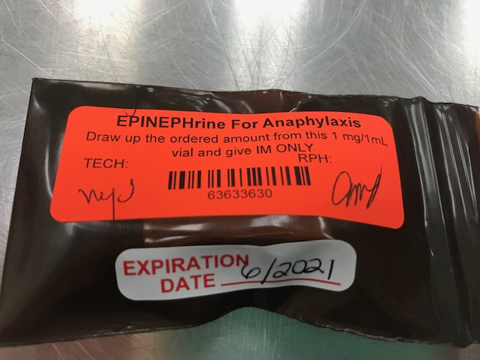
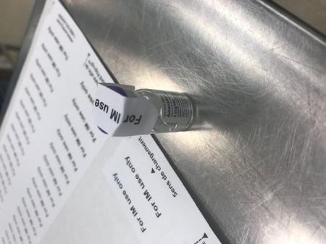
System Actions
A long-term solution was identified which involves the development of a standard kit for the high concentration epinephrine to include an IM syringe and clear labeling on the syringe and vial.

Slide 72
System Solutions
Care for the caregiver
Formal event review to determine causal factors
Conversation with experts and direct care practitioners
Review of the literature (ISMP, AHRQ, FDA alerts)
Use of occurrence reports (which include both near misses and harm events) and other available data to identify trends in patient safety risks associated with medications
All medication related serious safety events are presented at the system Pharmacy and Therapeutics Committee
Notes:
Review of medication related serious safety events (SSEs) utilizing the principles of MedStar’s event review process and safety science

Slide 73
Georgia Z. Lewis, MSN, RN, CPNP-PC Pediatric Nurse Practitioner - Signature Health

Slide 74
EILEEN R. LANG, Pharm.D., BCPS, CPPS
MEDICATION AND PATIENT SAFETY COORDINATOR – KAISER PERMANENTE

Slide 75
Thank you
Visit us online at: https://cme.smhs.gwu.edu/dcrx-/group/dcrx-dc-center-rational-prescribing
Follow us on social media:
@DCHealthDCRx
DC Health

